Slide 1
Peer Review of Teaching…during a pandemic
Dr. Taimi Olsen, director taimio@clemson.edu 9/18/2020

Slide 2
Purpose of the session:
Discuss peer review / peer observation in context of Fall 2020 and pandemic teaching
Consider implications of applying current practice to these new contexts
Consider and practice best practices in process
aspects of teaching
process
protocol
Please provide feedback of the session at: https://bit.ly/2FRPObj

Slide 3
CONTEXT

Slide 4
Fall 2020
Pandemic Teaching
Methods of face-to-face review
Current practices
Considerations for peer observation today
Recommendations
Maintaining awareness of circumstances

Slide 5
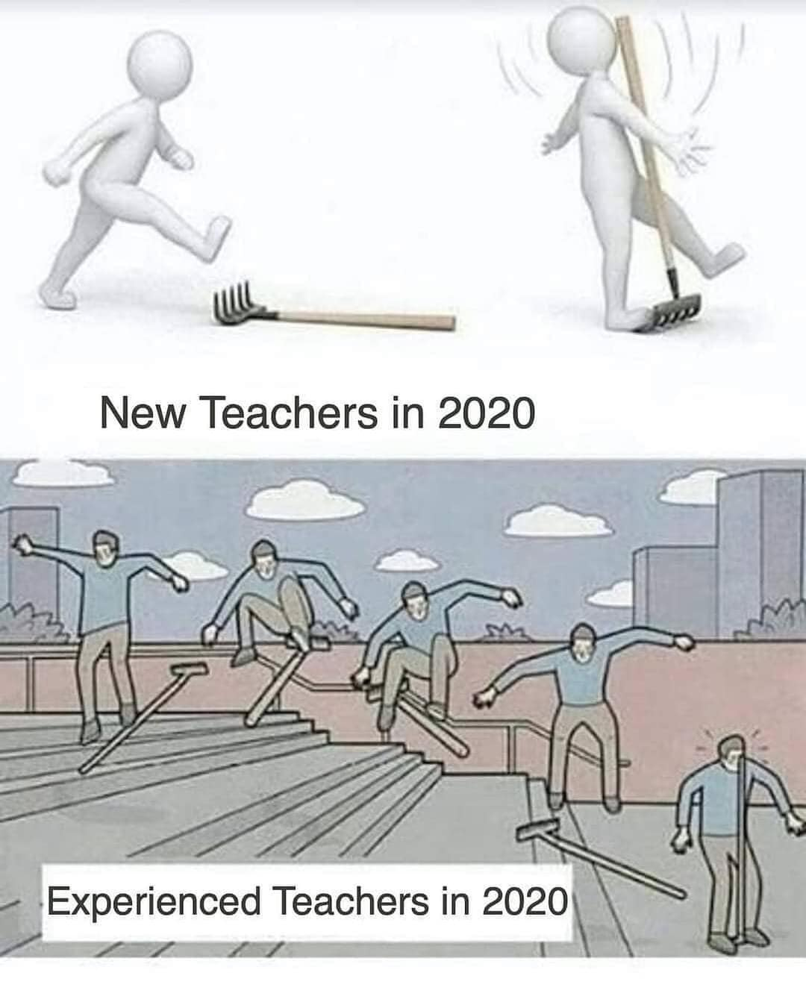

Slide 6
How do you do a peer observation?
What do you look for?
https://bit.ly/3iIb9mp

Slide 7
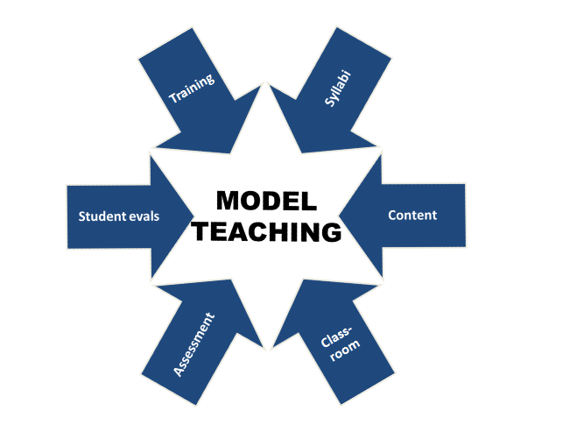
Research-based model, 2018, from the work of the APA and Dr. Regan Gurung.

Slide 8
Two areas of practice that significantly impact learning are Rapport and Clarity:
From John Hattie (2008); and the Australian Society for Evidence Based Teaching http://www.evidencebasedteaching.org.au
Notes:
http://www.evidencebasedteaching.org.au/hattie-his-high-impact-strategies/
Draw two columns—list clarity evidence on one side and rapport evidence on the other

Slide 9
Clemson course evaluation questions
Clarity
Qs 1, 3, 5, 6, 7, 11
Both: 8, 9
Qs 2, 4, 17
Rapport
Notes:
1. The instructor clearly communicated what I was expected to learn.
2. The instructor made the relevance of the course material clear.
3. The course was well organized
4. There was a positive interaction between the class and the instructor.
5. The instructor's teaching methods helped me understand the course material.
6. The instructor's verbal communication skills helped me understand the course material.
7. The instructor clearly explained what was expected on assignments and tests.
8. The instructor kept me informed about my progress in the course.
9. The feedback I received on assignments and tests gave me the opportunity to improve my performance.
10. Overall, the instructor is an effective teacher.
11. The instructor clearly explained what was expected on assignments and test
17. Please indicate your satisfaction with the availability of the instructor outside the classroom by choosing one response from the scale. In selecting your rating, consider the instructor's availability via established office hours, appointments, and other opportunities for face-to-face interaction as well as via telephone, email, fax and other means 12. How much work did you put into this course relative to your other courses?
13. How difficult was this course for you relative to your other courses?
14. To what extent was this course a requirement for you?
15. Was this course in your major?
16. Was this course team-taught?

Slide 10
PROCESS

Slide 11
Prepare
Prepare for a class visit by meeting with the instructor
Keep
Keep observation notes during the visit
Follow
Follow-up after the class visit with instructor
Complete and submit
Complete and submit your evaluation
Notes:
Prepare for a class visit
Meet with the faculty member to get oriented to class.
Review syllabus, learning outcomes, and lesson plans for the class you are observing (whether face-to-face or reviewing online).
Discuss the process, discuss any concerns the instructor has and ask about strengths to watch for in the visit.
Keep observation notes during a class visit
Remember to sit in the back and avoid interruptions. Just observe.
Take notes on visible behaviors, concrete details, and evidence of learning. Reviewing the content delivered during the class can happen as well but is not the primary focus.
Note the time periodically (every 5-10 minutes) as you take notes.
Draw a diagram of where people are during class. Note how many students talk / ask questions and note if the instructor moves around the room (as much as is possible).
Record what you see as if you were ‘in the field’ (which you are, in a sense!) How does everyone interact? What are people doing? What can you observe?
Follow-up after a class visit
Write-up the visit in the form of a summary of your notes
Meet with the person you observed
Gather input from the faculty member. How did they think class went? Was it typical?
Discuss areas of observation (using a formal protocol or other guideline)
Complete and submit your final evaluation, with a copy to the instructor.

Slide 12
Processes
Consult the new Peer Observation of Blended and Online Instruction Guide for suggestions on what to “observe”. Visit OTEI Resources: review of teaching:
https://www.clemson.edu/otei/resources/review-of-teaching.html
A Guide to Peer Observation: Observing Teaching in Higher Education (OTEI)This guide provides an overview of teaching observations in higher education today, a suggested approach and schedule, and sample documentation

Slide 13
Protocols

Slide 14
How do we do a teaching observation…during a pandemic? With examples from Microbiology and others….
Notes:
What are you looking for? What are observable behaviors? We have types of class of ALL SORTS

Slide 15
Principles for Effective Teaching: Hybrid course review
Build rapport between students and faculty through meaningful contact
Develops reciprocity and cooperation among students
Encourages and embeds active learning
Gives prompt feedback and checks for understanding
Provides an organized course, organized class sessions, and clarity throughout the course
Communicates high expectations and pathways to achievement for all students
Respects, accommodate, supports diverse talents and paths to learning
Incorporates metacognitive activities for deeper learning

Slide 16
Build rapport between students and faculty through meaningful contact
Notes:
Use of the Canvas site to engage

Slide 17
Develops reciprocity and cooperation among students
Notes:
Dr. Ellen Vincent (CAFLS): from her video. All screenshots shared with instructor permission

Slide 18
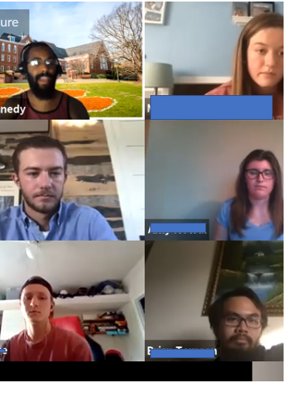
Encourages and embeds active learning student presentations and peer feedback
Notes:
From Dr. Cazembe Kennedy’s honors class

Slide 19
Gives prompt feedback and checks for understanding

Slide 20
Provides an organized course, organized class sessions, and clarity throughout the course

Slide 21
Communicates high expectations and pathways to achievement for all students
Notes:
Syllabus, first class, prior to a new section: example from OTEI and UGS’s Assignment Design course in Canvas

Slide 22
Respects, accommdate, supports diverse talents and paths to learning
Notes:
Visual, short video—13 minutes. Diversity in the examples

Slide 23
Incorporates metacognitive activities for deeper learning
This Photo by Unknown Author is licensed under CC BY
Notes:
Hard to get a photo but they could see Trogden’s sparkpage for metacognitive ideas

Slide 24
Will you see all of these? Not likely but look for several!

Slide 25
Conclusions and Feedback!
Please provide feedback of the session at: https://bit.ly/2FRPObj
You have the powerpoint slides and the guide
Contact me at any time (taimio@clemson.edu) or the staff (otei@clemson.edu)
Keep it simple!

Slide 26
Resources:
Developing a Comprehensive Faculty Evaluation System 3/e (Arreola, Jossey-Bass), in our library (LB2333 .A77 2000)
Best Practices in Faculty Evaluation (Buller, Jossey-Bass,) in our library, full text online.
ACE Issues White Paper Examining Institutional Commitment to Teaching Excellence (2017) Can be borrowed from OTEI.
Kite, M. E. (2012). Effective evaluation of teaching: A guide for faculty and administrators. Retrieved from the Society for the Teaching of Psychology web site: http://teachpsych.org/ebooks/evals2012/index.php

Slide 27
Relevant Clemson student rating questions:
The instructor clearly communicated what I was expected to learn.
The instructor made the relevance of the course material clear.
The course was well organized
There was a positive interaction between the class and the instructor.
The instructor's teaching methods helped me understand the course material.
The instructor's verbal communication skills helped me understand the course material.
The instructor clearly explained what was expected on assignments and tests.
The instructor kept me informed about my progress in the course.
The feedback I received on assignments and tests gave me the opportunity to improve my performance.
Overall, the instructor is an effective teacher.
The instructor clearly explained what was expected on assignments and test
17. Please indicate your satisfaction with the availability of the instructor…

