Slide 1
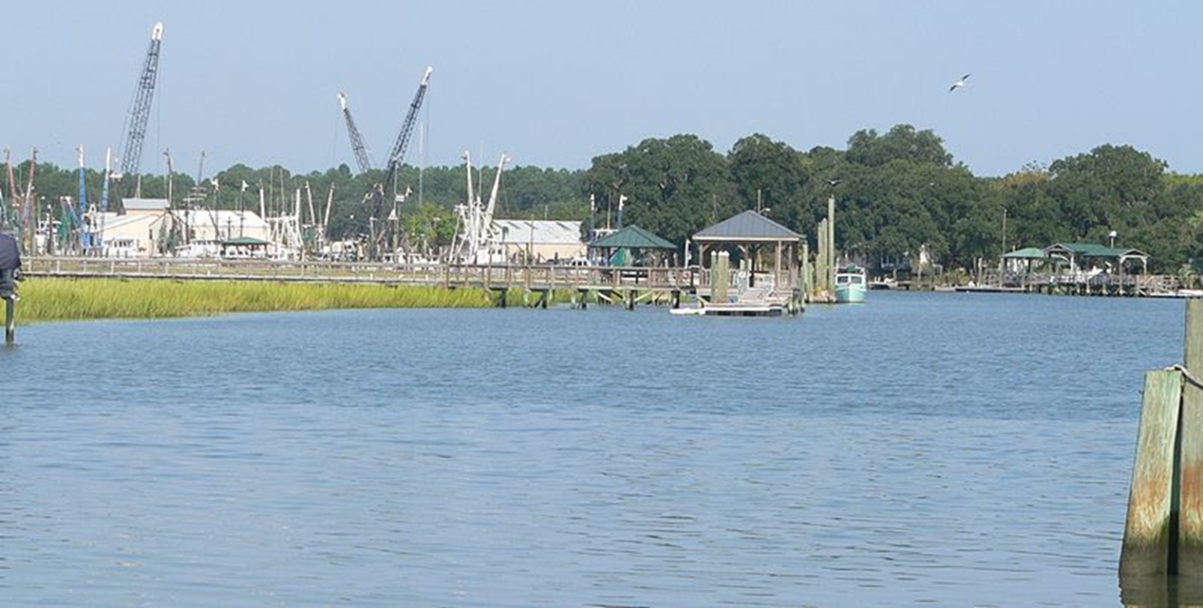
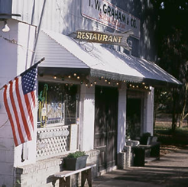
Service Learning for Economic and Community Development Strategic Planning:
McClellanville, South Carolina as a Case Study
Notes:
Mcclennaville

Slide 2
How We Will Proceed
Little background data on the community
Timing and personnel
SWOT-based strategic planning in general
Application to McClellanville
Implementation
Lessons learned as summary and conclusions

Slide 3
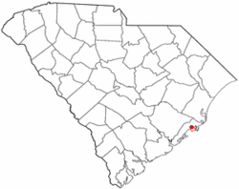
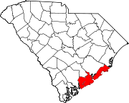
McClellanville, SC small fishing village in Charleston County (population of 500)
Part of Charleston, MSA
Established 1860s
Direct Hit Hurricane Hugo in 1989
Extremely Scenic Area
Quant Village Atmosphere
Primarily, White, significant African-American Community
Well-educated population, commute into Charleston, Mt. Pleasant

Slide 4
Timeline: Strategic Planning
2009: Harry Crissy starts process (GIS and other data, key informant interviews)
2009 Fall: Clemson students develop, administer, and analysis survey data
2009 December: Community Workshop
2010: Results presented to City Council
2010: Implementation starts and continues through present
Notes:
Fall Semester 2009:
7 Clemson Undergraduate students enrolled in independent study
Topic of Community and Economic Development of McClellanville, SC
All students from previously classes
Harry Crissy conducted key informant interviews
Developed and conducted surveys
December 2009: community workshop
McClellanville

Slide 5
Timeline: Implementation
Harry Crissy assists in organizing local charter school, emphasis on environmental education (implemented)
GIS-based kayak tour (being implemented)
Clemson students conduct market study of McClellanville Shrimp in Charleston restaurant market (being implemented)
Clemson students analyze effective demand for physician clinic and pharmacy (not implemented)
Notes:
As component of APEC 412-612, Regional Economic Policy. January 2011-May 2011: student team developed marketing plan for Mcclennaville Shrimp in Charleston, SC Area Restaurant Market
APEC 361, Introduction to Health Economics. January-May 2012: student team examined the effective demand for local clinic and local pharmacy

Slide 6
People Involved in Effort
Mr. Harry Crissy is the Clemson Extension CD Agent for the area; his role was critical in organizing and maintaining contacts and in developing SWOT Analysis and implementation!
All students involved in strategic plan vetted (independent study class 6 students)
Other student projects tied into other classes taught by Hughes (5-6 students per team)
Mr. Devin Swindall, Research Associate, plays major role, especially in coordinating student implementation efforts

Slide 7
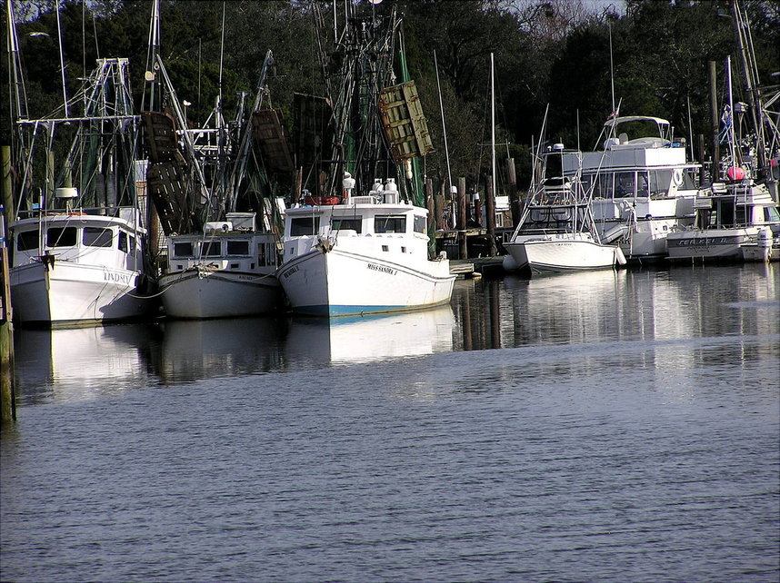
SWOT-based Strategic Planning

Slide 8
Outcomes for Implementation
The Clemson Institute for Economic and Community Development
Harry Crissy

Slide 9
Introduction- Planning Problems
Insufficient implementation
Costly
Fragmentation
Special interest
Exclusive
Notes:
Implementation- many rural communities have plans that they have spent valuable resources on, that will never be implemented. Community members see this and when someone comes in to plan and implement, residents are reluctant to participate. They’ve already ‘seen it all before.’
Costly- plans are not cheap, usually costing between $50k-100k. Private organizations charge for their work, but the communities rarely understand what they’re undertaking. Without implementation, the chances for success diminish with each new plan. Our rural communities can no longer afford this.
Fragmentation- often there are various entities creating plans for the same community. Their aim is to get grant funding. They produce a product expecting someone else to follow through with the plan when the document is complete. Each claims that their plan is ‘the one.’
Special interest- in some instances an group or individual has a certain project in mind that they expect to be included in the planning process. They engage the public in participation with the intention of only implementing that part of the plan that interests them, wasting resources and credibility during the process.
Exclusive- often, the same active community members participate in the process, while the majority of the community remains inactive. Many are simply disinterested. They feel no real ownership of their community. While the activists should be commended for their efforts, a strategy to include those lacking participatory inclinations is needed.
Inclusive Processes- while we cannot fix all of the problems mentioned, we must keep them in mind as we proceed with the planning. If the planning entity is not going to follow through with implementation, the rural communities should take up the planning process themselves. Getting the community behind the plan is crucial, if it is to be realized. We’re going to describe an inclusive process that will result in executable plans. Repeat the fact that the entity creating the plan must stay to implement.

Slide 10
Gather Secondary Data
Search newspapers, journals, websites, etc.
Search town council minutes
Look at census trends, BEA website, economic census
Build a GIS of the community and the surrounding region-use longitudinal data
Notes:
Council minutes are often available on-line. Geographical Information Systems (GIS) are very useful in this process. School district data are useful as well (where available).

Slide 11
Create Interview Questions
Based on impressions from step one
Based on impressions from windshield surveys
Keep these open ended
Designed to generate conversation
Interview:
  Business owners, Public officials, random
Notes:
You usually want about twenty questions administered to at least twenty people. The number should be based on the time that you can afford. The more data you get at this stage, the more strength your outcomes will have. Try to get them to identify problems and assets spatially, if possible.

Slide 12
Survey Development-Administer
Use basic categories with scalable questions but also some open ended questions
Include space for comments
Stay under 5 pages/20 minutes
Use GIS to identify proper distribution
Use Community Development students to help administer surveys. Be sure to be visible. Look for discussions with pedestrians as you go (you’re marketing the process)
Notes:
Using all of the data and impressions gathered up to this point, the PI now develops a survey. Part of this will be standard (questions about basic services, housing, safety, transportation), but some questions should come from outstanding issues from the earlier processes. Try to incorporate some questions that measure perceived capabilities and deficiencies in terms of current market conditions (without stating these conditions).

Slide 13
Public Workshop
Follow best practices in formulating workshop (lead time on advertising, neutral ground in community core, breakup cliques).
Assess Strengths, Weaknesses, Opportunities and Threats in terms of external and internal forces
1=major weakness, 4=major strength for example
Workshop used to obtain public input assessment
Small group each provided with 100 poker chips to distribute based on priority items; used to facilitate discussion and ultimately to vote on priorities
Notes:
The previous process prepares for the workshop
Begin advertising two weeks before the event
Be sure to use a neutral ground (not a church or an institution that can be identified as belonging to one group)
Be sure to locate this in the community core if at all possible
Include workshop details in survey cover letter
Coordinate with graduate students
Number name tags to avoid ‘clique’ grouping

Slide 14
Mapping
Used to identify target areas based on opportunity and/or need
Examples:
  Green indicates places I like
  Blue indicates areas with potential but in need of work

Slide 15
What happens next
Prepare a report based on survey data and public workshop—identify specific, reasonable objectives
Town council approves moving forward
Keep students engaged whenever possible
Use university resources whenever possible
Notes:
It is important to keep the town council informed throughout this process.

Slide 16
McClellanville Public Workshop
Administrative Team:
Harry Crissy
Dr. David Hughes
Devin Swindall
Student Team:
Catherine Barnes
Story Cosgrove
Meghan Harper
Michael Inman
Sarah Meyers
John Zelenka

Slide 17
Vision
Maintain ‘communityscape’
Family environment (schools, rec, etc.)
Opportunities for personal and economic growth
People work together (status quo)
Opportunities for youth
Opportunities for recreation (LID)
‘Eco’-destination
Boutique destination- very low profile
  Lodging?
  Retail?

Slide 18
External Forces To Consider
  These are forces outside of our boundaries that we should be paying attention to. They can be regional, statewide, national or global. We’ve considered these in term of ‘Us’ (McClellanville)

Slide 19
Green Technology (Op)
Could become a model community for environmentally friendly development
A strong movement in the Charleston area
Would improve preservation efforts
Could instill attractive values in youth- stimulate career paths
Would create income opportunities
Could be extended to education infrastructure

Slide 20
Interest in Seafood (Op)
Traditional contributor to our economy
Many consider this part of healthy living
Consumers/tourists in Charleston expect exceptional seafood when they visit
Makes town attractive
May be new possibilities for growth
  Requires creative approaches
  Requires differentiation
Notes:
How much effort for rebirth?

Slide 21
Southern Growth (Th)
Pressure from developers to develop infrastructure
Could ruin what we love most about our community
Sometimes $$$ is hard to resist
Neighboring communities already developing

Slide 22
Economic Turmoil (Th)
Loss of employment opportunities
Lower retirement income for many
Less disposable income for tourism
Commuting costs rising
Community more vulnerable to opportunistic investment (if we do not act on our own behalf)

Slide 23
Exercise One
You have 100 points (chips) to distribute according to the importance of each factor. Where should we turn our attention. Please assign a value to each of the forces according to decisions reached through discussions at your table. Once you’ve agreed on proper distribution, your facilitator will write the totals in the squares. Question to ask: ‘How important is this factor in developing a strategy for our community?’

Slide 24
Internal Forces to Consider
  These are characteristics of McClellanville. This is what we have determined are our most relevant characteristics for economic development. This is what we have to work with.

Slide 25
Protective Community (St)
Residents appreciate their environment and the close knit nature of the town
Most understand the circumstances they face
Can restrict strategies to focus on our needs
Investors know what they are getting into-characteristics will be slow to change or not change at all
Community places high premium on itself

Slide 26
Natural Assets (St)
History- rich with it, community very knowledgeable of this
Waterways- kayak/canoes
Waterways/ocean- sport fishing
Wetlands- wildlife and bird watching
Trees, forests- natural beauty, even ‘downtown’- quiet living, peaceful environment
Francis Marion National Forest

Slide 27
Shrimping/Fishing Industry (St)
Already have many well-versed professionals (and equipment) for this industry
Charleston, Georgetown, Myrtle Beach, Columbia and Savannah are close by
  All easy day trips for shipping
  All important markets

Slide 28
Schools (Wk)
Declining youth population weakens our local school system
Long commute to other systems
Hard to offer quality programs with limited tax base
Hard to attract younger families when schools are declining and property costs are high

Slide 29
Retail Infrastructure (Wk)
Lack of grocery store
Lack of lodging facilities
Lack of tourism retail
  While we have some, more would support what exists and improve our tourism product
Lack of outfitters
  Would support local (Charleston) recreation
  Would support tourism product

Slide 30
Exercise Two
You have 100 points (chips) to distribute according to the importance of each factor. Where should we turn our attention. Please assign a value to each of the forces according to decisions reached through discussions at your table. Once you’ve agreed on proper distribution, your facilitator will write the totals in the squares. Question to ask: ‘How important is this factor, or changing this factor, to the success of our community?’

Slide 31
Mapping
Green= places I think people should see
Yellow= places that should remain ‘ours’—they need protection from outsiders
Red= places that are unsightly/ desolate
Blue= areas that should be developed/improved

Slide 32
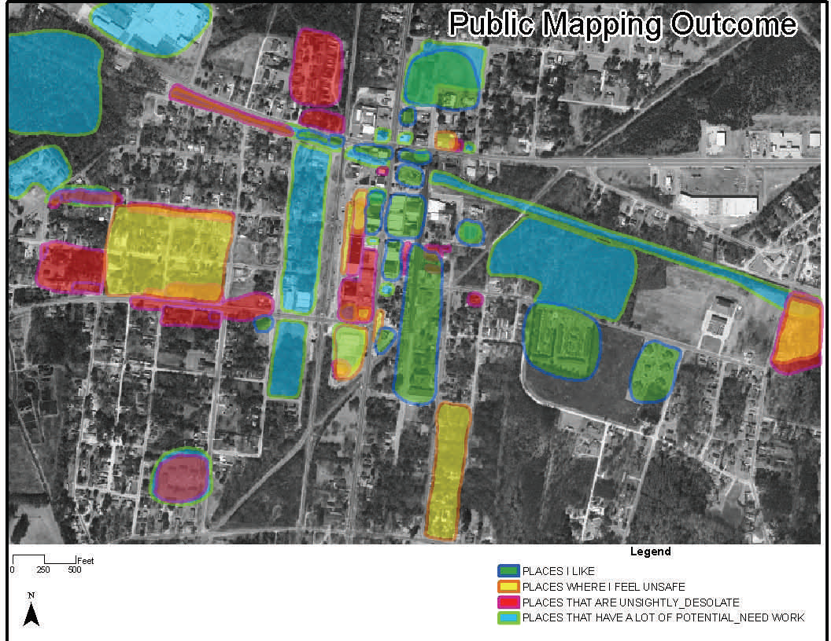
Mapping

Slide 33
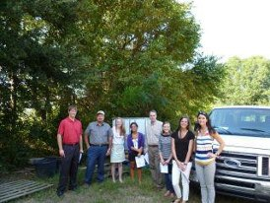
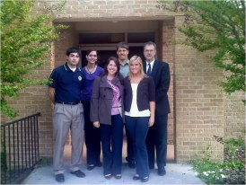
Implementation Phase
An Ongoing Process!
Often 4-5 Years!
Critical to Maintain Engagement!

Slide 34
Fresh, Local Seafood
McClellanville, SC
Alfred Bundrick, Alex Crunkleton, Kevin Diener, David Lorentz

Slide 35

Summary of Student Work
Growing Demand for local foods
Economic clustering strategies
Seafood S-D data, emphasis on local shrimp
Seafood branding by other communities
Seafood regulations
Community-supported-fishery (CSF)
Connected with local CSA to start process

Slide 36

Cape Romain Environmental Charter School
No local school identified as a major weakness
Charter School an option for ground-up school development
Centering on environmental education incorporated local strength
9/21/10- Public Meeting
6/16/10- Conditional approval
Fall 2012- Opens Door
Currently K5 through 5th grade,
ultimately through 8th grade

Slide 37
Lessons Learned
Using vetted students a big plus
On the ground personnel critical to maintaining contact and insuring community groups keep momentum
Implementation process is long term
Use of students groups over multiply classes-semesters is very doable and has worked well but with timing, class tie-in drawbacks

Slide 38
Lessons Learned
Use of research associate, graduate students in leadership:
  Allows for multiple projects
  Frees up faculty time and energy for publishing, other work
Projects aimed at communities that can’t pay
Use direct fund to support research associate but often indirect, other $s, to cover projects
Support of CU service learning invaluable, especially for funding student site visits

