Slide 1
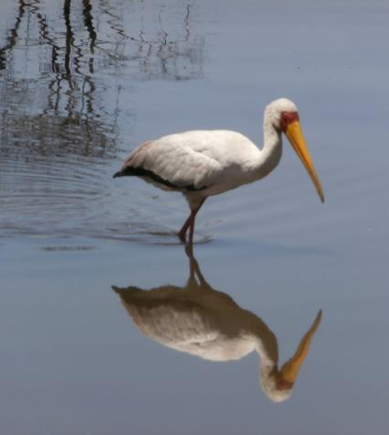
Service Learning in International Contexts: A New Approach to Collaboration
Cassie Quigley
Assistant Professor
Science Education

Slide 2
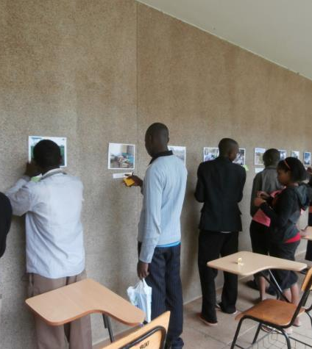
Why?
¼ of college graduates studied abroad in 2011.
Many of the reasons universities cite as reasons to study abroad are also goals of service learning:
  Gain a new perspective
  Discover your passions
  Enrich your education
  Distinguish yourself
  Demonstrate your adaptability
  Accomplish more that you imagined
  Prepare for the future
Notes:
Some universities are now requiring students to study abroad. Many universities require some sort of culture immersion experience.

Slide 3
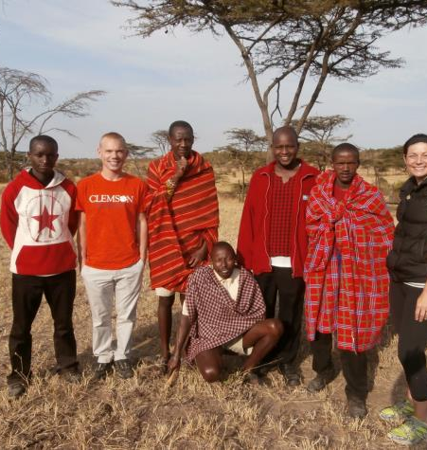
Joining Service Learning and International Experiences
By immersing students in local culture, landscapes and experiences
By forging strong ties between local social and environmental organizations and their constituencies in the schools and community.
By making tangible contributions to resolving local issues.

Slide 4
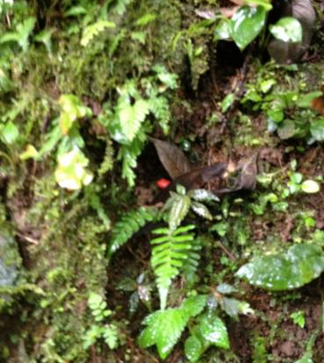
Developing connections in international contexts
Search local NGOs, governmental organizations and existing connections between your university and organizations.
Meet with coordinator to find out their needs.
Create a variety of projects to promote student interests.
Maintain a positive relationship between the community organization and the university.
Encourage product-driven projects with tangible results.
Create clear guidelines timeliness and expectation
Do not create more work for your community partners.

Slide 5
Ways to ease the communication gap
Use technology
  Email
  Text
  Closed sites that allow for communication regardless of time zone issues
  Synchronous communication

Slide 6
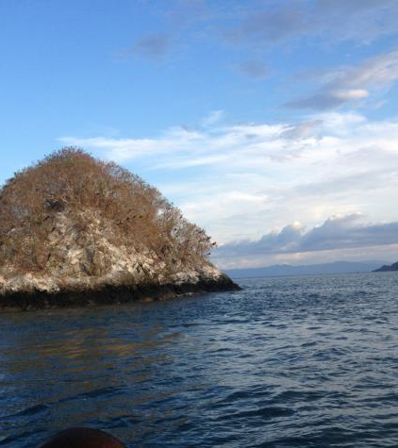
Crowd Sourcing Data
is the practice of obtaining needed services, ideas, or content by soliciting contributions from a large group of people, and especially from an online community, rather than from traditional employees or suppliers.

Slide 7
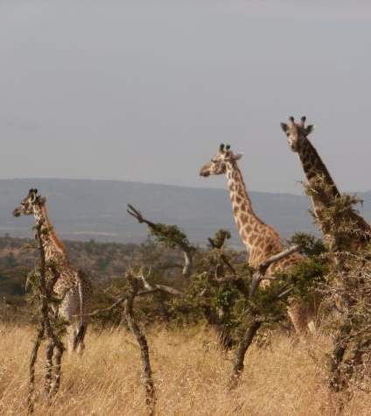
Examples
Oxford English Dictionary
Genealogy research
Animal Monitoring
-Water Quality Testing
Trash Maps

Slide 8
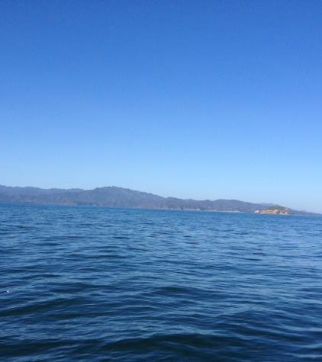
Animal Monitoring
Christmas Day Bird Count
Monarch Migration
Whooping cranes
Bald Eagles
Hummingbirds
Tortuga Island Fish Count

Slide 10
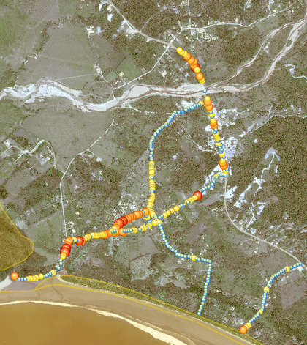
Trash Maps
Using GPS and mobile apps, students record the presence of trash along bodies of water.

Slide 11
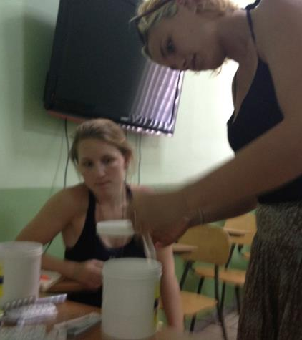
Water Quality
Using mobile apps and test kits, students record the presence of certain toxins and record the data on websites to provide better data to scientists.

Slide 12
Resources
Journey North- http://www.learner.org/jnorth/
Geoporter ( Geospacial Educators’ Opportunities for Partnership) http://geoporter.net
NOAA- http://www.noaa.gov/ocean.html

