Slide 1
Thinking it Through
Tools for Teaching Ethics in Service Learning
With Teddi Fishman, Director of the International Center for Academic Integrity

Slide 2
Developed in collaboration with
Lorelei Swanson
The Rutland Institute for Ethics
The Pearce Center for Communication
The National Center for Dropout Prevention &
The International Center for Academic Integrity

Slide 3
Strengths of Service Learning
Real
Applied
Complicated
“Messy”

Slide 4
Perceptions of Ethics
Not my field
Subjective
Risky

Slide 5
Teachable Moments: Ethics and Reflection in Service-Learning (by T. Fishman & L. Swanson)
Written to give teachers “tools” they can use to address ethical issues comfortably while at the same time providing students with a ethical framework they can transfer to other ethical dilemmas they face.

Slide 6
Toolbox Approach pioneered by the Rutland Institute for Ethics
1. Consequences Tool
2. Respectful Treatment Tool
3. Aspirational Tool

Slide 7
Toolbox Approach pioneered by the Rutland Institute for Ethics
Consequences Tool
Asks, “what will bring the most good to the most people?” and “what are the foreseeable consequences—positive and negative—of the different choices?”

Slide 8
Toolbox Approach pioneered by the Rutland Institute for Ethics
Respectful Treatment Tool
Asks, “how would I want t be treated?” and, “what if the shoe were on the other foot?”

Slide 9
Toolbox Approach pioneered by the Rutland Institute for Ethics
Aspirational Tool
Asks, “what would someone I admire do in this situation” and, “which course of action will help me become the person I would like to be?”

Slide 10
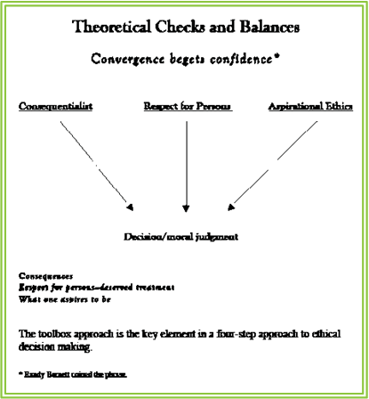
Source: “Convergence begets confidence” comes from R. Barnett.
(1990). The virtues of redundancy in legal thought, 38 Cleveland
State Law Review, 153(190), 154-155

Slide 11
Steps in the Toolbox Approach:
Identify
Analyze
Justify
Decide

Slide 12
Steps in the Toolbox Approach:
1. Identify
What are the Issues? Who are the Stake-holders?
2. Analyze
Use the tools to analyze options
3. Justify
What are the benefits and costs of the various options?
4. Decide
Take (responsible) action

Slide 13
Make ethical decision-making part of community conversations to help build climates of ethical action

