Slide 1
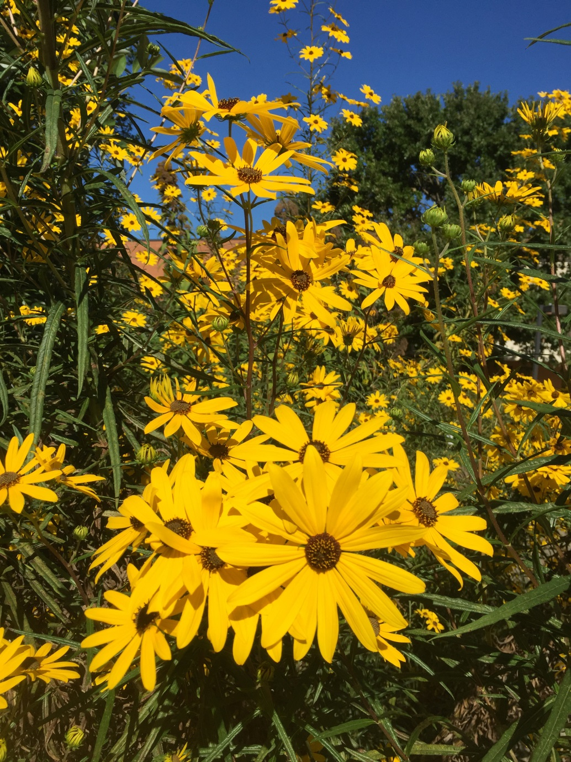
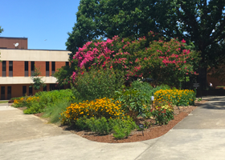
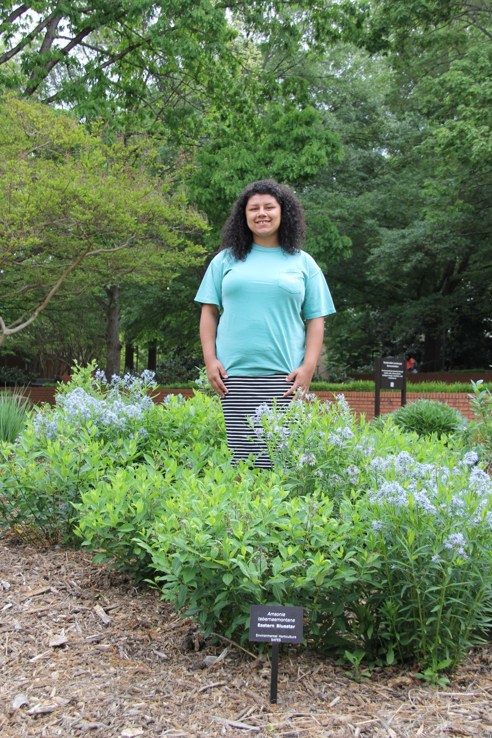
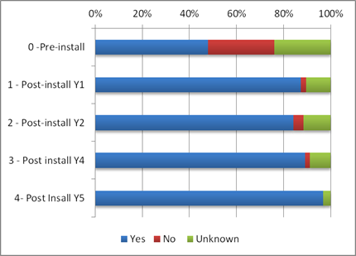
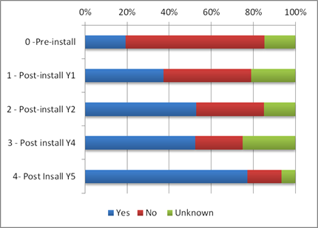
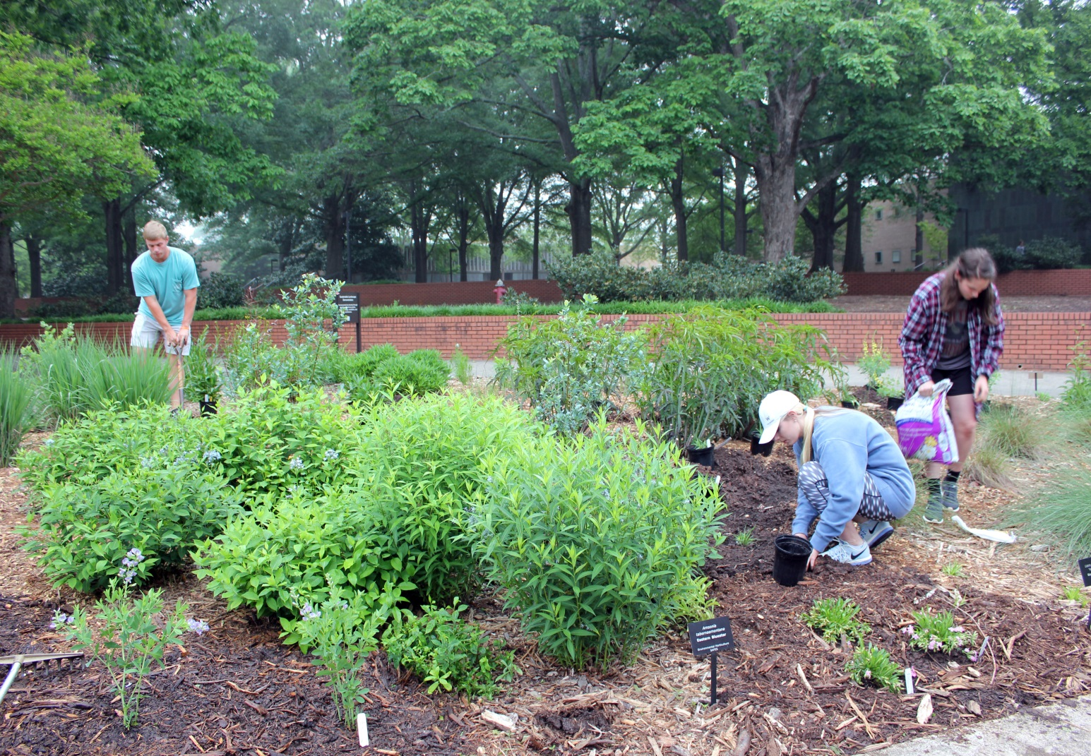
The Sustainable Landscape Demonstration Garden
Alexis Anthony, Dr. Ellen Vincent, Dr. Sarah White
Abstract/Poster ID: 18
Abstract
Outcomes
The Sustainable Landscape Demonstration Garden (IRB2012_096) was created to test the relationship between humans and the environment. For the past five years, the project has allowed undergraduate students enrolled in the Creative Inquiry #827 to explore the health benefits of the designed space on both people and the environment. The plant care and maintenance is preformed by students and overseen by campus landscape professionals and the research advisor. Every semester, students receive the Human Subjects Behavioral Science Certification for Research to be able to conduct surveys of people passing by the garden. Over the past five years, there has been a significant increase in the health of the environment in the space as well as an increase in a positive perception of the garden by its visitors. In conclusion, there is a strong correlation between environmental health and human well-being.
After the installation occurred, the number of people visiting the garden space increased. Through data collected via surveys, visitors found the space to be more inviting and safe. This was an indicator that they were more likely to return to the demonstration in the future. From the soil tests that have been taken over the past five years, data shows that the soil health has improved. Soil health greatly impacts the health of the plants that are in the space. Through observations taken by the undergraduate student workers and the research advisor, it was discovered that animals and insects started to become frequent visitors of the garden as well.
Photos By: Ellen Vincent, Walker Massey and Ken Allen
HEALTH
ENVIRONMENTAL BENEFITS
Methods
Implications
In order to determine the health effects of the garden on people, undergraduate students are required to take surveys of individuals walking by the garden space. By using the same sampling methods each time the survey is conducted, reliable data is collected on various items in the garden. Questions about site safety and aesthetic value help to determine the relationship individuals have with the space. The students also record data on the health of the ecosystem in which the garden thrives. Through yearly soil samples and observations of plant growth and wildlife populations, the site development is monitored.
The sustainable garden demonstration is located in a busy part of campus to simulate what it would be like if a sustainable garden was located in a well traveled part of a city. It serves as a fantastic education tool and a place for wildlife to live. The purpose of this project is to better a forgotten location and to enrich the lives of the passersby and student workers.
Photo By: Ellen Vincent

