Slide 1


PRTM 2060/2070
RT – Specific
Practicum Orientation
Notes:
1

Slide 2
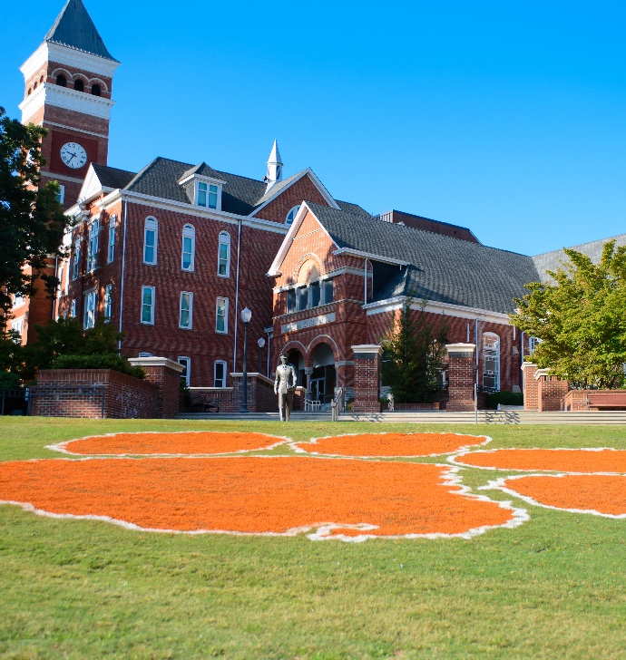

The purpose of completing the recreational therapy sections of PRTM 2060 and PRTM 2070 is to enhance your understanding of individuals with various health conditions, improve your ability to support them, and teach you how to adapt activities for safe and independent participation. You'll also learn about different service delivery settings and develop skills in the APIED process (assessment, planning, implementation, evaluation, and documentation). This experience will help you decide which client population(s) you may want to work with as a recreational therapy intern or CTRS post-graduation.
Notes:
2

Slide 3
RT Specific Practicum Sections
As a PRTM major who has declared an emphasis in recreational therapy, you will be completing recreational therapy-specific sections of PRTM 2060 Practicum I and PRTM 2070 Practicum II.
Prerequisites: C or better in PRTM 2600 Foundations of Recreational Therapy.
Like other PRTM majors, you will be required to complete two 80-hour practicum experiences. However, as a recreational therapy student, both of your practicum experiences need to involve opportunities that will allow you to gain experience working directly with individuals (or groups of individuals) who have a disability or health condition (i.e., populations we would work with as recreational therapists in professional practice) during program activities and services.
You will be required to complete your two 80-hour practicums (i.e., PRTM 2060 and PRTM 2070) with two (2) different client populations or in two different service settings.
For example, you might complete PRTM 2060 with individuals with physical health conditions and complete PRTM 2070 working with individuals with mental health conditions. Or you might complete PRTM 2060 working with individuals with intellectual and developmental disabilities in a camp setting and complete PRTM 2070 working with individuals with IDD in a community-based day program.
Both PRTM 2060 and PRTM 2070 must be completed prior to your being approved to register for/complete PRTM 4250 Internship in Recreational Therapy.

Slide 4
Guidelines
Complete all 80 hours for PRTM 2060 or 2070 at a single site; hours cannot be split across multiple locations.
You must complete practicums at two different sites or with two different client populations.
Find a site with an on-site supervisor to confirm your hours and communicate with Mrs. Zikeya Hickman-Glanton, your practicum instructor.
Practicum hours can be completed in any semester (fall, spring, or summer) and at any location, not limited to South Carolina.
If completing both PRTM 2060 and 2070 in the same semester, you must complete a total of 160 hours; ensure it's feasible with your schedule.
We encourage seeking new experiences with different agencies.
Past work or volunteer experience cannot be used for practicum credit.
You cannot work with family members or significant others for practicum credit.
Practicums may be paid or unpaid; if paid, notify the agency if you plan to terminate employment.
Sites may require background checks, vaccines, and CPR/First Aid certification, and you’ll be financially responsible for these requirements.
A list of available practicum sites in Upstate South Carolina is on Canvas.

Slide 5
Where can I complete my Practicum?
As a recreational therapy student, you are required to complete your practicum at a site that serves individuals with disabilities. This includes, but is not limited to:
Settings:
Hospitals (inpatient or outpatient
Nursing Homes
Schools
Mental Health/Behavioral Health
Rehabilitation Centers
Community Recreational
Correctional Facilities
VA Hospitals
Home Health Care
Population:
Children & Adolescents
Adults
Seniors
Individuals with IDD/DD
Veterans
Individuals with MH/BH disorders
Individuals At-Risk
Individuals with Physical disabilities

Slide 6
Site Criteria
For your Practicum Site to be considered (and approved), your Site must meet the following criteria:
The organization provides programs/services (e.g., leisure activities, recreational therapy) to individuals with disabilities or health conditions.
The site offers enough programming opportunities during the semester to complete 80 hours.
The site has an on-site staff member committed to being your Site Supervisor, verifying hours, and completing an evaluation.
You can commit to completing 80 hours based on your availability, transportation, and the site’s schedule.
Sites will NOT be approved for practicum placement if:
The organization/site does not provide direct services to individuals with disabilities or health conditions.
Your roles/responsibilities do not involve direct interaction with individuals with disabilities or health conditions.
You will be shadowing or observing practitioners working with clients.
Your responsibilities involve assisting with managerial/administrative tasks (e.g., social media, registration packets, equipment cleaning).
Your responsibilities involve assisting with early intervention services for infants/toddlers (birth to three years old).

Slide 7
What about Shadowing Hours?
Practicum applications involving shadowing Physical Therapy and Athletic Training will NOT be approved.
Why won’t this be approved?
Shadowing usually consists of observing. We want you to receive hands on experience, which means direct contact with special populations.
What are my options to get experience with these allied health professions?
We encourage you to research settings such as physical rehab or VA hospitals. These settings usually have different types of therapies where you can still see the other allied health professions and get hands on experience at the same time.
Notes:
Examples, Shiners Children’s Hospitals, RCP, etc. They have different disciplines.
The supervisor must also confirm that you will be working with individuals with disabilities and not injuries.
Please note that all of your hours at an OT site must have involvement with patients, if you log hours where you’re only cleaning rooms, arranging equipment, then those hours will NOT count.

Slide 8
Does PRTM-RT help me find a Practicum?
The CURT Program does have a list of Service-Learning Sites that is available on the CURT website. You can also ask Mrs. Zikeya Hickman-Glanton for the list if you are not able to locate the list online.
Please note: You are NOT limited by this list. If you find a site not on this list, that is fine, as long as they meet the site criteria for recreational therapy students.
The list can be found here.

Slide 9
Practicum Deadlines
Registration
Varies each semester as it is based on the final day to withdraw from the University w/o final grades
You can be added late, BUT….
Assignments
Varies each semester due to different add/drop and final grade submission deadline

Slide 10
The Process for Approval
Email your Practicum Placement Application to the Fieldwork Coordinator, Mrs. Zikeya Hickman-Glanton. The application can be found here.
Upon approval, view the orientation video via Canvas once cleared to register.
Review and sign acknowledgment form via Canvas verifying that you watched the orientation video and reviewed the syllabus in its entirety.
You will NOT be able to register for practicum(s) until you have emailed your application to Mrs. Zikeya Hickman-Glanton, FWC and received a response confirming your approval.
Notes:
Application is found on the CURT website under the Practicum tab.

Slide 11
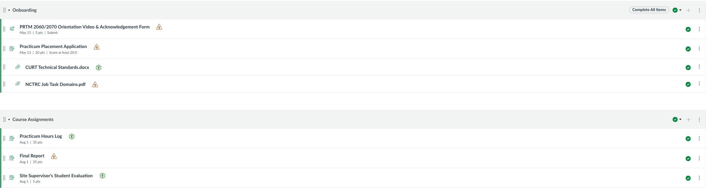
Canvas Overview
You MUST complete the Onboarding module before you’ll be able to access the Course Assignments module.

Slide 12
Course Assignments
PRTM 2060/PRTM 2070 Acknowledgement Form
Practicum Placement Application:
Information required for site approval
Self-evaluation
80-hour Log Sheet (w/supervisor signature)
Site Supervisor’s Student Evaluation
Final Report
APIED Worksheet
Self-Evaluation
Site Evaluation
This is the same form you submitted to me in order to obtain approval to register for the course. You’ll need to upload to Canvas for full credit of this assignment.
PRTM 2060 and PRTM 2070 are Pass/Fail courses. You will need to finish both classes with 70 points (i.e., a 70% average, C letter grade) or better to Pass the course.
Notes:
I will email all supervisors one week prior to final assignments being due to request that they complete your evaluation. You only need to politely remind them.

Slide 13
Professionalism
Ethical Conduct
Communication
Attire
Notes:
Professional & Ethical Conduct
Remember that you are representing yourself, Clemson University, the PRTM Department, and the CURT program during your practicum experience. Demonstrate professional and mature behaviors during your practicum experience, including being on time for your scheduled practicum hours; being mindful of your appearance, attire, mannerisms, and language; taking initiative to assist others or complete tasks; maintaining a positive attitude; and respecting others that you interact with.
Unless your practicum site supervisor indicates differently, please leave your cell phone (and other technology: Apple Watch or equivalent; iPad/tablet, etc.) at home. You should not be making phone calls, receiving/sending text messages, taking photos/videos/audio recordings on any of your personal devices during practicum hours.
Regarding social media content/posts:
Remember that posting identifiable photos of patients/clients and/or patient/client belongings is a violation of federal rules and regulations (Health Insurance Portability and Accountability Act - HIPAA). Students who violate HIPAA can face disciplinary action, including CURT Program dismissal.
Remember not to post information, photos, or other items online that could embarrass you, your practicum site, Clemson University, the PRTM Department, or the CURT Program/faculty. This includes photos and items that may be posted by others on your page.

Slide 14
Incident Reporting
Any incidents, injuries, and/or unusual occurrences you experience during PRTM 2060 or PRTM 2070 should be reported to the course instructor (Mrs. Zikeya Hickman-Glanton) immediately no matter how minor the incident(s) seem. Incidents, injuries, and/or unusual occurrences may be specific to your interactions with an instructor, an on-site supervisor/staff, peers/colleagues/volunteers/interns, and/or patient/clients.
If the course instructor is unavailable (and/or the incident involves the course instructor), contact the CURT Program Coordinator (Dr. Brandi Crowe; bmcrowe@clemson.edu) immediately.
If the incident involves the course instructor and/or the CURT Program Coordinator, contact the PRTM Department Undergraduate Coordinator (Dr. Daniel Anderson at dander3@clemson.edu) immediately.
Additional points of contact for reporting an incident:
Report conduct violations via the Office of Community and Ethical Standards: https://www.clemson.edu/studentaffairs/community-resources/oces/incident-report.html.

Slide 15
Reminders
You MUST read and sign the acknowledgement form(located on Canvas) after watching this pre-recorded video
After, viewing this video you will be asked to verify that you reviewed the course syllabus and watched this video in its entirety, along with signing the acknowledgment form.
BOTH are needed to proceed in this course.

