Slide 1
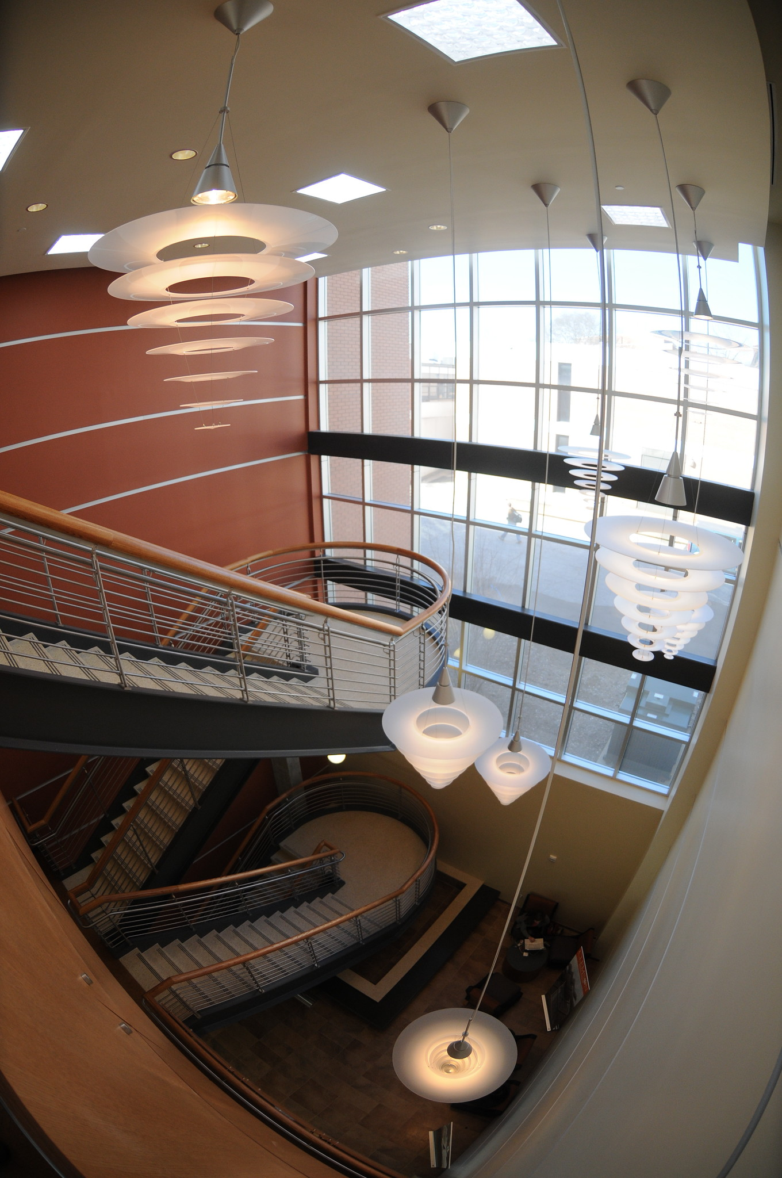
BIOE Faculty Elevate:
A Collective Approach toward Elevating Faculty Professional Development
May 7, 2024

Slide 2
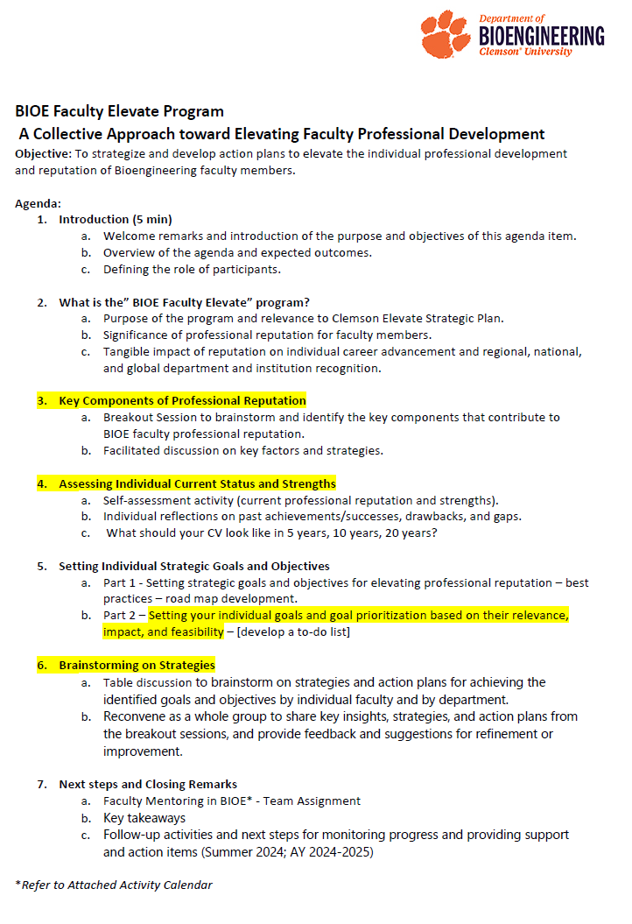
MEETING OBJECTIVE
To strategize and develop action plans to elevate the individual professional development and reputation of Bioengineering faculty members and the Bioengineering Department.

Slide 3
A Collective Approach toward Elevating Faculty Professional Development – Introduction Session
Expected Outcomes
Introduce “BIOE Faculty Elevate” Program
Brainstorm on strategies to achieve goals (individual and department)
Participant Role
Contribute to discussion
Share thoughts, ideas, and experiences and be open to new ideas and thoughts
Identify key components of professional reputation
Assess current status and strengths
Setting individual goals and objectives
Support collegiality and collaboration
Endorse the BIOE Faculty Elevate Program as an enabling tool for success

Slide 4
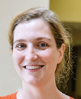
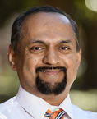
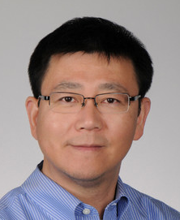
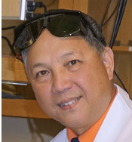
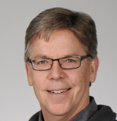
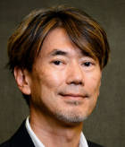
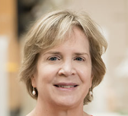
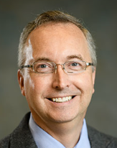
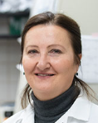
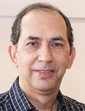
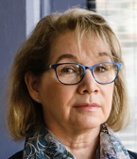
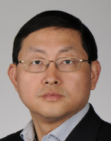
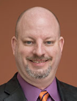
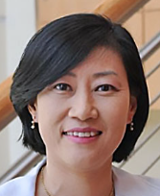
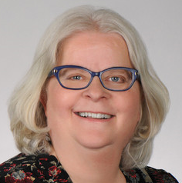
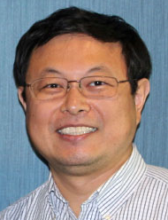
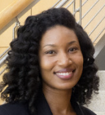
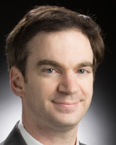
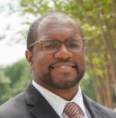
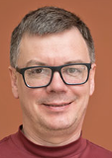
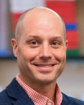
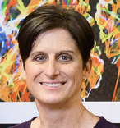
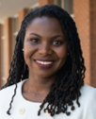
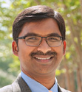
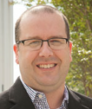
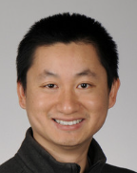
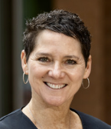
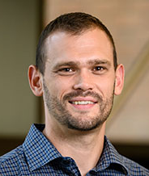
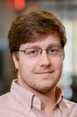
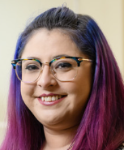
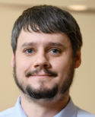
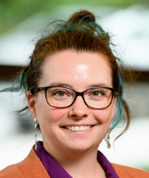
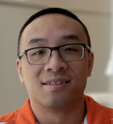
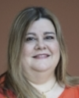
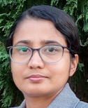
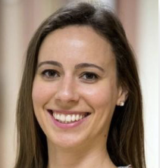
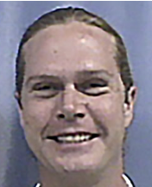
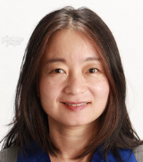
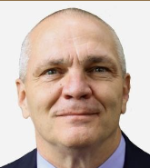
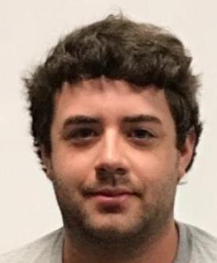
BIOE Faculty Article 1 – Faculty bylaws 2020 (to be revised)
According to the most recent bylaws of the Department of Bioengineering (2020), the “Bioengineering Faculty consist of faculty who hold tenured or tenure-track appointments as assistant professor, associate professor, or professor and full-time lecturers, senior lecturers and principal lecturers with a primary appointment in the department.” The Faculty Elevate Program also includes Research faculty with a full-time appointment in the Department of Bioengineering.

Slide 5
Faculty Member – Academic Profession not an Academic Job
A professional who demonstrates:
Specialized knowledge
Professional standards
Credentials
Autonomy and Accountability
Service Oriented
Advanced degree
And is dedicated to
Advancing knowledge,
Educating students, and
Contributing to the academic community through scholarship.
Home – AAUW : Empowering Women Since 1881
(Merriam-Webster)

Slide 6
What is the “BIOE Faculty Elevate” Program?
Purpose of the program and relevance to Clemson Elevate Strategic Plan
Significance of professional reputation for faculty members
Tangible impact of reputation on individual career advancement and regional, national, and global department and institution recognition

Slide 7
Program Aim and Objectives
To support the growth, advancement, and success of all faculty members at all ranks.
Help you meet your targeted career goals
Support the mission and vision of the Bioengineering Department
Assure the preeminence of Clemson BIOE within the academic community
Empower you to thrive in your roles and your academic community
"True success is not merely about reaching the pinnacle of achievement, but about embracing the journey of growth and advancement along the way. It's about continuously expanding our capabilities, seizing opportunities for progress, and evolving into the best version of ourselves."
Arthur Ashe; The Socratic Method

Slide 8
1. Help you meet your targeted
career goals
2. Empower you to thrive in your roles and your academic community
Faculty
Objectives
1. Support the mission and vision of Bioengineering Department
2. Assure the preeminence of CU BIOE within the academic community
Department
Objectives

Slide 9
Program Foundation
CORE VALUES
Commitment, Accountability, Collaboration, Leadership, Reputation
SUCCESS ENABLER
Engaging and supportive environment
SUCCESS ENABLER
Emphasis on the value of mentoring
SUCCESS ENABLER
Clear guidance on program purpose
SUCCESS ENABLER
Ongoing support and communication
Collegial and Collaborative Approach
Collegial and Collaborative Approach

Slide 10
(quotenova.net)
This quote suggests that success is not merely achieving a goal or reaching a destination, but rather the entire process of striving, learning, and growing that leads to that endpoint.

Slide 11
What is success in academia?
A “journey to a destination” with opportunities for growth, learning, and adaptation along the way.
Is multifaceted and vary based on individual goals, departmental and institutional expectations, and field.
Resilience, determination, flexibility, enthusiasm.
Professional reputation
Planning
Proceeding
Adapting
Achieving

Slide 12
Professional Reputation
Collective perception and assessment of an individual's character, competence, and credibility within their professional community.
Valuable asset that influences opportunities for career advancement, collaboration, and success.
Reflection of the esteem and regard that others hold for an individual based on their professional achievements and contributions.
Key Components:
Competence
Achievements
Contributions
Endorsement
Networking
Relationships
(Merriam-Webster)
Maintaining and enhancing a positive professional reputation requires ongoing attention to building trust, demonstrating competence, and acting with integrity.

Slide 13
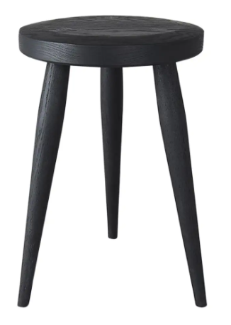
Profile of a BIOE Faculty Member
Contributor to the mission of the department
“…to educate and prepare students for professional careers in bioengineering for global competitiveness and to develop and disseminate bioengineering knowledge through research and engagement in economic development to advance health innovation and biotechnology in alignment with Clemson’s land-grant mission.” (2018)
%
%
100%
%

Slide 14
Workload and Goals Factored in Success
Faculty Individual Roadmap and Career Goals
WORKLOAD
GOALS
Individual
FACULTY SUCCESS
Annual
Department
Short term (1 yr)
Need-based
Equity
Expertise-based
Faculty success
Aligned with workload and roadmap
Long term (5 yr+)
Success Milestones
Goal-assessed
Metric-driven
Roadmap-focused
Chair assigned
evaluation
Department Success and Reputation
(Mission Driven; Assessment, Rankings, etc.)

Slide 15
Departmental Reputation - Rankings
Perception of excellence and preeminence. In the fiercely competitive and increasingly global higher education sector, perception is nearly as important as performance.
USNWR rankings (and others)
Impact on recruitment (students, staff, faculty), research, et al.
Impact on research – Important for grant funding, peer-review process.
USNEWS RANKING - ENGINEERING SPECIALITY: For engineering specialties, in summer, U.S. News works directly with each engineering school to collect a list of its engineering programs that offered a doctoral degree in each specialty area, as well as a list of each program's department heads. Then in fall, the department heads are given a list of the schools that offered doctoral programs in their particular specialty and asked to rate them on a scale from 1 (marginal) to 5 (outstanding) or Do not Know. The responses for each school were then averaged by the number of responses for that school. https://www.usnews.com/education/best-graduate-schools/articles/how-us-news-calculated-the-rankings

Slide 16
Reputation Factored in Rankings
VOTERS
1 (marginal) to 5 (outstanding) or Do not Know
Data used to assess reputation (professional society involvement, awards (students, faculty), panels, study sections, research awards, newsletters, “wow” news, etc.)
Impact of student visibility (e.g. BME IDEA, NIH DEBUT)
Impact of faculty accomplishments
ENABLING TOOLS
Research visibility
Professional visibility
Education visibility (through faculty and students)

Slide 17
TABLE ASSIGNMENT:
Key Components of Professional Reputation

Slide 18
Group Assignment #1
PART 1. (10 minutes)
Select a scribe
Identify key components that contribute to BIOE faculty professional reputation
List current obstacles to productivity and faculty success
PART 2.
Presentation of group report by scribes
B. Discussion

Slide 19
Common Obstacles to Work Productivity
Anxiety
Burnout
Lack of sleep
Poor time management or decision-making skills
Having too many competing priorities
Poor communication
Procrastination
Loss of motivation
Change
Lack of incentives
Productivity - Tips to Increase your Productivity on Personal Scale (marketing91.com)

Slide 20
Assessing Individual Current Status and Strengths

Slide 21
Individual Assignment #1 (15 minutes)
Individual Assignment #1 - BIOE Faculty Elevate Program https://redcap.link/IndividualAssignment1
PART 1.
Self-assessment activity
Current professional reputation and strengths
Individual reflections on past achievements/successes and drawbacks
Gaps to be filled – what is missing
PART 2.
What should your CV look like in 5 years, 10 years, 20 years (as applicable)?
PART 3.
Submit the confidential questionnaire (to Department Chair)

Slide 22
Setting individual Strategic Goals and Objectives

Slide 23
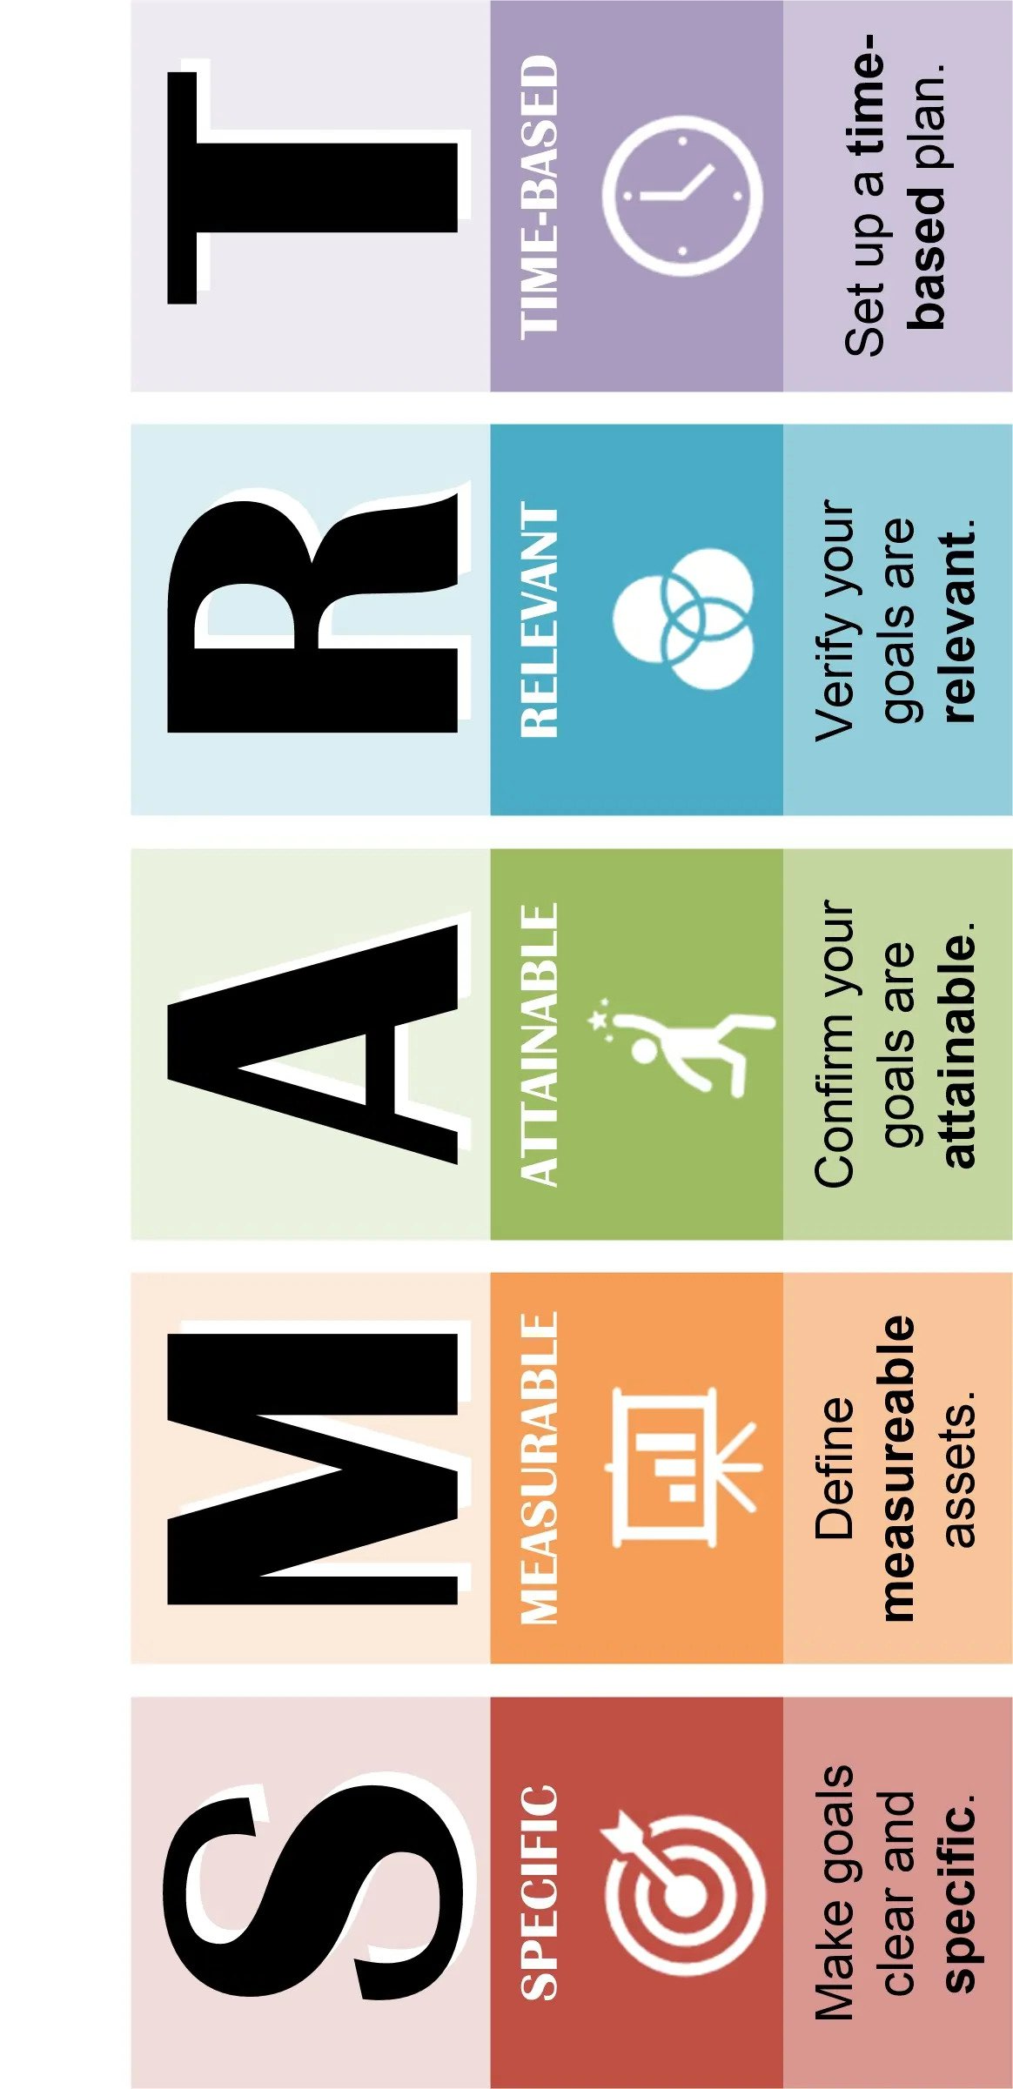
Setting strategic goals for elevating professional reputation
Goals/Objectives
Specific, Measurable, Achievable, Relevant, and Time-bound (SMART)
May be related to:
Scholarly work
Research productivity
Teaching effectiveness
Service contributions
Leadership roles
Networking
Visibility
Recognition
Assess current reputation
Define desired reputation
Identify strategic Goals
Prioritize Goals
Develop an Action Plan
Identify resources
Monitor progress and adapt
Celebrate and Learn

Slide 24
Roadmap (Action Plan) for Faculty Success
Develop a detailed action plan for each strategic objective.
Outline specific steps, resources, and timeline needed to achieve them.
Identify key stakeholders and collaborators who can support you in achieving your goals.
Break down each objective into smaller, manageable tasks and milestones to track progress over time.
Refer to BIOE Faculty Performance Guidelines and metrics.

Slide 25
Example of Roadmap for NIH R01 Success
What is needed
Novel, innovative, gap filling idea
Publications to show expertise and authority; competence and recognition
Right team – expertise and skills
Sustained and demonstrable relationship with collaborators
Resources availability; commitment
Grantsmanship skills
What is the plan
Target date for application
Chronological list of to-do’s

Slide 26
Individual Assignment #2 (10 minutes)
Individual Assignment #2 - BIOE Faculty Elevate Program https://redcap.link/IndividualAssignment2
PART 1. Develop a to-do list
List your individual career goals
Prioritize based on their relevance, impact, and feasibility
What is your action plan to meet those career goals?
PART 2.
This is a continuous process as goals should be assessed and revised as needed. Review the to-do list with your mentoring team.
Only submit (to Department Chair) when completed.

Slide 27
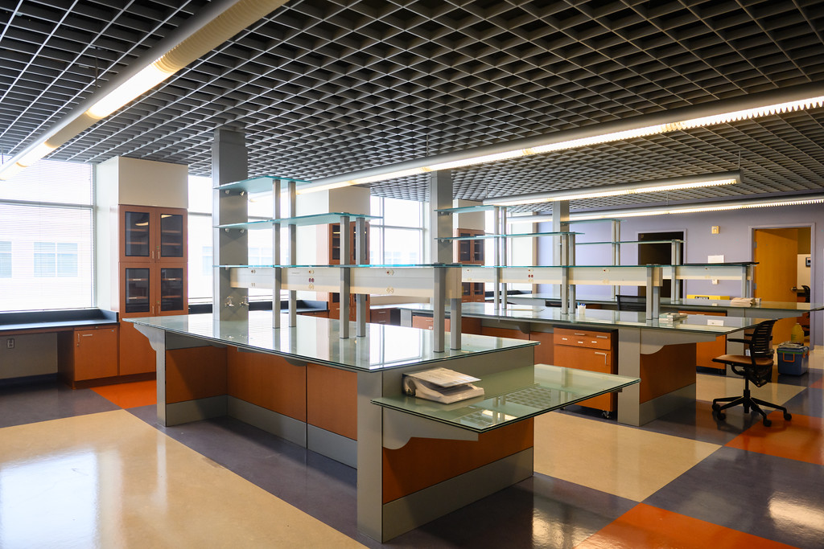
Brainstorming on Strategies

Slide 28
Group Assignment #2
PART 1. (15 minutes)
Select a scribe
Identify strategies for achieving goals and objectives by individual faculty and by department.
Propose suggestions for refinement or improvement of current practices.
PART 2.
Presentation of group report by scribes
B. Discussion

Slide 29
Next Steps

Slide 30
Academic Mentorship – Faculty Success
Knowledge Transfer: Mentors share their expertise, insights, and knowledge with mentees, accelerating their learning and skill development.
Career Guidance: Mentors provide guidance on career planning, academic pathways, tenure-track preparation, promotion, and navigating professional challenges.
Networking Opportunities: Mentors introduce mentees to relevant contacts, collaborators, and resources within their professional network, expanding mentees' opportunities for collaboration and career advancement.
Emotional Support: Mentors offer encouragement, validation, and empathy to mentees, helping them navigate personal and professional challenges with confidence and resilience.

Slide 31
A Mutually Benefiting Relationship
Mentor
Serves as a role model, advisor, and advocate for the mentee, offering expertise, wisdom, and perspective gained from their own experiences in academia.
Provides guidance on research, teaching, career development, work-life balance, and navigating the academic environment.
Offer constructive feedback, encouragement, and support to help mentee achieves their goals and aspirations.
Mentee
Actively seeks guidance, feedback, and support from the mentor, demonstrating openness, receptivity, and initiative in the mentoring relationship.
Takes ownership of their professional development, set goals, and work collaboratively with their mentor to achieve them.
Receptive to feedback, willing to learn, and proactive in seeking out opportunities for growth and advancement.
Workload Assignment
Academic Goals
Commitment
Confidentiality
Assigned and Reviewed by Department Chair
Commitment
Collegiality
Confidentiality
Responsiveness

Slide 32
Identification of mentors by individual faculty
Team-Based BIOE Faculty Mentoring
Professional Career Mentor
Research/Teaching Mentor (internal or external to BIOE)
Mandatory for early-stage career faculty
Strongly encouraged for mid-career faculty
Optional for later career faculty (administration/leadership/preeminence)

Slide 33
Individual Assignment #3
Fill the survey below – mentor and mentee
BIOE Faculty Elevate Program for Professional Development If the link above does not work, try copying the link below into your web browser: https://redcap.link/BIOEFacultyElevate
May 15 Deadline
Mentor assignment recommendation by committee to Department Chair
(July 15, 2024) for workload assignment.

Slide 34
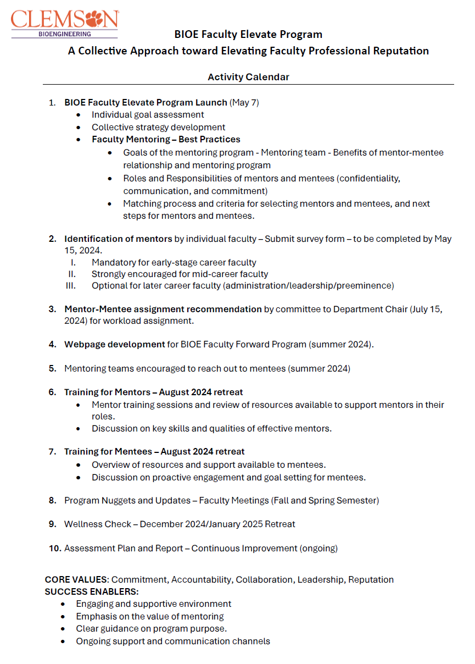
Activity Calendar AY 2024-25

