Slide 1


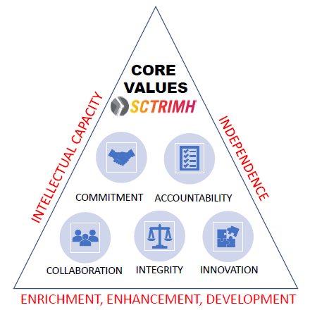



Strategy for Enhancing Academic Professional Reputation
Elevating Human Performance
Presented by ADMIN Core – Mentoring Program
NIH COBRE Grant: GM121342
SC TRIMH Center: 0948

Slide 2
What is Professional Reputation?
Collective perception and assessment of an individual's character, competence, and credibility within their professional community.
Valuable asset that influences opportunities for career advancement, collaboration, and success.
Reflection of the esteem and regard that others hold for an individual based on their professional achievements and contributions.
Key Components:
Competence
Achievements
Contributions
Endorsement
Networking
Relationships
(Merriam-Webster)
Maintaining and enhancing a positive professional reputation requires ongoing attention to building trust, demonstrating competence, and acting with integrity.

Slide 3
Why Discussing Professional Reputation?
Career Advancement
Trust and Credibility
Competitive Advantage
Resilience
Influence and Leadership
(Personal Satisfaction)

Slide 4
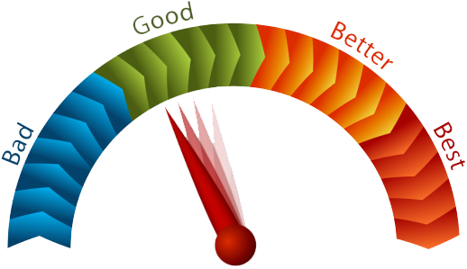
Individual Check
What is my current professional reputation?
What are the top three accomplishments I am proud of?
What am I not proud of?
What are the things that I must improve?
How did any advice I was given affect my work?
Am I able to get everything done?
What’s a goal that is really important to me?
What milestones have I set for myself this year? Next year? In 5 years?
What obstacles or blockers am I facing toward meeting these goals?

Slide 5

Developing a Strategy for Best Reputation
Building
a strong professional network
Producing
high-quality research
Engaging
in professional service
Gathering
a productive resilient research team
Participating
in outreach
Working
with a dedicated mentoring team for research and professional development

Slide 6



1. Build a Strong Network with Peers and Experts
Who are they?
Program officers, journal editors, associate editors, study section members, senior successful researchers and leaders in the field
Colleagues outside institution
Where to find them?
Attend targeted research conferences
Build and maintain a professional online presence on social media (LinkedIn), Instagram, and others
How to network with them?
Present your work at conferences to gain recognition and make valuable connections
Introduce yourself
Ask your mentor to introduce you.
Get assistance from colleagues.
Join professional organizations – participate in committees and leadership positions

Slide 7


Know who they are and seek them.
Introduce yourself at the right moment.
Keep focus on the goal – make connection – WHEN.
Avoid small talks – wasting time!
Be careful with too much drinking – and difficult food to carry or eat!
W – Work
H – Hobby
E - Education
N - Network

Slide 8

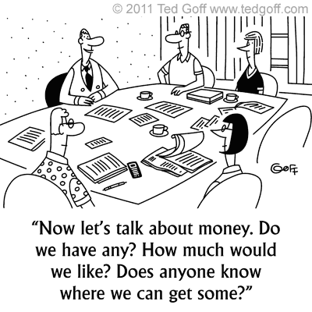
2. Produce High-Quality Research – Field? Topic?
What gets funded in your field? RePORT ⟩ RePORTER (nih.gov)

Slide 9
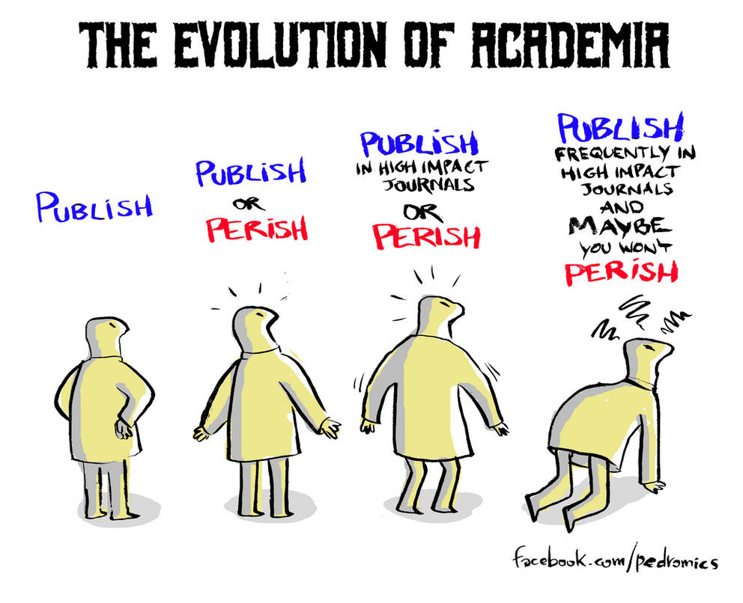
Publish or Perish
“Publish or perish” is a common phrase used to describe the pressure researchers feel to publish their research findings in order to stay relevant and be successful within the academic community (Van Weijen , 2014).
Publish or Perish by Velica on DeviantArt

Slide 10
2. Produce High-Quality Research – Visibility?
Publish and Present
  Target peer-reviewed journals with high impact factors in your field
  Prioritize conferences –strategy for maximum impact, visibility, networking
  Publish a steady stream of publications – visibility, authority
  Collaborate with the experts in the field – co-authorship & co-application
  Rigor and Reproducibility
Reliability
Validity
Credibility
Cited by Others

Slide 11
2. Produce High-Quality Research – Research Funding?
Secure funding - NIH, NSF, Foundations, etc.
At NIH - Which Institute? Which Study Section?
At NSF – Which Directorate? Which Division, Which Program?
Perfect grant applications – no mistakes
“In the current funding environment, preparing an outstanding grant proposal is critical, as even minute deficiencies can potentially lead to rejection. Furthermore, publications in reputable journals are crucial to disseminate research findings and promote career development”.
Ardehali, H. Circulation Research 114: 1231-1234, 2014.

Slide 12
3. Engage in Professional Service
Volunteer!!
  Study section membership
  Journal manuscript reviewer – tremendous benefits for research direction
  Editorial board membership – check on journal policies and best practices
  Professional society committee membership – need to start somewhere to reach national and international leadership status – IDEAL for Networking!!
Becoming a Peer Reviewer | grants.nih.gov
How Scientists Are Selected to Be Members of a Chartered Review Group | NIH Center for Scientific Review .

Slide 13
4. Build a Productive and Resilient Research Team via Graduate Student Mentorship
Select the right graduate students – due diligence
  Must have skills, motivation, be engaged, be determined, be a team player, must fit with you and your group
  Become a mentor rather than an advisor
  Be present – be attentive – set rules for productivity – require accountability
  Do wellness check –
  Empathy

Slide 14
5. Participate in Outreach
Serve as invited seminar speakers at other institutions
Use the opportunity to impress and be impressed
Press releases – work with your department and college – know the rules
Book chapters – co-editors

Slide 15
6. Work with a Dedicated Mentoring Team for Research and Professional Development
Work closely with your mentoring team
Seek help
Accept the support from others

Slide 16


Common Obstacles to Work Productivity
Anxiety
Burnout
Lack of sleep
Poor time management or decision-making skills
Having too many competing priorities
Poor communication
Procrastination
Loss of motivation
Change
Lack of incentives
Productivity - Tips to Increase your Productivity on Personal Scale (marketing91.com)

Slide 17


Setting individual Strategic Goals and Objectives

Slide 18
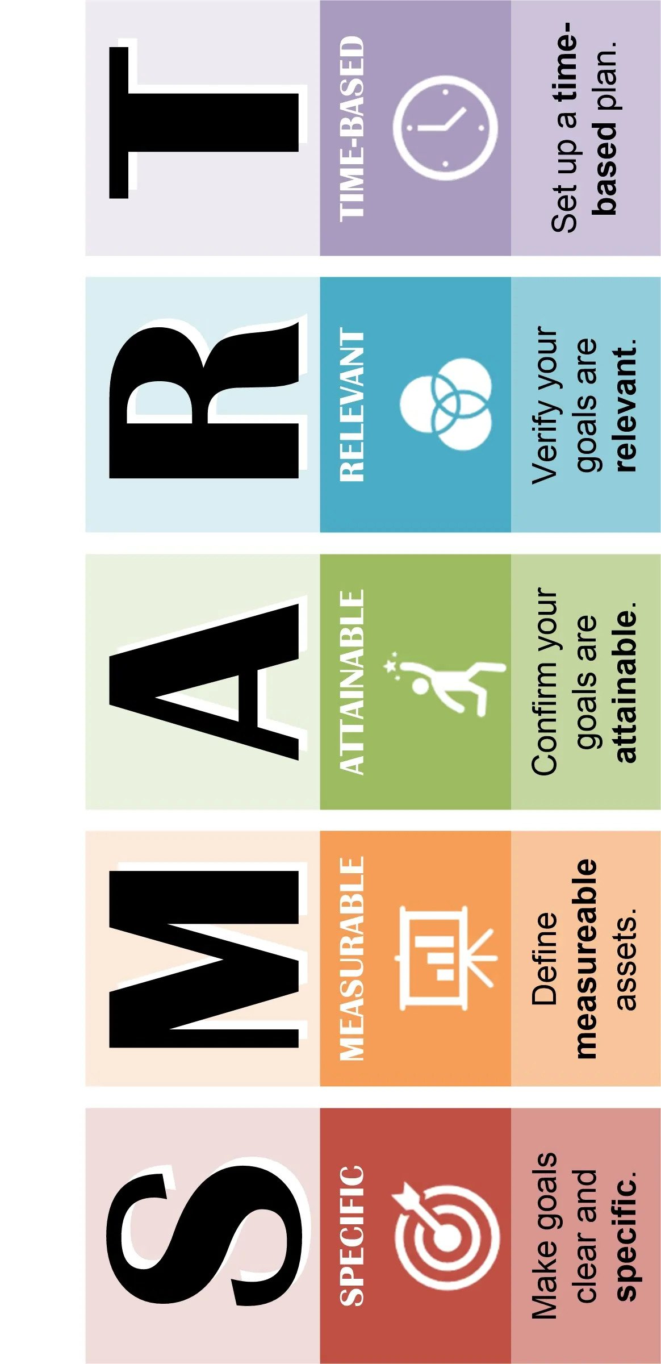
Setting strategic goals for elevating professional reputation
Goals/Objectives
Specific, Measurable, Achievable, Relevant, and Time-bound (SMART)
May be related to:
Scholarly work
Research productivity
Teaching effectiveness
Service contributions
Leadership roles
Networking
Visibility
Recognition
Assess current reputation
Define desired reputation
Identify strategic Goals
Prioritize Goals
Develop an Action Plan
Identify resources
Monitor progress and adapt
Celebrate and Learn

Slide 19
Roadmap Action Plan
Develop
Develop a detailed action plan for each strategic objective.
Achieve
Outline specific steps, resources, and timeline needed to achieve them.
Identify
Identify key stakeholders and collaborators who can support you in achieving your goals.
Break down
Break down each objective into smaller, manageable tasks and milestones to track progress over time.
Refer
Refer to your departmental faculty performance guidelines and metrics.

Slide 20
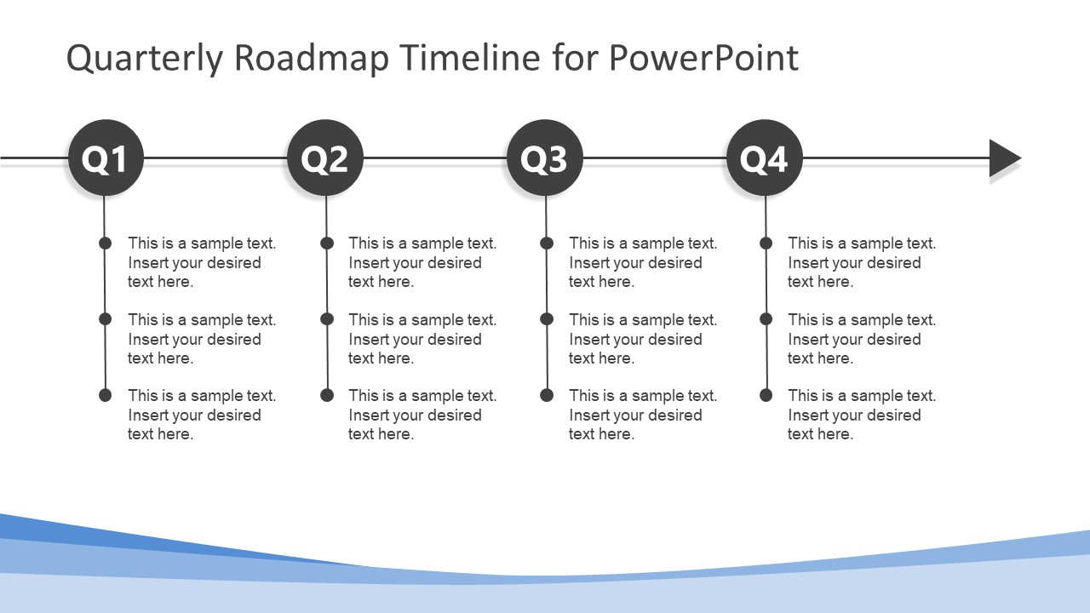
Example of Roadmap for NIH R01 Success
What is needed
  Novel, innovative, gap filling idea
  Publications to show expertise and authority; competence and recognition
  Right team – expertise and skills
  Sustained and demonstrable relationship with collaborators
  Resources availability; commitment
  Grantsmanship skills
What is the plan
  Target date for application
  Chronological list of to-do’s

Slide 21

SC TRIMH ADMIN Core
Grant Number: 2P20GM121342 - 06

