Slide 1
Pre-Labs for ECE 212
Created by Manas Tonapi on 02/16/2013
Last Updated: 02/23/2013

Slide 2
ECE 212 - Electrical Engineering Lab I
Pre-labs for ECE 212
Manas Tonapi
Created: 02/16/2013 Updated: 02/23/2013

Slide 3
ORIENTATION

Slide 4
Introduction
This course is intended to enhance the learning experience of the student in topics encountered in ECE 262.
In this lab, students are expected to gain experience in using the basic measuring devices used in electrical engineering and in interpreting the results of measurement operations in terms of the concepts introduced in the second electrical circuits course.

Slide 5
Lab Objectives
The Electrical Circuits Laboratory II is designed to provide the student with the knowledge to use basic measuring instruments and techniques with proficiency.
These techniques are designed to complement the concepts introduced in ECE 262. In addition, the student should learn how to effectively record experimental results and present these results in a written report. More explicitly, the class objectives are:
To gain proficiency in the use of common measuring instruments;
To enhance understanding of advanced electric circuit analysis concepts.
  Inductance, Capacitance, and reactance

Slide 6
Lab Objectives contd…
  AC voltage and current addition. Phasors
  AC power (real and reactive, instantaneous and average)
  Series and parallel resonant circuit behavior
  Passive Filters
  Transfer functions
  Transformers
  Two-port network analysis;
3. To develop communication skills through
  maintenance of succinct but complete laboratory notebooks as permanent, written
  descriptions of procedures, results, and analyses,

Slide 7
Lab Objectives contd…
  verbal interchanges with the Laboratory Instructor and other students, and
  preparation of succinct but complete laboratory reports;
  To compare theoretical predictions with experimental results and to resolve any apparent differences.

Slide 8
Student Responsibilities
The student is expected to be prepared for each lab.
The student is expected to ask the teaching assistant any questions he/she may have.
The student should understand the concepts and procedure of each lab.
The student should remain alert and use common sense while performing a lab experiment.
He/she is also responsible for maintaining a laboratory notebook.
Students should report any errors in the lab manual to the teaching assistant.

Slide 9
Use of laboratory instruments
Instrument protection rules
Set instrument scales to the highest range before applying power.
When using an oscilloscope, especially one with a cathode ray tube, do not leave a bright dot or trace on the screen for long periods of time. To avoid burning the image into the screen, reduce the intensity until the dot or trace is barely visible.
Be sure instrument grounds are connected properly. Avoid accidental grounding of "hot“ leads, i.e., those that are above ground potential. (See especially “Avoiding Grounding Errors with Oscilloscope” in Appendix C.)
Check polarity markings and connections of instruments and components carefully before connecting or turning on power.

Slide 10
Use of laboratory instruments contd…
Never connect an ammeter across a voltage source. Only connect ammeters in series with loads.
Do not exceed the voltage and current ratings of instruments or other circuit elements.
Be sure any fuse or circuit breaker is of suitable value.
Connect the main series portion of the network first, then go back and add the elements in parallel.

Slide 11
Lab Policy
Pre-Requisites:- ECE 202 MTHSC 206 and PHYS 221
Co-Requisites:- ECE 262
Attendance:- Attendance is mandatory and any absence must be for a valid excuse and must be documented.
Late Instructor:- If the instructor is more than 15 minutes late, students may leave the lab.
Pre-Lab:- Each lab has a “Preparation” section that should be read and completed prior to each lab.

Slide 12
Lab Policy contd…
Lab Records:- The student must keep all work in preparation of and obtained during lab in an approved notebook and prepare a lab report on selected experiments.
Late Work:- All full lab write-ups are due two weeks from the date lab is performed. Late work will NOT be accepted.
Final Exam:- The final exam will be given in lab on the last meeting. It will contain a written part and a practical (physical operations) part.

Slide 13
Grading Policy
The final grade is determined using the following criteria:-
Participation + Attendance + Lab Notebook:- 20%
Pre-Lab:- 20%
Lab Reports (3):- 40%
Final Exam:- 20%
Grade Scale:-
A: 90%-100%
B: 80%-89%
C: 70%-79%
D: 60%-69%
F: <60%

Slide 14
The Laboratory Notebook
The laboratory notebook should:-
Be kept in a sewn and bound or spiral bound notebook.
Contain the experiment’s title, the date, the equipment and instruments used, any pertinent circuit diagrams, the procedure used, the data, and the result analysis.
Contain plots of data and sketches when these are appropriate in the recording and analysis of observations.
Be an accurate and permanent record of the data obtained during the experiment and the analysis of the results.

Slide 15
The Laboratory Report
Your laboratory report must be clear and concise.
It should be typed on a word processor.
Use tables, diagrams, sketches, and plots, as necessary to show what you did, what was observed, and what conclusions you draw from this.
Your report should be the result of your individual effort.

Slide 16

The Laboratory Report-Format

Slide 17
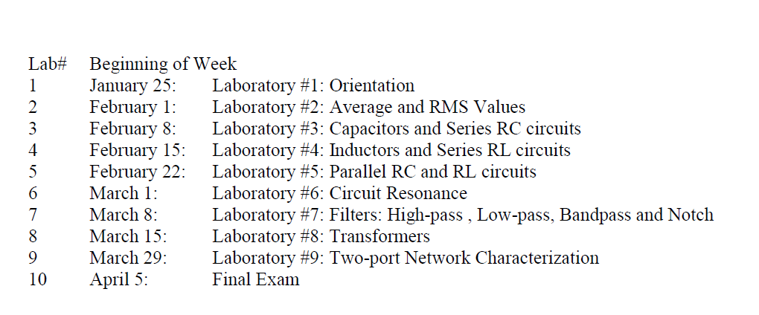
Tentative Schedule

Slide 18
Contact Information
Instructor:
Name: Manas Tonapi
Email: mtonapi@clemson.edu
Office: 313 Fluor Daniel (EIB)
Phone: (864)-656-5902
Office Hours: As needed (email for appointment)
Lab Coordinator:
Name: Dr. Timothy Burg
Email: tburg@clemson.edu
Office: 307 Fluor Daniel (EIB)
Phone: (864)-656-1368

Slide 19
Safety
Electricity, when improperly used, is very dangerous to people and to equipment.
This is especially true in an experimental or teaching laboratory where inexperienced personnel may use electrical equipment in experimental or nonstandard configuration.

Slide 20
Safety contd…
The knowledge and habit-forming experience to work safely around electrical equipment and the ability to design safe electrical equipment includes:-
Learning the types of electrical injuries and damage.
How the electrical injuries can be prevented.
The physiology of electrical injuries.
Steps to take when accidents occur.

Slide 21
Physiology of Electrical Injuries
There are three main types of electrical injuries:
Electrical shock
Electrical burns
Falls caused by electrical shock
A fourth type, 'sunburned' eyes from looking at electric arcs, such as arc-welding, is very painful and may cause loss of work time but is usually of a temporary nature.
Other injuries may be indirectly caused by electrical accidents, e.g., burns from exploding oil-immersed switch gear or transformers.

Slide 22
Prevention of Electrical Injuries
When hooking up a circuit, connect to the power source last, while power is off.
Before making changes in a circuit, turn off or disconnect the power first, if possible.
Never work alone where the potential of electric shock exists.
When changing an energized connection, use only one hand. Never touch two points in the circuit that are at different potentials.

Slide 23
Prevention of Electrical Injuries contd…
Know that the circuit and connections are correct before applying power to the circuit.
Avoid touching capacitors that may have a residual charge. The stored energy can cause a severe shock even after a long period of time.
Insulate yourself from ground by standing on an insulating mat where available.

Slide 24
After Accident Action
Shut off all power and remove victim from the electric circuit.
If the power cannot be shut off immediately, use an insulator of some sort, such as a wooden pole, to remove victim from the circuit.
If you are qualified in CPR, check for ventricular fibrillation or cardiac arrest. If either is detected, external cardiac massage should be started at once.
Notify EMS and the ECE Department at once.

Slide 25
After Accident Action contd…
Check for respiratory failure and take appropriate action.
Check for and treat other injuries such as fractures from a fall or burns from current entry and exit sites.
Investigations are always after accidents. As an engineer you will be involved as a part of the investigating team or in providing information to an investigator.

Slide 26
Emergency Numbers
Emergency (Fire/EMS):- 911 or 656-2222
Student Health Center:- 656-2233
ECE Department Office:- 656-5650

Slide 27
Safety Video

Slide 28
Conclusions
As a professional engineer, it will be your responsibility to prepare yourself to do your job correctly.
Learn as much as you can "up front”.
You will find that as a practicing professional if you wait until the last minute, you might have to pay a very painful price emotionally, financially, and professionally.

Slide 29
Preparations for Next Week
Reading:- Read Appendix A (Safety), Appendix B and Appendix C of this manual, paying particular attention to the methods of using measurement instruments. of this manual.
Writing:-
Using the definition of average value (equation 2.1) and rms value (equation 2.2), calculate the average voltage, the average absolute voltage, and the rms voltage values for the symmetrical sine, square, and triangular waveforms, assuming that the peak value of each waveform is 2 V.
Compute the voltage values that would be reported by non-true rms voltmeters. You may use the equations derived in the Background section for these calculations. Show all of your calculations in your lab notebook and summarize the results in

Slide 30
Preparations for Next Week contd…
a table.
After you have done these calculations, review the laboratory exercise procedures and plan how you will use the experience gained in these calculations to find the values sought.

Slide 31
References
ECE 212 – Electrical Engineering Lab II. Latest Revised January 2010

Slide 32
Thank you !!!

Slide 33
ECE 212 - Electrical Engineering Lab II
Pre-labs for ECE 212
Manas Tonapi
Created: 02/16/2013 Updated: 02/23/2013

Slide 34
AVERAGE AND RMS VALUES

Slide 35
Introduction
Waveforms of voltage and current that vary periodically with time may be characterized by their average value or their root mean square (rms) value.
The latter is used to determine the power supplied, dissipated, or stored by a circuit element.
Some of the measuring instruments you will use respond to average values of voltage or current, while others respond to rms values.

Slide 36
Lab Objective
Learn how to determine the values of rms voltage for three types of waveforms: a sinusoid, a square wave, and a triangular wave.
Understand the difference between a true-rms and a conventional multimeter.
Determine whether the voltage metering function of the NI-ELVIS’s Digital Multimeter (DMM) measures true RMS voltage for three types of waveforms: a sinusoid, a square wave and a triangular wave.

Slide 37
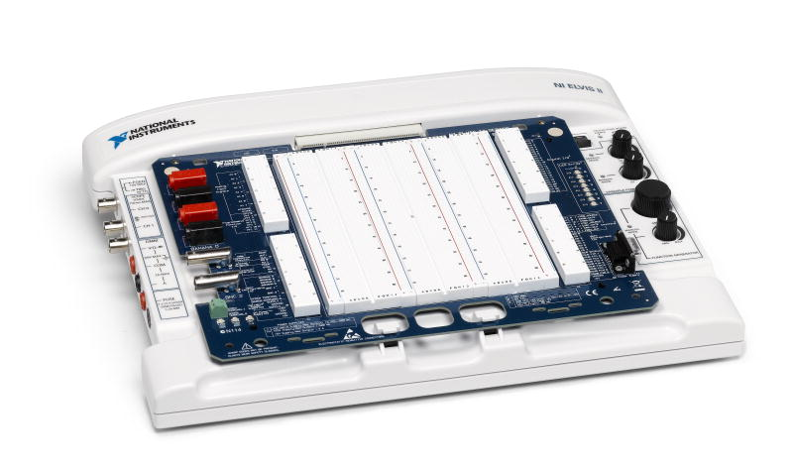
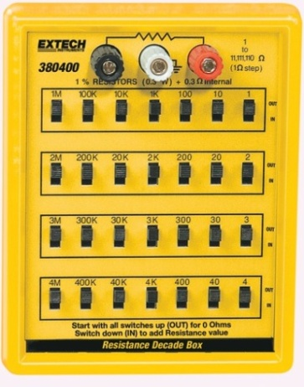
Equipment Needed
NI-ELVIS II including
  Function Generator
  Digital Multimeter (DMM)
  Oscilloscope
Resistance decade box

Slide 38
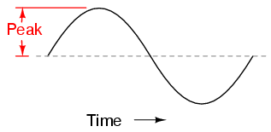
Background
Measurements of AC signal
  Amplitude is a nonnegative scalar measure of a wave's maximum magnitude of oscillation.
  In electrical engineering it may be thought of as the maximum absolute value reached by a voltage or current waveform as measured from the center of the oscillation.
  An amplitude measurement may be reported as peak, peak-to-peak, average, or RMS.

Slide 39
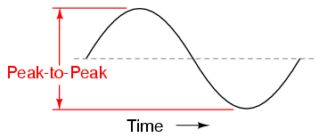
Background contd…
  Peak-to-peak amplitude is the total height of an AC waveform as measured from maximum positive to minimum negative peaks (the highest peak to the lowest valley) on a graph of the waveform. Often abbreviated as “P-P”, e.g., Vp-p or Vpp.

Slide 40
Background contd…
  Average value is the arithmetic “mean” of a waveform’s values over one cycle.
  The average value of any waveform with equal-area portions above and below the “zero” line on a graph is zero.
  However, often as a practical measure of amplitude, a waveform may be characterized by its average absolute value, calculated as the arithmetic mean of the absolute values of the waveform
  “RMS ” stands for Root Mean Square, and is a way of expressing an AC quantity of voltage or current in terms functionally equivalent to DC.
  Also known as the “equivalent” or “DC equivalent” value of an AC voltage or current.

Slide 41
Background contd…
  Analog, electromechanical meter movements respond proportionally to the average absolute value of an AC voltage or current.
  When RMS indication is desired, the meter's calibration must be adjusted accordingly, usually by applying a constant multiplicative factor assumed for a sinusoidal wave.
  This means that the accuracy of an electromechanical meter's RMS indication is dependent on the purity of the waveform and whether it is the same wave shape as the waveform used in calibrating.

Slide 42
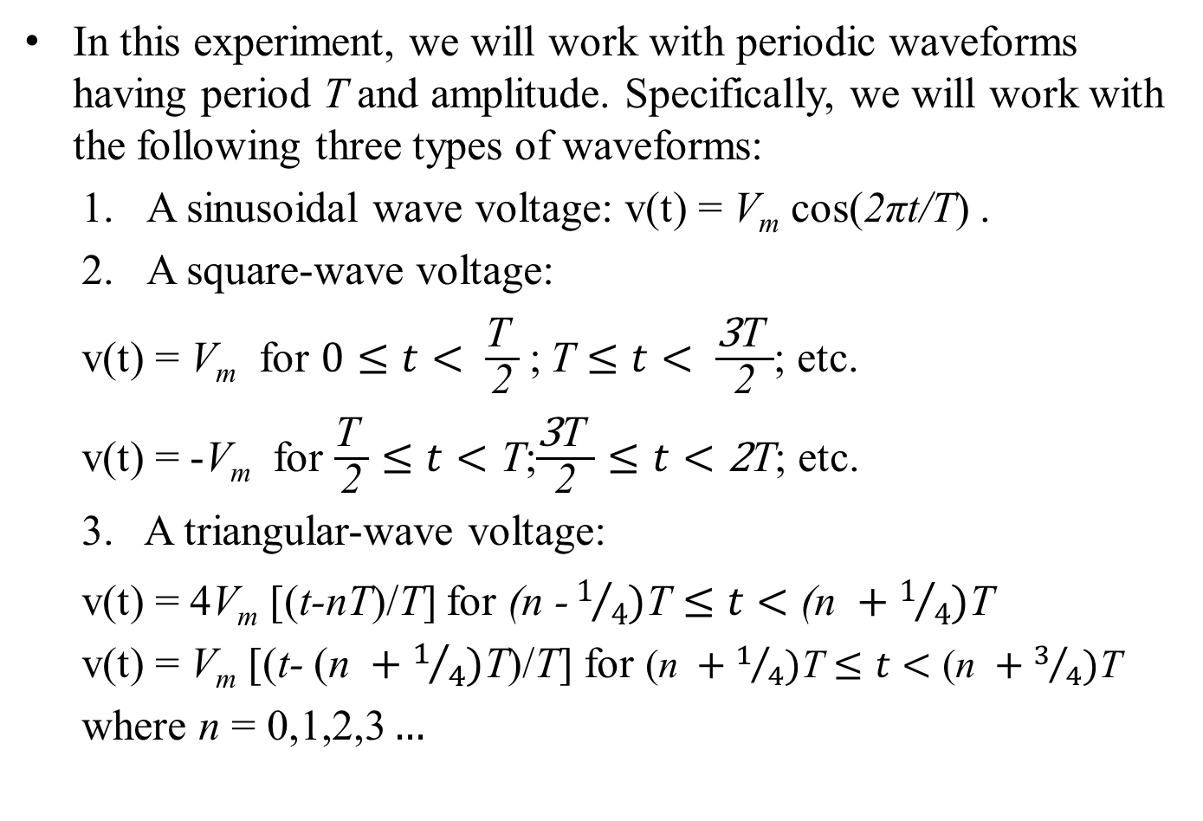
Background contd…
In this experiment, we will work with periodic waveforms having period T and amplitude. Specifically, we will work with the following three types of waveforms:
  A sinusoidal wave voltage: v(t) = V_{m} cos(2πt/T) .
  A square-wave voltage:
  v(t) = V_{m} for $0≤t< \frac{\text{T} }{\text{2}}$;$\text{T}≤t< \frac{\text{3}\text{T} }{\text{2}}$; etc.
  v(t) = -V_{m} for $\frac{\text{T} }{\text{2}}≤t<\text{T}$;$\frac{\text{3}\text{T} }{\text{2}}≤t<\text{2}\text{T}$; etc.
  3. A triangular-wave voltage:
  v(t) = 4V_{m} [(t-nT)/T] for $\text{(}\text{n}\text{ −}1/4)\text{T}≤t<\text{(}\text{n} +1/4)\text{T}$
  v(t) = V_{m} [(t- $\text{(}\text{n} +1/4)\text{T}$)/T] for $\text{(}\text{n} +1/4)\text{T}≤t<\text{(}\text{n} +3/4)\text{T}$
  where $\text{n} \text{=} \text{0,1,2,3}…$

Slide 43
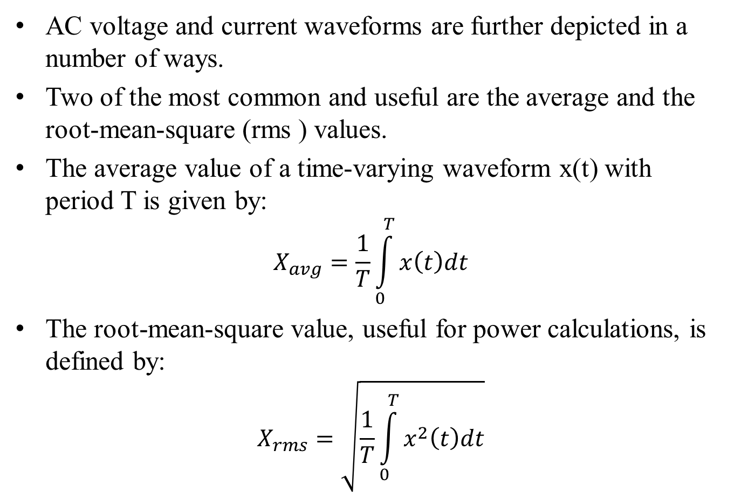
Background contd…
AC voltage and current waveforms are further depicted in a number of ways.
Two of the most common and useful are the average and the root-mean-square (rms ) values.
The average value of a time-varying waveform x(t) with period T is given by:
$$X_{avg}=\frac{1}{T}\int_{0}^{T}{x\left(t\right)dt}$$
The root-mean-square value, useful for power calculations, is defined by:
$$X_{rms}=\sqrt{\frac{1}{T}\int_{0}^{T}{x^{2}\left(t\right)dt}}$$

Slide 44
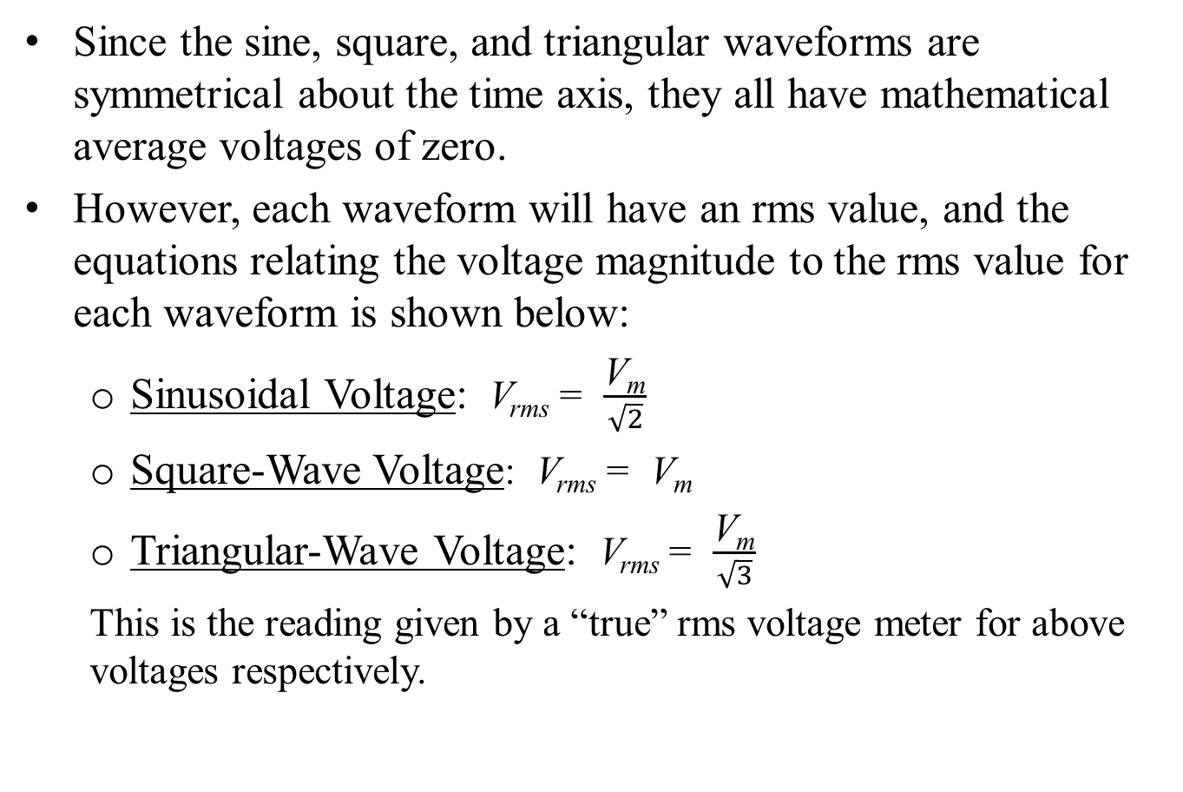
Background contd…
Since the sine, square, and triangular waveforms are symmetrical about the time axis, they all have mathematical average voltages of zero.
However, each waveform will have an rms value, and the equations relating the voltage magnitude to the rms value for each waveform is shown below:
  Sinusoidal Voltage: V_{rms} = $\frac{\text{V}\text{m}}{\sqrt{2}}$
  Square-Wave Voltage: V_{rms} = $\text{V}\text{m}$
  Triangular-Wave Voltage: V_{rms} = $\frac{\text{V}\text{m}}{\sqrt{3}}$
  This is the reading given by a “true” rms voltage meter for above voltages respectively.

Slide 45
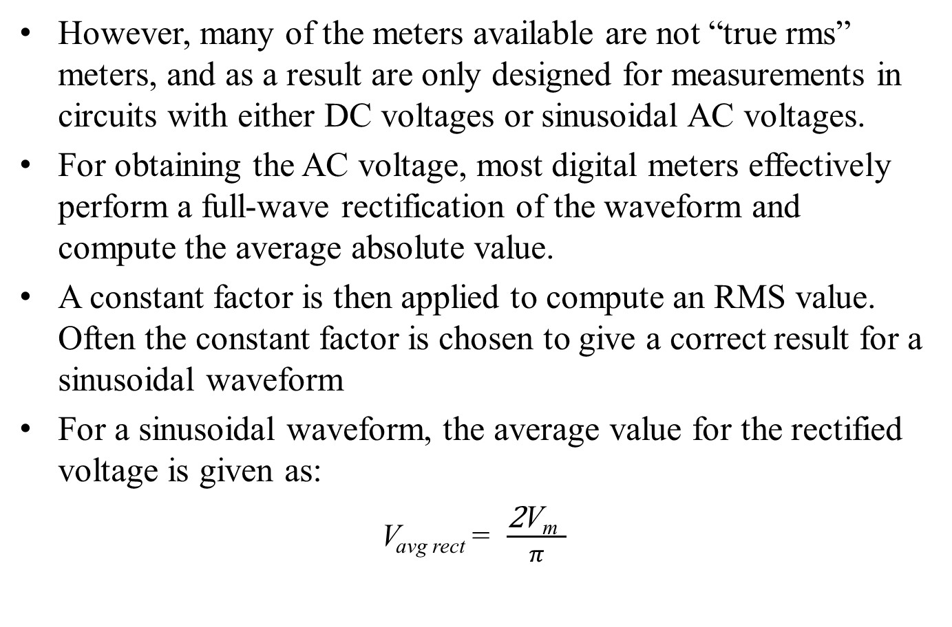
Background contd…
However, many of the meters available are not “true rms” meters, and as a result are only designed for measurements in circuits with either DC voltages or sinusoidal AC voltages.
For obtaining the AC voltage, most digital meters effectively perform a full-wave rectification of the waveform and compute the average absolute value.
A constant factor is then applied to compute an RMS value. Often the constant factor is chosen to give a correct result for a sinusoidal waveform
For a sinusoidal waveform, the average value for the rectified voltage is given as:
V_{avg rect} = $\frac{\text{2}\text{V}\text{m} }{π}$

Slide 46
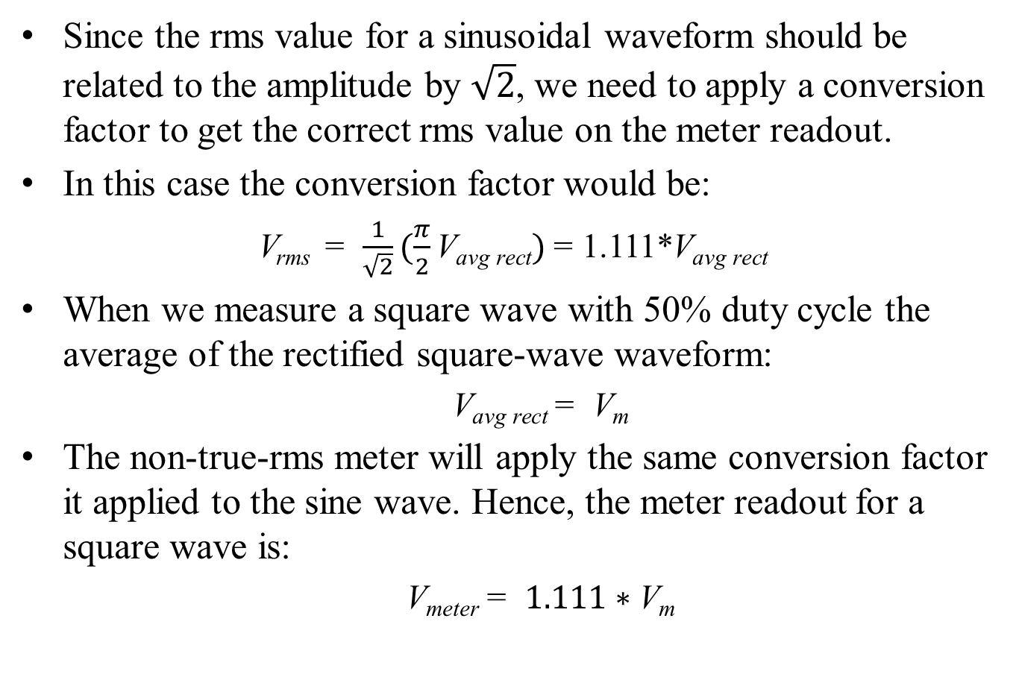
Background contd…
Since the rms value for a sinusoidal waveform should be related to the amplitude by $\sqrt{2}$, we need to apply a conversion factor to get the correct rms value on the meter readout.
In this case the conversion factor would be:
V_{rms} = $\frac{1}{\sqrt{2}}(\frac{π}{2}\text{V}\text{avg} \text{rect})$ = 1.111*$\text{V}\text{avg} \text{rect}$
When we measure a square wave with 50% duty cycle the average of the rectified square-wave waveform:
  $\text{V}\text{avg} \text{rect}$= $\text{V}\text{m}$
The non-true-rms meter will apply the same conversion factor it applied to the sine wave. Hence, the meter readout for a square wave is:
  V_{meter} = $1.111∗\text{V}\text{m}$

Slide 47
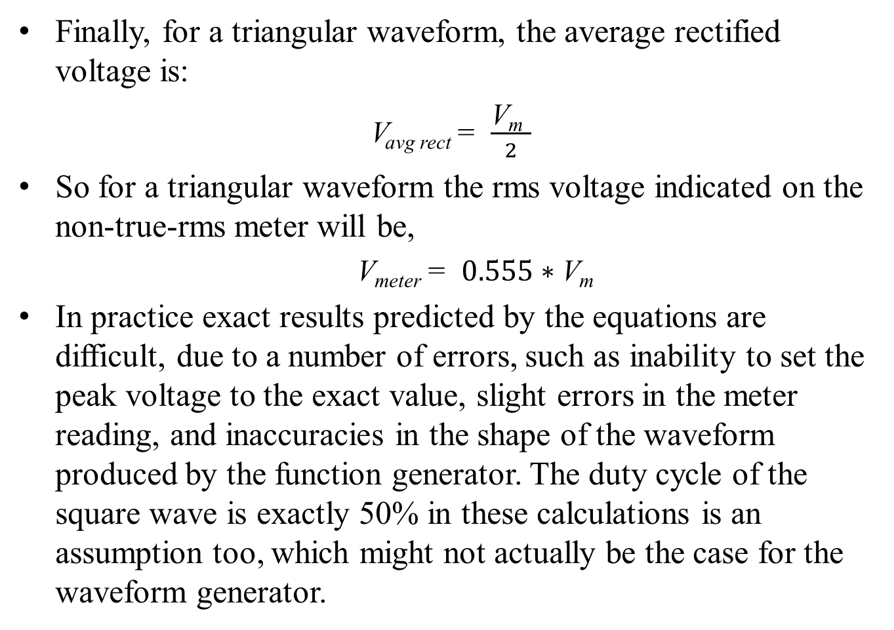
Background contd…
Finally, for a triangular waveform, the average rectified voltage is:
V_{avg rect} = $\frac{\text{V}\text{m} }{2}$
So for a triangular waveform the rms voltage indicated on the non-true-rms meter will be,
  V_{meter} = $0.555∗\text{V}\text{m}$
In practice exact results predicted by the equations are difficult, due to a number of errors, such as inability to set the peak voltage to the exact value, slight errors in the meter reading, and inaccuracies in the shape of the waveform produced by the function generator. The duty cycle of the square wave is exactly 50% in these calculations is an assumption too, which might not actually be the case for the waveform generator.

Slide 48
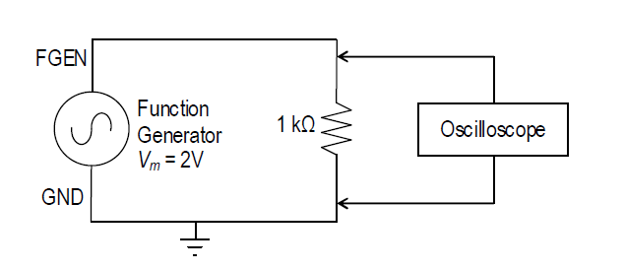
Procedure
Connect the output terminals of the Function Generator to a Resistance Decade Box.
Set the decade box to 1 kΩ resistance as the load on the output of the Function Generator.

Slide 49
Procedure contd…
Turn on the Function Generator and use the oscilloscope to observe the voltage drop across the 1 kΩ resistance. Remember that the oscilloscope’s ground is the same as the Function Generator’
Select the sine wave output option of the Function Generator
  Set the frequency of the function generator to 1 kHz.
  Observe the waveform on the oscilloscope using the CH0 BNC connector.
  Connect the SYNC signal (located directly below the FGEN signal row) to the Trigger BNC input on the left side on the workstation. Change the Trigger type to "Digital".

Slide 50
Procedure contd…
  Adjust the DC offset control of the Function Generator to obtain a zero DC level in the output.
  Use the Function Generator’s output level control (Amplitude control knob/numerical input) to obtain a 2.0 Volt peak value (4.0 Vpp) on the scope measurement.
  Use the digital multimeter (DMM) AC Voltage [V~] function to measure the Function Generator [FGEN] voltage by connecting the VΩ and COM banana jacks to FGEN and GND respectively. Make sure to include DC offset values in the RMS calculation.

Slide 51
Procedure contd…
Repeat the steps from 4a to 4f using a triangular wave output from the Function Generator.
Repeat the steps from 4a to 4f using a square wave (50% duty factor) output from the Function Generator.
Adjust the DC offset control to add a 2 Volt DC offset to the original 1 kHz sine wave. Now the waveform should vary from 0 to 4 Volts. Sketch this waveform in your lab notebook. Use the DMM to measure the AC RMS voltage and the DC voltage across the resistance. Record the values. Repeat this same step for triangular wave and square wave.

Slide 52
Lab 2-Student Tasks
Compare the RMS voltage value calculations you made for the Pre-Lab to the AC voltage measurements made in 4th, 5th, and 6th steps in the Procedure. Do your measured values agree with the calculated values in all cases? If not, why? Repeat the steps from 4a to 4f using a square wave (50% duty factor) output from the Function Generator.
Determine the theoretical RMS voltage value and DC voltage value you should have measured in Step 7 of the Procedure and compare this to what you actually measured. Show all of your math calculations. Do your measured values agree with the calculated values? If not, why?
Summarize your comparisons: Does the digital multimeter (DMM) in the NI-ELVIS provide true RMS measurements of voltage for all three waveforms? Justify your conclusion.

Slide 53
Preparations for Next Week
Reading:- (1) Read and study the Background section of this Laboratory. (2) Read Appendix C, especially Avoiding Grounding Errors with Oscilloscope, Voltage Measurement, and Phase-Angle Measurement for an oscilloscope with two vertical inputs.
Written:- (1) In your lab notebook sketch the circuit diagram to be used in the procedure and prepare Tables 3.1 and 3.2 to record data. (2) Sketch the impedance and voltage phasors diagrams (as in Figure 3.2) you would get at 500 Hz for the circuit in Figure 3.3. (3) Make a table of the magnitudes and phase angles. You will use this to check that your experimental setup is correct.

Slide 54
References
ECE 212 – Electrical Engineering Lab II. Latest Revised January 2010.

Slide 55
Thank you !!!

Slide 56
ECE 212 - Electrical Engineering Lab III
Pre-labs for ECE 212
Manas Tonapi
Created: 02/16/2013 Updated: 02/23/2013

Slide 57
CAPACITORS AND SERIES RC CIRCUITS

Slide 58
Introduction
Linear circuit elements — resistors, capacitors, and inductors — are the backbone of electrical and electronic circuits.
These three types of elements respond to electrical voltages in different ways, variously consuming, storing, or supplying electrical energy.
Understanding these behaviors and learning to calculate the result of combining elements is critical for designing and working with electric circuits.
While a resistor consumes electrical energy, converting it to heat, capacitors and inductors vary their responses according to the frequency of the voltage or current applied to them.
This laboratory will explore those responses for series-connected capacitors.

Slide 59
Lab Objective
Learn to avoid oscilloscope grounding errors when measuring voltages. Learn the two-channel difference method and the interchanging-components method (Appendix C).
Learn to measure capacitive reactance.
Learn to measure phase angles between voltages.
Learn to draw impedance and voltage phasor diagrams for resistors and capacitors in series.
Understand how impedance and voltage phasors add (i.e., like vectors).
Learn to simulate AC series circuit in B2-SPICE.

Slide 60
Lab Objective contd…
Confirm how capacitances add when two capacitors are connected in parallel; in series.
Determine the reactance of a capacitor in a series RC circuit by measuring voltages.
Draw impedance and voltage phasor diagrams for a series RC circuit.
Explain the effect of frequency on the impedance and voltage phasors for a series RC circuit.

Slide 61
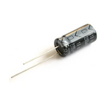
Equipment Needed
NI-ELVIS II including
  Function Generator
  Digital Multimeter (DMM)
  Oscilloscope
Resistance decade box
Capacitors, 0.01 μf, qty 2 (discrete capacitors)

Slide 62
Background
A capacitor is formed whenever two conductors are separated by an insulating material.
Consider the simple example of two parallel conducting plates separated by a small gap that is filled with an insulating material (vacuum, air, glass, or other dielectric).
If a potential difference exists between the two plates, then an electric field exists between them, and opposite electric charges will be attracted to the two plates.
The ability to store that electric charge is a fundamental property of capacitors.
The larger the plates, the more charge can be stored. The closer the plates, the more charge can be stored…at least until the charges leap the gap and the dielectric breaks down.

Slide 63
Background contd…
If a voltage source is connected across a capacitor, charge will flow in the external circuit until the voltage across the capacitor is equal to the applied voltage.
The charge that flows is proportional to the size of the capacitor (its “capacitance”) and to the applied voltage.
The relationship is given by the equation
Q = CV
where Q is the charge in coulombs, C is the capacitance in farads, and V is the applied voltage in volts.

Slide 64
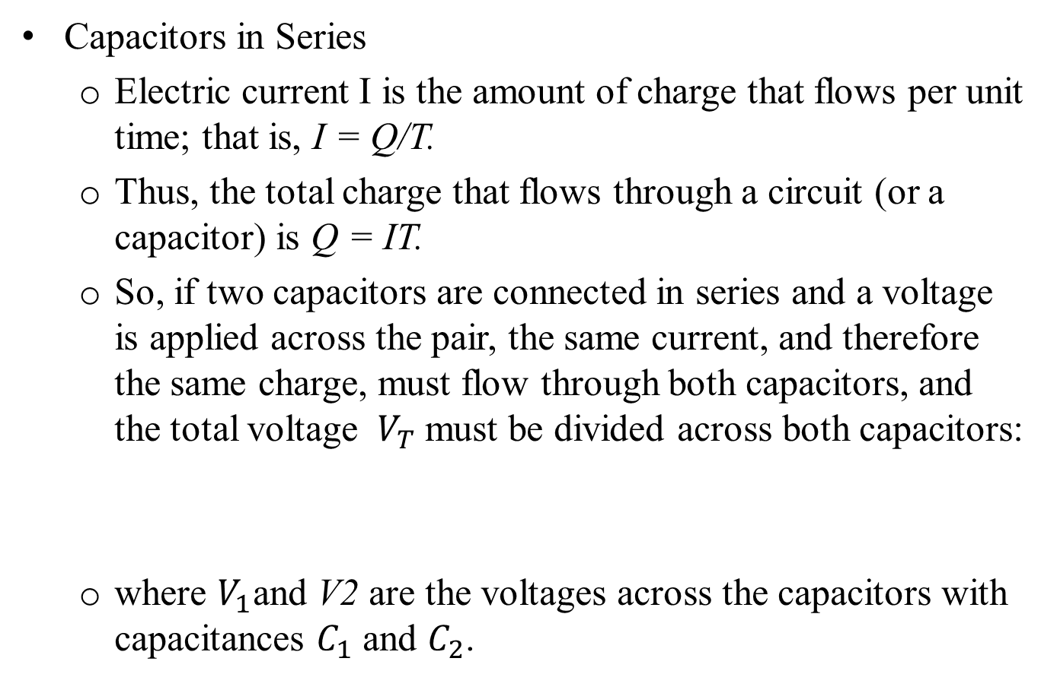
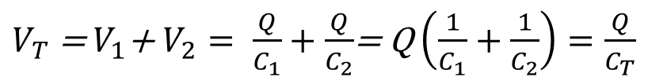
Background contd…
Capacitors in Series
  Electric current I is the amount of charge that flows per unit time; that is, I = Q/T.
  Thus, the total charge that flows through a circuit (or a capacitor) is Q = IT.
  So, if two capacitors are connected in series and a voltage is applied across the pair, the same current, and therefore the same charge, must flow through both capacitors, and the total voltage ${ V}_{T}$must be divided across both capacitors:
  where $V_{1}$and V2 are the voltages across the capacitors with capacitances $C_{1}$ and $C_{2}$.
$V_{T}$ = $V_{1}$+ $V_{2}= \frac{Q}{C_{1}}+\frac{Q}{C_{2}}$= Q $\left(\frac{1}{C_{1}}+\frac{1}{C_{2}}\right)=\frac{Q}{C_{T}}$

Slide 65
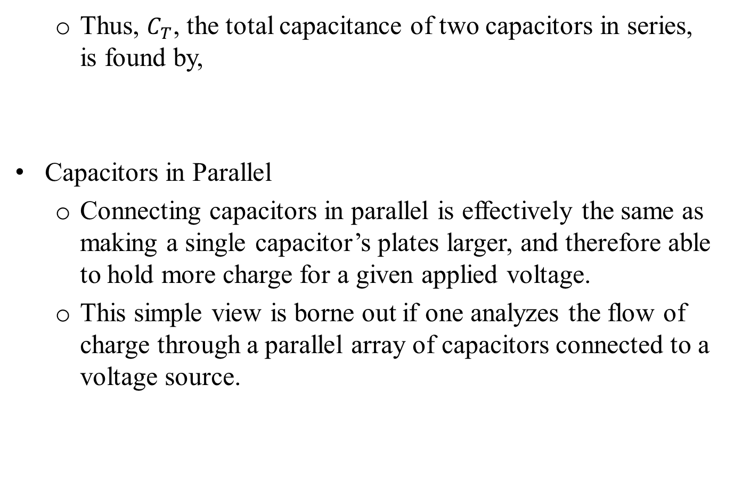
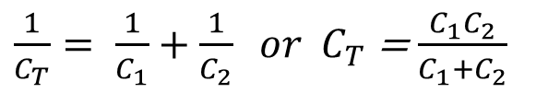
Background contd…
  Thus, $C_{T}$, the total capacitance of two capacitors in series, is found by,
  Capacitors in Parallel
  Connecting capacitors in parallel is effectively the same as making a single capacitor’s plates larger, and therefore able to hold more charge for a given applied voltage.
  This simple view is borne out if one analyzes the flow of charge through a parallel array of capacitors connected to a voltage source.
$\frac{1}{C_{T}}= \frac{1}{C_{1}}+\frac{1}{C_{2}} or$ $C_{T}$ = $\frac{C_{1}C_{2}}{C_{1}+C_{2}}$

Slide 66
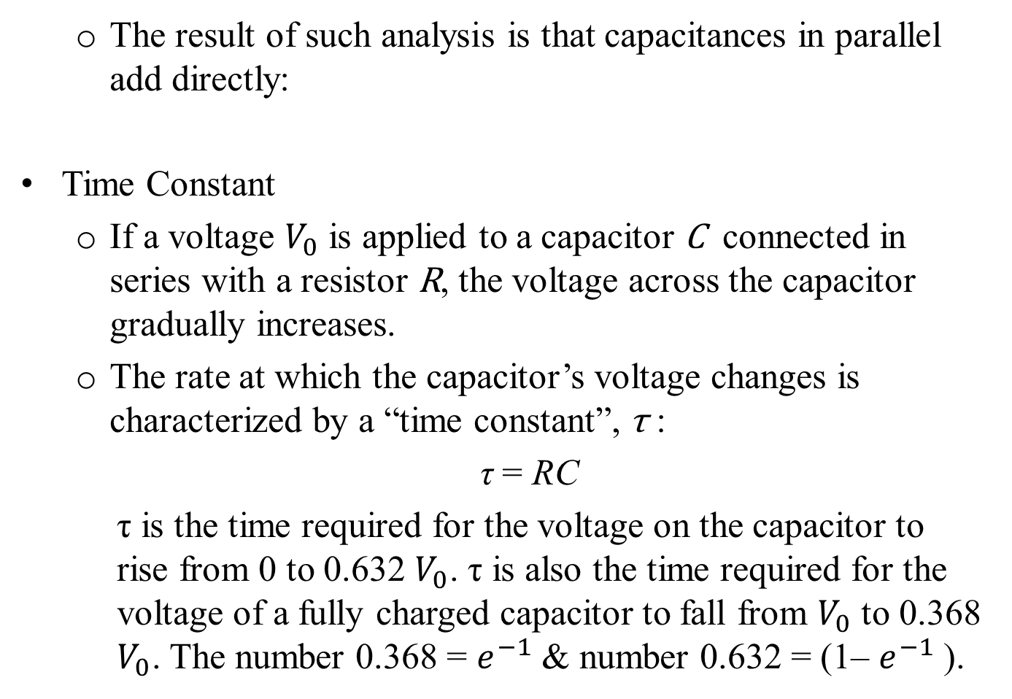

Background contd…
  The result of such analysis is that capacitances in parallel add directly:
  Time Constant
  If a voltage $V_{0}$ is applied to a capacitor C connected in series with a resistor R, the voltage across the capacitor gradually increases.
  The rate at which the capacitor’s voltage changes is characterized by a “time constant”, τ :
  τ = RC
  τ is the time required for the voltage on the capacitor to rise from 0 to 0.632 $V_{0}$. τ is also the time required for the voltage of a fully charged capacitor to fall from $V_{0}$ to 0.368 $V_{0}$. The number 0.368 = $e^{−1}$ & number 0.632 = (1– $e^{−1}$ ).
$C_{T}$ = $C_{1}$+ $C_{2}+C_{3}+ ….$

Slide 67
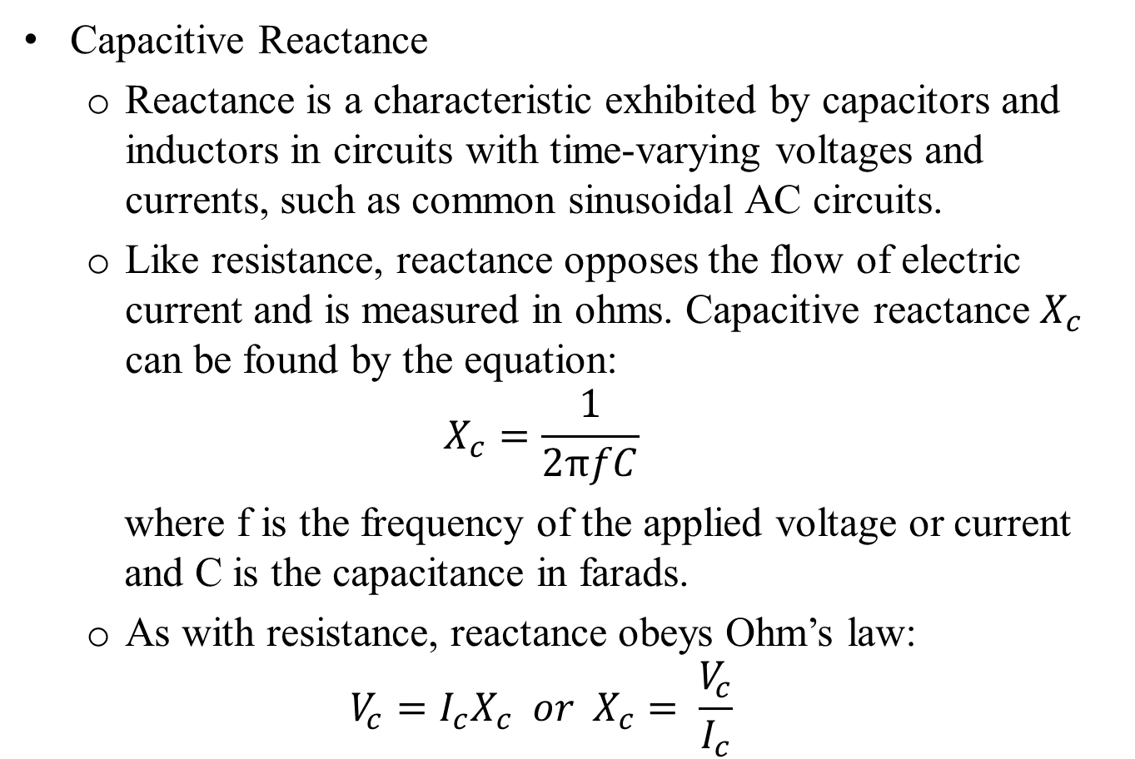
Background contd…
  Capacitive Reactance
  Reactance is a characteristic exhibited by capacitors and inductors in circuits with time-varying voltages and currents, such as common sinusoidal AC circuits.
  Like resistance, reactance opposes the flow of electric current and is measured in ohms. Capacitive reactance $X_{c}$ can be found by the equation:
  $$X_{c}=\frac{1}{2πfC}$$
  where f is the frequency of the applied voltage or current and C is the capacitance in farads.
  As with resistance, reactance obeys Ohm’s law:
  $$V_{c}=I_{c}X_{c} or{ X}_{c}= \frac{V_{c}}{I_{c}}$$

Slide 68
Background contd…
  If a sinusoidal voltage is applied across a resistor, the current through the resistor is in phase with the voltage. That is not true for a capacitor.
  If we connect a capacitor across a sinusoidal voltage, the maximum current flows through the capacitor when the voltage’s rate of change is maximum (i.e., at V=0), and diminishes as the voltage on the capacitor increases, until finally the current is zero when the voltage is at maximum and its derivative is zero.
  At that instant, the maximum possible charge for the applied voltage is stored in the capacitor, and so the flow of charge (i.e., the current) stops.

Slide 69
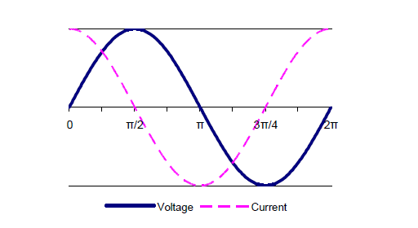
Background contd…
  The current and the voltage have exactly the same frequency, but the current through the capacitor is leading the voltage by ¼ cycle — 90° or π/2 radians. Figure 3.1 below illustrates this relationship.
Figure 3.1

Slide 70
Background contd…
Phasors
  When a sinusoidal voltage at frequency f drives a circuit that contains only linear elements, the waveforms throughout the circuit are also sinusoidal and at the same frequency.
  To understand the relationships among the sinusoidal voltages, currents, and impedances, we represent the various waveforms as two-dimensional vectors called phasors.
  A phasor is a complex number used to represent a sinusoidal wave, taking into account both its amplitude and phase angle.

Slide 71
Background contd…
  As a complex number, a phasor has “real” and “imaginary” components, but like any two-dimensional vector, it can be drawn simply on ordinary XY axes, with the “real” axis in the usual X direction and the “imaginary” axis in the usual Y direction.
  Such phasor drawings are very helpful in analyzing circuits and understanding the relationships of the various voltages and currents.
  The algebra of complex numbers can then be used to perform arithmetic operations on the sinusoidal waves.
  Make no mistake: adding voltages or currents in an AC circuit without taking account of phase angles will lead to confusing and wrong results.

Slide 72
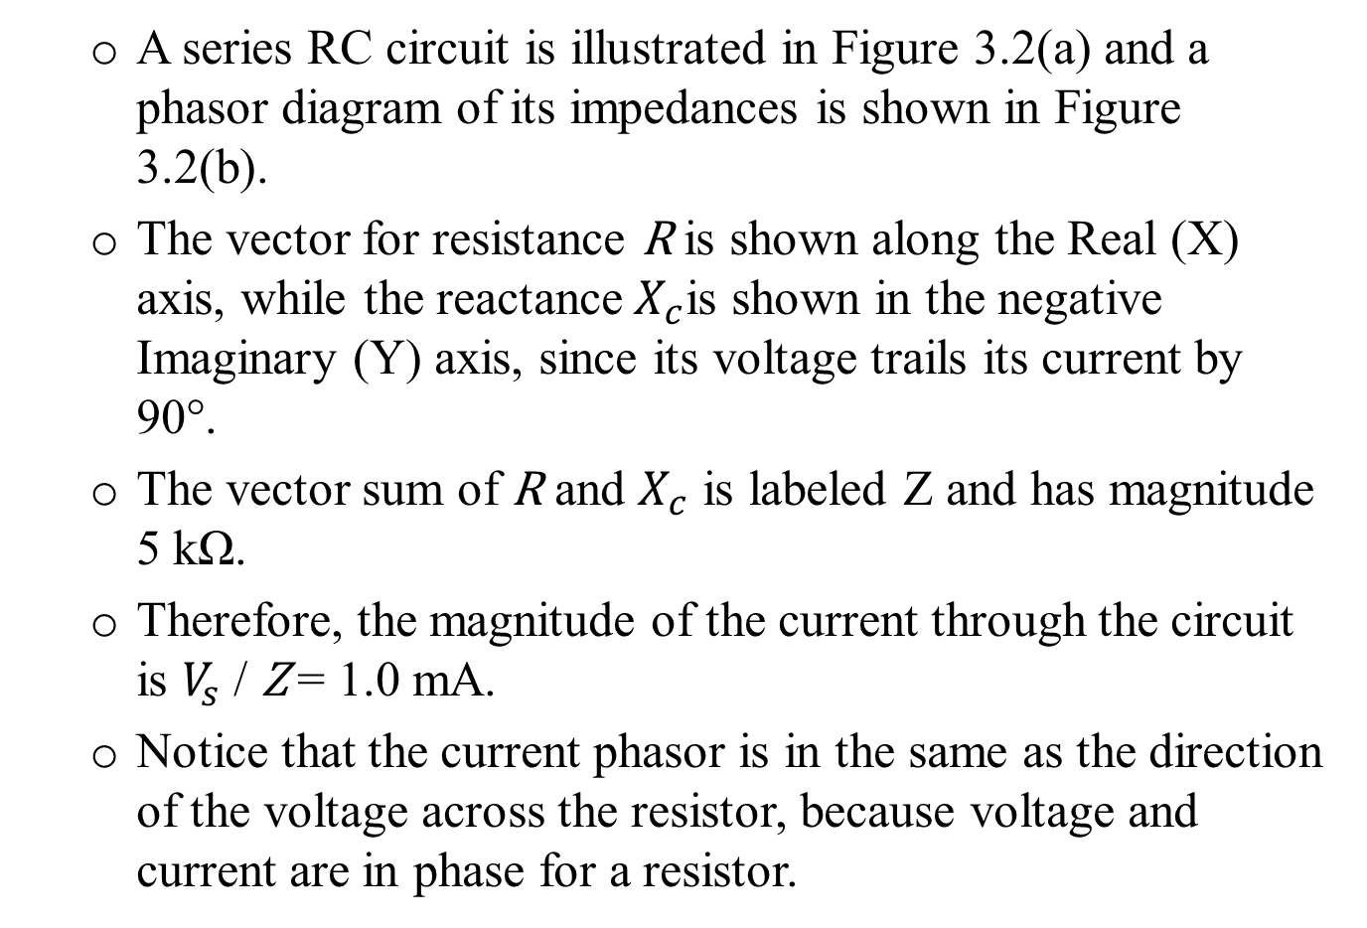
Background contd…
  A series RC circuit is illustrated in Figure 3.2(a) and a phasor diagram of its impedances is shown in Figure 3.2(b).
  The vector for resistance R is shown along the Real (X) axis, while the reactance${ X}_{c}$is shown in the negative Imaginary (Y) axis, since its voltage trails its current by 90°.
  The vector sum of R and $X_{c}$ is labeled Z and has magnitude 5 kΩ.
  Therefore, the magnitude of the current through the circuit is $V_{s}$ / Z = 1.0 mA.
  Notice that the current phasor is in the same as the direction of the voltage across the resistor, because voltage and current are in phase for a resistor.

Slide 73
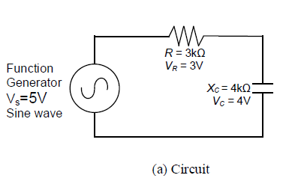
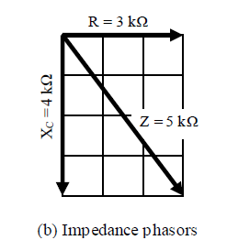
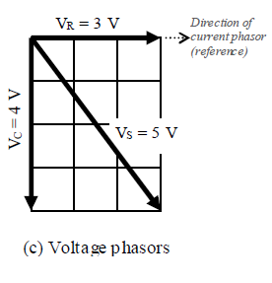
Background contd…
  The current is the same throughout the series circuit, including the capacitor, and the voltage across the capacitor trails the current by 90°.
  The source voltage is the vector sum of the voltages across the resistor and the capacitor, as is illustrated in the phasor diagram, Figure 3.2(c)..
Figure 3.2

Slide 74
Safety Precautions
Always turn off power to the circuit when changing the circuit.
Failure to turn off power when making circuit changes is a major reason for blowing fuses in the equipment, thereby rendering the equipment unusable and wasting your time and that of others.
Please carefully check circuit wiring, resistor settings, and voltage settings before applying power to the circuits.
Only reapply power after verifying that the circuit is properly wired and that the voltage to be applied is at or below the required value.

Slide 75
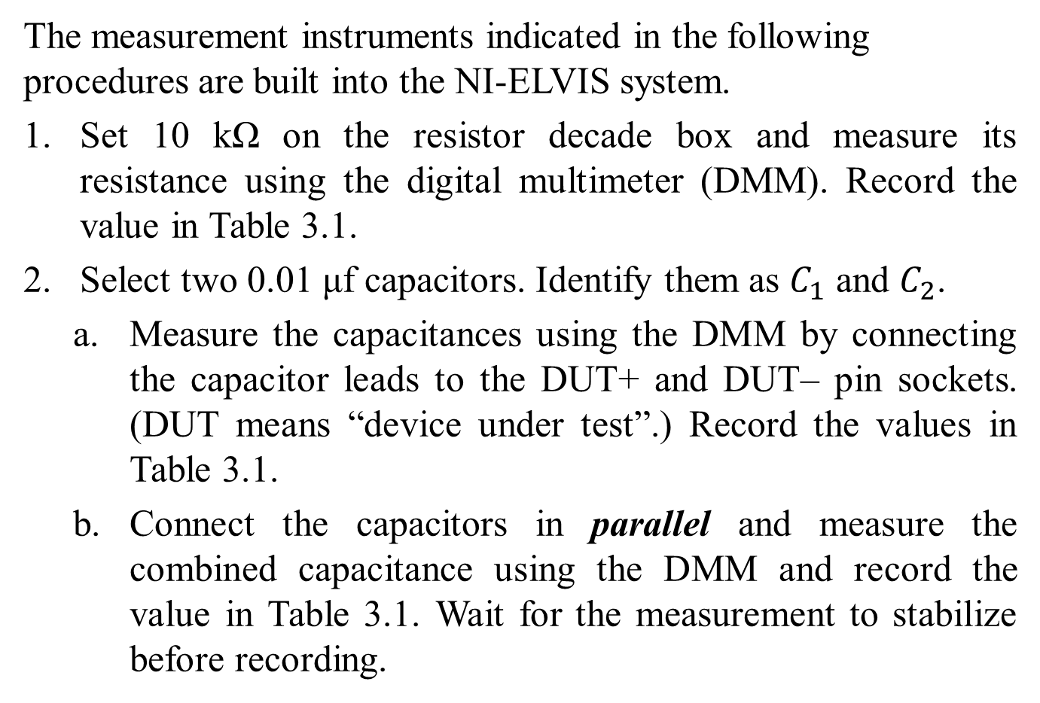
Procedure
The measurement instruments indicated in the following procedures are built into the NI-ELVIS system.
Set 10 kΩ on the resistor decade box and measure its resistance using the digital multimeter (DMM). Record the value in Table 3.1.
Select two 0.01 μf capacitors. Identify them as $C_{1}$ and $C_{2}$.
  Measure the capacitances using the DMM by connecting the capacitor leads to the DUT+ and DUT– pin sockets. (DUT means “device under test”.) Record the values in Table 3.1.
  Connect the capacitors in parallel and measure the combined capacitance using the DMM and record the value in Table 3.1. Wait for the measurement to stabilize before recording.

Slide 76
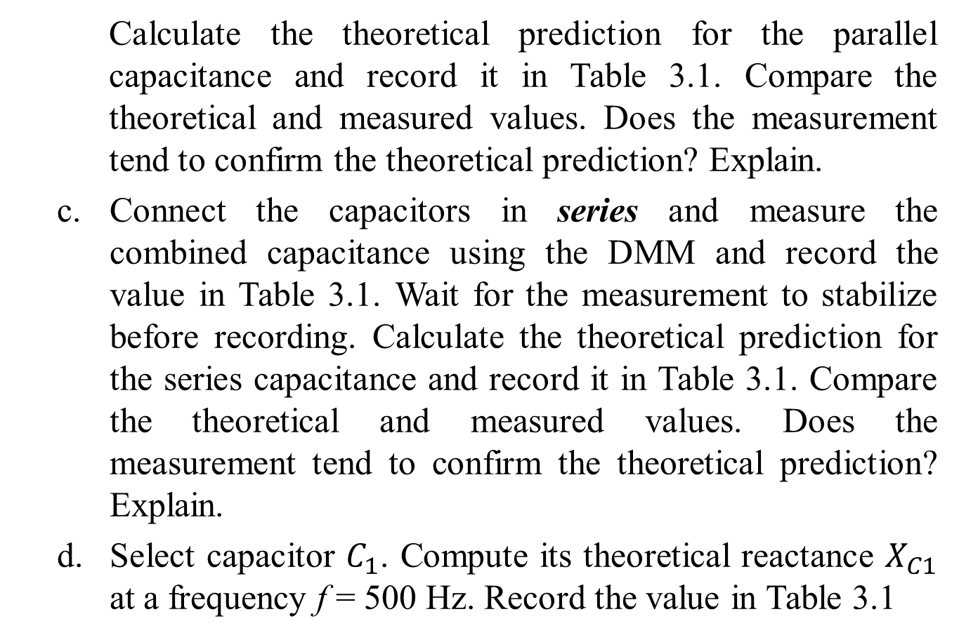
Procedure contd…
  Calculate the theoretical prediction for the parallel capacitance and record it in Table 3.1. Compare the theoretical and measured values. Does the measurement tend to confirm the theoretical prediction? Explain.
  Connect the capacitors in series and measure the combined capacitance using the DMM and record the value in Table 3.1. Wait for the measurement to stabilize before recording. Calculate the theoretical prediction for the series capacitance and record it in Table 3.1. Compare the theoretical and measured values. Does the measurement tend to confirm the theoretical prediction? Explain.
  Select capacitor $C_{1}$. Compute its theoretical reactance $X_{C1}$ at a frequency f = 500 Hz. Record the value in Table 3.1

Slide 77
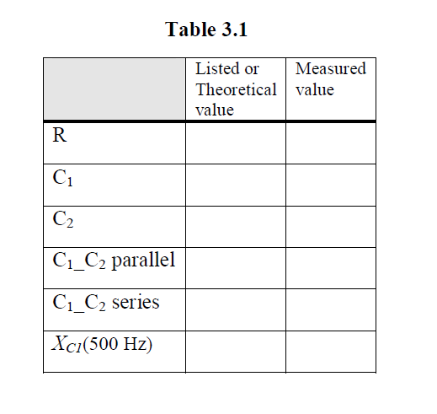
Procedure contd…
For steps 3 through 6, record the results of the measurements in Table 3.2. Throughout the experiment measure all voltages as peak-to-peak values.

Slide 78
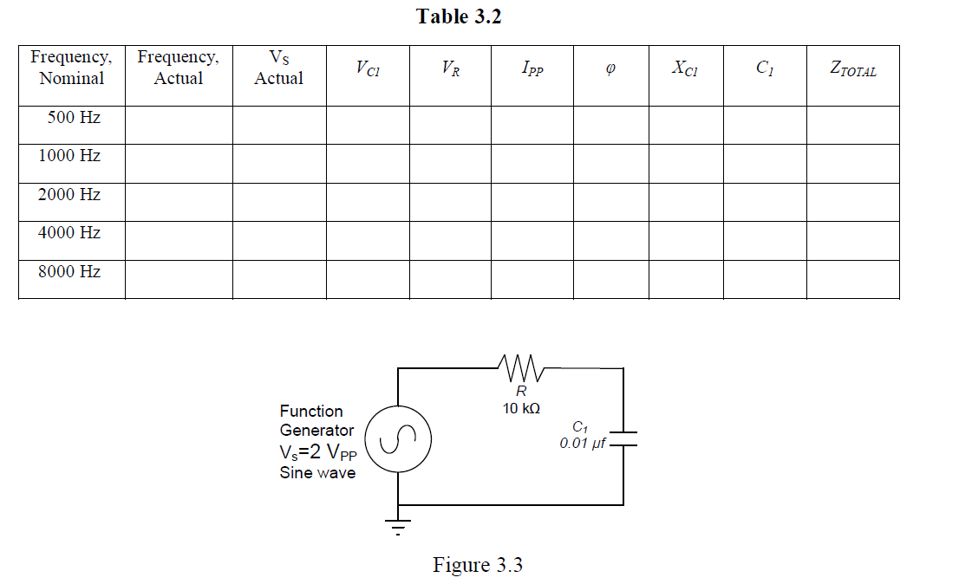
Procedure contd…

Slide 79
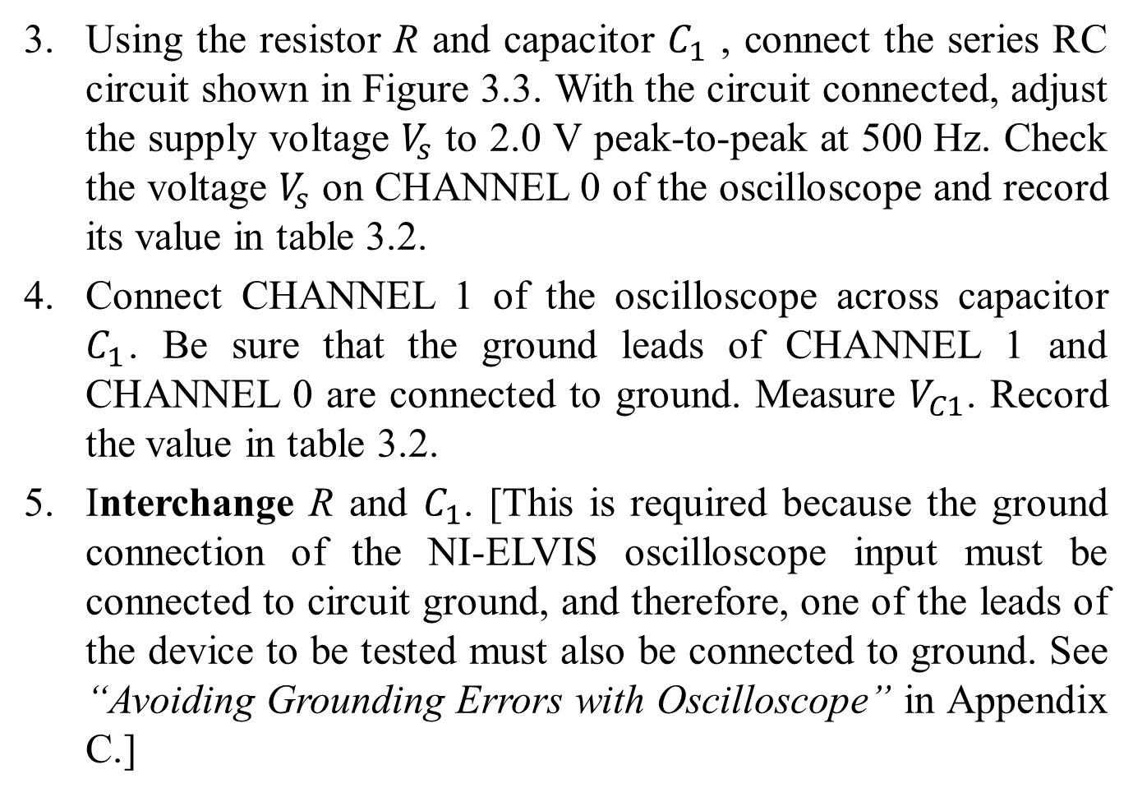
Procedure contd…
Using the resistor R and capacitor $C_{1}$ , connect the series RC circuit shown in Figure 3.3. With the circuit connected, adjust the supply voltage $V_{s}$ to 2.0 V peak-to-peak at 500 Hz. Check the voltage $V_{s}$ on CHANNEL 0 of the oscilloscope and record its value in table 3.2.
Connect CHANNEL 1 of the oscilloscope across capacitor $C_{1}$. Be sure that the ground leads of CHANNEL 1 and CHANNEL 0 are connected to ground. Measure $V_{C1}$. Record the value in table 3.2.
Interchange R and $C_{1}$. [This is required because the ground connection of the NI-ELVIS oscilloscope input must be connected to circuit ground, and therefore, one of the leads of the device to be tested must also be connected to ground. See “Avoiding Grounding Errors with Oscilloscope” in Appendix C.]

Slide 80
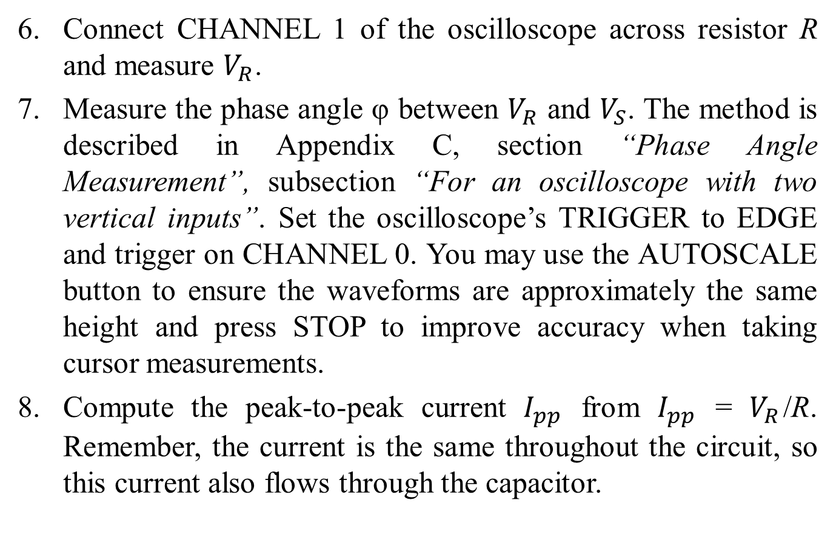
Procedure contd…
Connect CHANNEL 1 of the oscilloscope across resistor R and measure $V_{R}$.
Measure the phase angle φ between $V_{R}$ and $V_{S}$. The method is described in Appendix C, section “Phase Angle Measurement”, subsection “For an oscilloscope with two vertical inputs”. Set the oscilloscope’s TRIGGER to EDGE and trigger on CHANNEL 0. You may use the AUTOSCALE button to ensure the waveforms are approximately the same height and press STOP to improve accuracy when taking cursor measurements.
Compute the peak-to-peak current $I_{pp}$ from $I_{pp}$ = $V_{R}$/R. Remember, the current is the same throughout the circuit, so this current also flows through the capacitor.

Slide 81
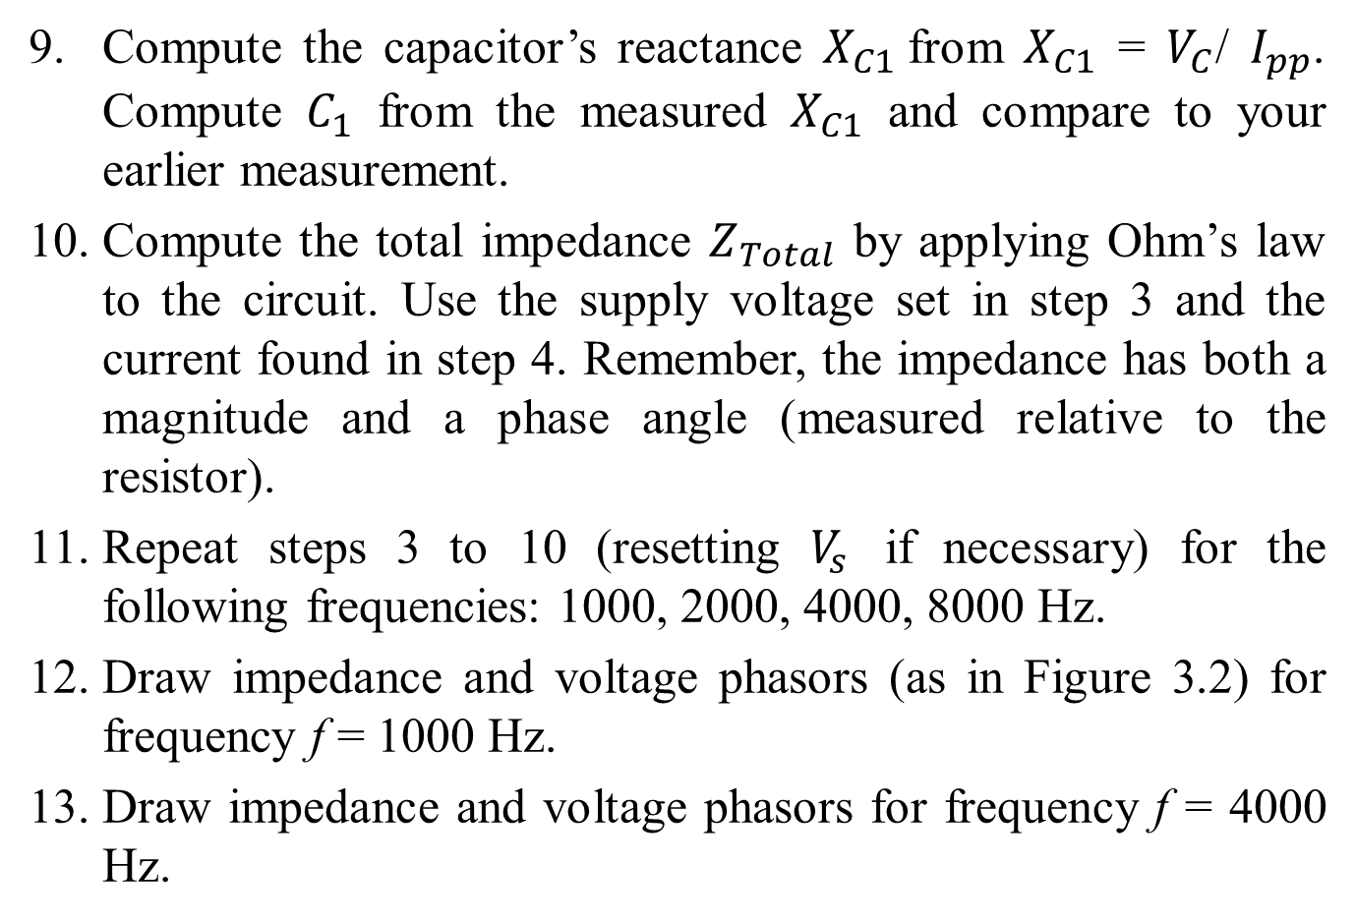
Procedure contd…
Compute the capacitor’s reactance $X_{C1}$from $X_{C1}$ = $V_{C}$/ $I_{pp}$. Compute $C_{1}$ from the measured $X_{C1}$ and compare to your earlier measurement.
Compute the total impedance $Z_{Total}$ by applying Ohm’s law to the circuit. Use the supply voltage set in step 3 and the current found in step 4. Remember, the impedance has both a magnitude and a phase angle (measured relative to the resistor).
Repeat steps 3 to 10 (resetting $V_{s}$ if necessary) for the following frequencies: 1000, 2000, 4000, 8000 Hz.
Draw impedance and voltage phasors (as in Figure 3.2) for frequency f = 1000 Hz.
Draw impedance and voltage phasors for frequency f = 4000 Hz.

Slide 82

Procedure contd…
The phasor diagrams at various frequencies show how the impedances, and therefore the voltages, change with frequency. To better see the net effect on the circuit, graph $V_{C1}$ and $V_{R}$ versus frequency for the values in Table 3.2. Label the curves.

Slide 83
Lab 3-Student Tasks
Describe what happens to the current in this RC series circuit as the frequency increases. Explain in general terms why the observed change should occur.
Simulate the circuit in B2-SPICE and graph VC1 and VR versus frequency over the range of values in Table 3.2. Compare to your manually drawn curves. [Instructions for setting up the necessary AC simulation in B2-SPICE are shown in Appendix D.]
In this experiment it was shown that the voltage phasor diagram can be obtained by multiplying each of the impedance phasors by the current in the circuit. If each of the voltage phasors in the voltage phasor diagram is again multiplied by the current, the resulting diagram is the power phasor diagram. Using the data in Table 3.2 convert the

Slide 84

Lab 3-Student Tasks contd…
current I and source voltage $V_{S}$ to RMS values. Then draw a plot of the power phasor diagrams at a frequency of 1000 Hz and another at a frequency of 4000 Hz. Determine the real power, the reactive power, and the apparent power in the RC circuit at those frequencies.

Slide 85
Preparations for Next Week
Reading:- (1) Study the Background section of this Laboratory experiment. (2) Review Appendix C, especially Avoiding Grounding Errors with Oscilloscope, and Phase-Angle Measurement for an oscilloscope with two vertical inputs.
Written:- (1) In your lab notebook sketch the circuit diagram to be used in the procedure. (2) Prepare tables to record the data. (3) Sketch the impedance and voltage phasors diagrams (as in Figure 4.2) you would get at 10 kHz for the circuit in Figure 4.3, using nominal values for the components. Make a table of the magnitudes and phase angles. You will use this to check that your experimental setup is correct.

Slide 86
References
ECE 212 – Electrical Engineering Lab II. Latest Revised January 2010.
http://www.tvrepairkits.com/xcart/1000uf-16v-high-temp-capacitor.html.

Slide 87
Thank you !!!

Slide 88
ECE 212 - Electrical Engineering Lab IV
Pre-labs for ECE 212
Douglas Dawson
Created: 02/16/2013 Updated: 02/23/2013

Slide 89
Inductors and Series RL Circuits

Slide 90
Introduction
In this lab, we will investigate circuits with resistors and inductors and AC voltage sources.
By the end of the lab you should be able to:
  Be able to predict and measure inductive reactance.
  Be able to apply Ohms law for RL circuits
  Be able to construct phasor diagrams for impedances and voltages
  Be able to calculate the complex power for AC circuits and create power phasor diagrams
By studying the voltage phasor diagrams, we will be able to verify Kirchhoff’s Voltage Law.

Slide 91
Background:
Inductors are coils of wires.
When current flows through the coil, a magnetic field is formed.
As the current changes, the magnetic field will also change a voltage is induced opposing the change in current.
Thus, the voltage across the inductor is proportional to the change in current:
So, if , then
Or, in phasor form:

Slide 92
Background

Slide 93
Background
The inductive reactance is given by:
The inductive impedance is given by:
Suppose we have the following circuit:
with
Then:

Slide 94
Background: Phasors
Impedance Phasor:
Voltage Phasor:

Slide 95
Background: Power
The complex power for an element is related to the RMS current through and RMS voltage across it:
For our previous circuit:
Thus:
Reminder: In the lab you will be using peak-to-peak, voltages and currents not peak. So:

Slide 96
Background: Power Phasor
Power Phasor:

Slide 97
Objectives
Experimental Objectives:
  Determine the reactance of an inductor in a series RL circuit by measuring voltages.
  Draw impedance and voltage phasor diagrams for a series RL circuit.
  Determine the real, reactive, and apparent power for a series RL circuit.
  Explain the effect of frequency on the impedance and voltage phasors for a series RL circuit

Slide 98
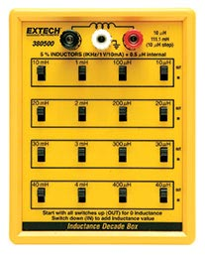
Equipment
NI-ELVIS workstation
Resistor, (Discrete or substitution box)
Inductor,

Slide 99
Procedure
The measurement instruments indicated in the following procedures are built into the NI-ELVIS system. Use peak-to-peak readings for all voltage and current measurements in this experiment.
Construct a table for recording experimental data:
R | L | f | Vs (gen) | Vs (osc) | V_{R} | V_{L} | I | X_{L} | Z_{T} | Phi (meas) | Phi (calc)

Slide 100
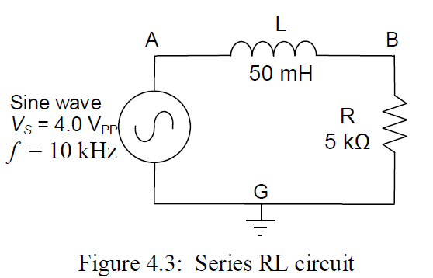
Procedure
Select a 5 kΩ resistor or set that value on the resistor decade box. Measure its resistance using the digital multimeter (DMM) and record the measured value.
Select a 50 mH inductor or set that value on the inductor decade box. Measure its inductance L and winding resistance R_{W} using the DMM and record the value. To measure inductance requires connecting the leads to DUT+ and DUT–, as you did for the capacitor.
Construct the circuit shown in Figure 4.3. With the circuit connected, adjust the function generator’s frequency f to 10 kHz with an output voltage of 4.0 V_{PP}. Record the actual values of f and V_{S} (generator).

Slide 101
Procedure
Using the 2-channel oscilloscope, connect CHANNEL 0 to measure V_{S}, the voltage across the source (nodes A and G). Connect CHANNEL 1 to measure V_{R}, the voltage across the resistor (nodes B and G). Be sure that the ground leads are both connected to the same point (node G). Record V_{S} (Oscilloscope) and V_{R}.
With the oscilloscope still connected as in step 5, measure the phase angle φ between V_{R} and V_{S}. The method is described in Appendix C, section “Phase Angle Measurement”, subsection “For an oscilloscope with two vertical inputs”. Set the TRIGGER to EDGE and trigger on CHANNEL 0. You may use the AUTOSCALE button to ensure the waveforms are approximately the same height and press STOP to improve accuracy when taking cursor measurements. Record this value as φ_{meas} in the table.
Interchange R and L. [This is required because the ground connection of the NI-ELVIS oscilloscope input must be connected to circuit ground, and therefore, one of the leads of the device to be tested must also be connected to ground.] Connect CHANNEL 1 of the oscilloscope across the inductor L and measure V_{L}. Record the value.

Slide 102
Procedure
Calculate the peak-to-peak current in the circuit by applying Ohm's law to the resistor. That is,
Record the calculated current I in the table.
Calculate the inductive reactance X_{L} by applying Ohm's law to the inductor. That is,
Record the calculated reactance in the table.
Calculate the total impedance Z_{T} by applying Ohm's law to the entire circuit.
Record the value of Z_{T} in the table.

Slide 103
Procedure
Using the values listed in the table, draw a diagram of the impedance phasors and a second diagram of the voltage phasors, as illustrated in Figure 4.2 of the Background section of this laboratory experiment.
Compute the phase angle φ between V_{S} and V_{R}. Recall that
Record this value as φ_{calc} in the table, and compare it to the value measured on the oscilloscope.
Using the data in the table, convert the current I and source voltage V_{S} to RMS values. Then draw plots of the power phasor diagrams at the frequency of 10k Hz. Determine the real power, the reactive power, and the apparent power in the R_{L} circuit at that frequency.

Slide 104
Preparations for Next Week
Reading:
  Study the Background section of Lab 5.
Written:
  In your lab notebook sketch the circuit diagrams to be used in the procedure.
  Prepare tables to record data.

Slide 105
ECE 212 - Electrical Engineering Lab V
Pre-labs for ECE 212
Raihan Hazarika
Created: 02/16/2013 Updated: 02/23/2013

Slide 106
Parallel RC & RL Circuits

Slide 107

Background
In parallel circuit voltage across all the components remain the same, so voltage is the logical and appropriate reference.
In parallel circuits, Kirchhoff’s current law applies to any junction, however the currents need to be added in phasor. Current entering a junction is always equal to the current leaving the junction.
In a parallel circuit, if the impedance of each branch is known, then the current in that branch can be determined directly from the applied voltage and Ohm's law.
For both RC and RL circuits, the Pythagorean theorem and ordinary vector addition can be applied to the current phasors to determine the magnitude of the total current I_{T}

Slide 108
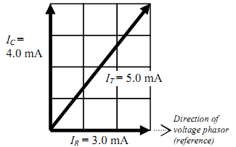
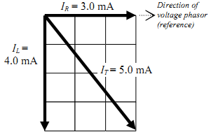
Current Phasor diagram for a parallel RC circuit. The current in the capacitor is shown at +90° from the voltage reference because the current leads the voltage in a capacitor. The current in the resistor is along the x-axis because current and voltage are in phase in a resistor.
The current in an ideal inductor is at -90° from the voltage reference, because the current lags the voltage in an inductor. However, practical inductors contain resistance that often is large enough to affect the phasor.
Figure 1

Slide 109
Objective
Apply Kirchhoff’s voltage law (KVL) and Kirchhoff’s current law (KCL) in parallel circuits.
2. Draw current phasor diagrams for parallel circuits.
Gain experience in the construction and use of phasor diagrams.
Gain experience in calculating real, reactive, and apparent power

Slide 110
Pre-Lab
Reading:
Study the Background section of this Laboratory.
Written:
In your lab notebook sketch the circuit diagrams to be used in the procedure.
2. Prepare tables to record data.

Slide 111
Equipments Needed
1. NI-ELVIS II
- Function generator
- Oscilloscope
- Digital Multimeter
Resistor, 10 kΩ
Resistor, 2.2 kΩ
Resistor, 100 Ω, Qty 2 (discrete)
Resistor, 22 Ω, Qty 2 (discrete)
Inductor, 100mH
Capacitor, 0.01 µF
Components may be discrete or via decade substitution boxes, unless otherwise indicated.

Slide 112
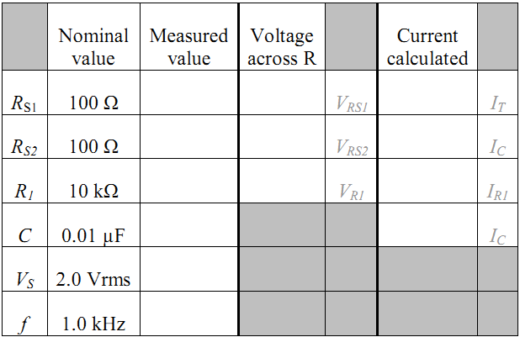
Procedure: Parallel RC Circuit
Create a table similar to the one below for recording experimental data: R₁, R_{S1}, R_{S2}, C, f, V_{S},V_{RS1}, V_{RS2}, V_{R1}, I_{T}, I_{C}, I_{R1}.
Table 1

Slide 113
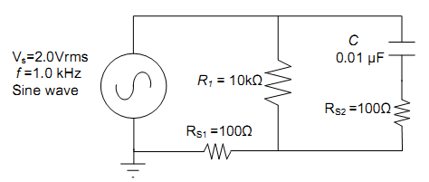
2. Measure circuit components using the DMM: one 10 kΩ resistor, two 100 Ω sense resistors, and one 0.01 µF capacitor. (Be sure to wait until the capacitance measurement stabilizes.) Record the measured values in Table
3. Construct the circuit shown in Figure 1 . Set the function generator to provide a sinewave with a voltage of 2.0 Vrms at 1.0 kHz. Verify the voltage and frequency with your oscilloscope while the circuit is connected and operating; adjust if necessary.
Figure 2

Slide 114
4. Using the DMM voltmeter in AC mode [V~], measure the voltage drop across each resistor. The voltage drops are small, so measure as accurately as possible and keep three significant figures in your measurement. Record the voltage drops in Table 1.
5. Compute the current in each resistor using Ohm's law, and record the calculated currents in Table 1.
6. Draw the current phasors I_{R1}, I_{C}, and the total current I_{T} in a plot similar to that of Figure 1. The total current is through sense resistor R_{S1}. The current I_{C} is through sense resistor R_{S2}. Ignore the small effect of the sense resistors on the phasor diagram. Note carefully the direction of the phasors. Label each of the current phasors.
7. Compute X_{C} for the 1.0 kHz frequency and record the value in Table 2. Using this value and that of the sense resistor, calculate the expected current, I_{C}, through the capacitor. Record the value in the available space in Table 1 on the line listing the capacitor’s value. How does this value compare to that found from the sense resistor?

Slide 115
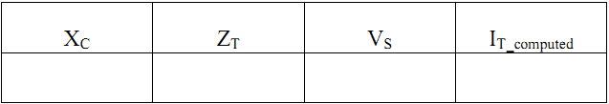
Table 2
8. Using the value of X_{C} for the 1.0 kHz frequency and the measured resistance of R₁, find the total impedance, Z_{T}, of the circuit. Remember that these impedances add like parallel resistors. Ignore the sense resistors for this calculation. Show your work.
9. Using Z_{T} and the applied voltage, V_{S}, compute the total current, I_{T}. Show your work. The total current should reasonably agree with the value determined in step 5.
10. Change the frequency to 2.0 kHz at 2.0 Vrms. Repeat steps 4, 5, and 6, recording the results in a separate table.

Slide 116
Probing Further
Ignoring the effect of the sense resistors, compute the real, reactive, and apparent power of the circuit in Figure 5.3 at 1.0 kHz and at 2.0 kHz.
Explain how increasing the frequency affected (a) the total impedance of the circuit and (b) the phase angle between the function generator's voltage and the function generator's current.
If the capacitor C were made smaller, what would happen to the current phasor diagrams?

Slide 117
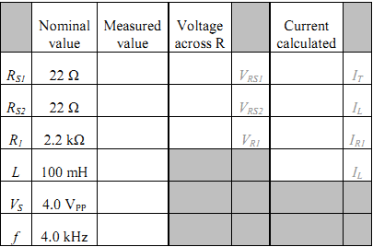
Procedure: Parallel RL circuit
1. Create a table similar to the one below for recording experimental data: R₁, R_{S1}, R_{S2}, L, f, V_{S}, V_{RS1}, V_{RS2}, V_{R1}, I_{T}, I_{L}, I_{R1}.
Table 3

Slide 118
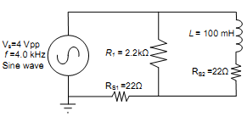
Using the DMM, measure the actual values of a 2.2 kΩ resistor, two 22 ohm resistors and a 100 mH inductor.
3. Measure the winding resistance of the inductor, RW, with an ohmmeter.
Figure 3
4. Construct the circuit shown in Figure 5.4. Using the oscilloscope’s CHANNEL 0 to monitor the function generator, set the source voltage to a sine wave with a voltage of 4.0 VPP at 4.0 kHz. Verify both the voltage and the frequency with the oscilloscope.

Slide 119
5. Using oscilloscope CHANNEL 1, measure the peak-to-peak voltage across R_{S1}. Apply Ohm's law to calculate the peak-to-peak value of the total current, I_{T}.
6. Because RS1 is small compared to R₁, the source voltage V_{S} is very nearly the voltage across the resistor R₁. Furthermore, since only resistors are in that loop, the phase of the voltage across R₁ — and current through R₁ — is the same as the phase of the source voltage V_{S}.
With CHANNEL 0 of the oscilloscope displaying the voltage across the function generator (V_{S}), and CHANNEL 1 displaying the voltage across R_{S1}, measure the phase angle between the generator voltage, VS, and the generator current, I_{T}, (i.e., the current flowing through R_{S1}). This is equivalently the phase angle between I_{R1} and I_{T}. To make the measurement, set the scope’s TRIGGER to EDGE and trigger on CHANNEL 0.
Use the AUTOSCALE button to ensure the waveforms are approximately the same height. You may press STOP to improve accuracy when taking cursor measurements. Record the measured phase angle between I_{R1} and I_{T}.

Slide 120
7. Replace the sense resistor R_{S1} with a jumper wire. CHANNEL 0 is still measuring the output voltage of the function generator, which now is also the voltage across R₁. Connect CHANNEL 1 of the oscilloscope across sense resistor R_{S2}. Record the voltages across R₁ and across R_{S2}. Apply Ohm's law to calculate the current in each branch of the circuit, and record the currents. Since L is in series with R_{S2}, enter the same current for both in Table 5.3.
8. Using the computed peak-to-peak currents from Table 5.3, draw the current phasor diagram for the circuit. Ignore the effects of the sense resistors. Your diagram should look somewhat similar to Figure 5.2 (b).
9. The phasor diagram depicts visually the relationship between the total current and the currents in each branch of the circuit. From the currents in the phasor diagram, compute the phase angle between the total current (I_{T}) and the current in R₁ (I_{R1}). Then compute the phase angle between the total current (I_{T}), and the current in L (I_{L}). Ideally, what should be the sum of these angles?

Slide 121
10. On the oscilloscope, measure the angle between I_{L} and I_{R1}. (The oscilloscope’s leads were already connected to do this as a result of step 7.) Ideally, this measurement should be 90°, but resistance in the inductor, may reduce the angle. If necessary, adjust both scope channels to have the same apparent height on the oscilloscope screen in order to make the measurement.
11. In step 6 you measured the phase angle Φ_{RT} between I_{R1} and I_{T}. In step 10 you measured the phase angle Φ_{RL} between I_{R1} and I_{L}. Compute the phase angle Φ_{TL} between I_{T} and I_{L} by subtracting Φ_{RT} from Φ_{RL}. That is, Φ_{TL} = Φ_{RL} – Φ_{RT}.
12. Construct a table that will allow easy comparison of the computed and measured phase angles from steps 6, 9, 10, and 11. Compare the measured phase angles versus the computed phase angles. Discuss likely causes for any discrepancies

Slide 122

Probing Further
The currents I_{R1} and I_{L} were measured in step 7. If those currents are 90° apart, we can calculate the total current I_{T} using the Pythagorean theorem:
a. Compare this calculated total current to the total current measured in step 5.
b. What factors might cause any discrepancies observed between the values?
2. What effect does the inductor’s coil resistance have on the phase angle between the currents in the resistor and the inductor?

Slide 123
ECE 212 - Electrical Engineering Lab VI
Pre-labs for ECE 212
Raihan Hazarika
Created: 02/16/2013 Updated: 02/23/2013

Slide 124
Circuit Resonance

Slide 125


Background
The reactance of inductors increases with frequency:
The reactance of capacitors decreases with frequency:
In an LC circuit, whether series or parallel, there is some frequency at which the magnitudes of these two reactances are equal. That point is called resonance.
Setting X_{L} = X_{C}, and solving for f, we find that the resonant frequency of an LC circuit .
The bandwidth of a resonant circuit is the frequency range over which the current is at least 70.7% of the maximum.
BW = f₂ – f₁

Slide 126
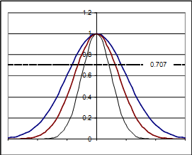
f1 and f2 are also defined as the half power frequency points, at which the power is ½ that at the peak frequency. Since power goes like the square of the current, the current at the half-power points is 1/sqrt( 2) = 0.707 times the current at the maximum.
Figure 1

Slide 127


As the bandwidth narrows, the circuit becomes more highly selective, responding to a narrow range of frequencies close to the center frequency. The sharpness (narrowness) of that resonant peak is measured by the quality factor Q. The quality factor is a unit less quantity that is defined as:
In more practical terms,

Slide 128
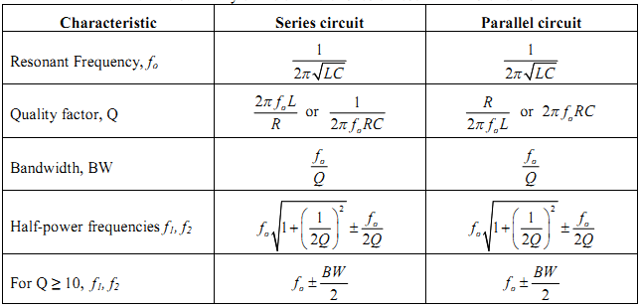
Summary of the characteristics of resonant RLC circuits
Table 1

Slide 129
Objectives
Learn the definition of resonance in AC circuits.
Learn to calculate resonant frequencies, band widths, and quality factors for series and parallel resonant circuits.
Learn to use NI-ELVIS’s Bode plot function to view circuit response.

Slide 130
Pre Lab
Reading:
Study the Background section of this Laboratory exercise.
Written:
In your lab notebook sketch the circuit diagram to be used in the procedure.
Prepare tables to record data.

Slide 131
Equipments used
NI-ELVIS II
- Function generator
- Oscilloscope
- Digital Multimeter
- Bode analyzer
2. Resistor, 100 Ω
Resistor, 10 Ω
Inductor, 100 mH
5. Capacitor, 0.01 µF

Slide 132
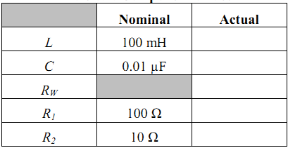
Procedure
Using the NI-ELVIS’s DMM, measure the values of the following components: 100mH inductor; 0.01µF capacitor; 100 Ω resistor; 10 Ω resistor. Also measure the winding resistance RW of the 100 mH inductor. Record the nominal and measured values in table as shown below.
Table 2

Slide 133
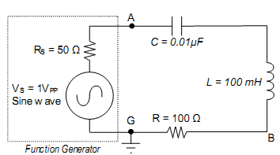
2. For the circuit shown in Figure 2, calculate predictions for f0, Q, BW, f1, and f2. Don’t forget to include the impedance of the function generator (RS ≈ 50 Ω) and RW as part of the total resistance in the circuit. Record the results in the first “predicted” column in a table such as Table 3
Figure 2

Slide 134
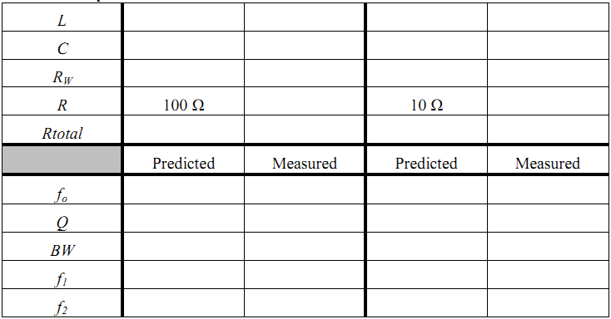
Table 3

Slide 135
3. Construct the circuit shown in Figure 2 Adjust the function generator to generate a sine wave with voltage 1.0 VPP. Initially set the frequency to 1 kHz.
4. Connect oscilloscope CHANNEL 0 across the function generator (FGEN and GND) and confirm that the voltage is 1.0 VPP.
5. Connect oscilloscope CHANNEL 1 across the resistor R and observe the voltage.
6. Using your predicted values as a guide, adjust the frequency of the function generator to tune for resonance, as observed on CHANNEL 1 of the oscilloscope. Measure the resonant frequency on the oscilloscope, and record the value in the first “measured” column of Table 3
Confirm that the voltage on CHANNEL 0 of the scope is 1.0 VPP, and adjust it if necessary. The current through the circuit and resistor R is proportional to the voltage across R. Record the voltage across resistor R
For steps 8 and 9, DO NOT adjust the voltage output of the function generator

Slide 136
8. Reduce the frequency on the function generator until the voltage across R is 70.7% of the initial value. This is the lower half-power point f₁. Record the measured frequency f₁ in the first “measured” column of Table 3.
9. Increase the frequency through resonance and continue to increase it until the voltage across R is 70.7% of the value at resonance. This is the upper half-power point f₂. Record the measured frequency f₂ in the first “measured” column
10. Calculate the bandwidth BW = f₂ – f₁. Record the result in the first “measured” column of Table 3.
11. Stop the function generator. Remove the 100 Ω resistor from the circuit and replace it with the 10 Ω resistor measured earlier.
12. Calculate predictions for resonant frequency, Q, BW, f₁, and f₂ and record the results in the second “predicted” column in Table 3.
13. Start the function generator and, as before, adjust the function generator to create a sine wave with voltage 1.0 VPP.

Slide 137
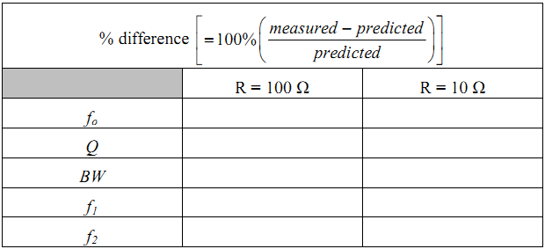
14. Repeat steps 5 through 10, recording the measured values in the second “measured” column.
15. Fill out Table 4, calculating the percent differences between predicted and measured values.
Table 4

Slide 138
16. Use the Bode (pronounced Bō´·dē) analyzer of the NI-ELVIS II to view the plot of the last circuit’s response. To do so:
[a] connect jumpers from the function generator to the Analog Inputs, i.e., FGEN (point A) to AI1+ and GND (point G) to AI1–;
[b] connect a jumper from the high side of the resistor (point B) to A0+;
[c] connect the a jumper from the low side of the resistor (point G) to A0–. Then start the Bode Analyzer. Set the frequency to cover the range of interest. Be sure to sample enough points for an adequate view of the circuit’s response. Turn on CURSORS to be able to locate specific values. The NI-ELVIS’s Help function can aid you in learning to use the analyzer to explore the plot.

Slide 139
Probing Further
From the measured L, C, resonant frequency, and BW, compute the total series resistance of the circuit. Suggest and explain likely causes for any discrepancy; what might not have been taken into account for the predictions?
Discuss the effect of changing the resistor R from 100 Ω to 10 Ω. How dramatic was the impact?
What would happen to the resonant frequency if the inductance were doubled and the capacitance cut in half? What would happen to the bandwidth? What would happen to the quality factor?
Simulate the second circuit (with R=10Ω) in B2-SPICE, using the AC Frequency Sweep (see Appendix D). In the simulation, set up a voltmeter across R and an ammeter to measure the total current. Be sure to have B2-SPICE display both graphs and a table of the results. Select an appropriate range of frequencies to sweep and sample at least 100 steps per interval. When the graph is displayed, right-click the graph and toggle the X-axis to be logarithmic. Do you see a sharp peak in the magnitude (dB) plots of voltage and current at the resonant frequency you predicted? Notice that the phase plot for the circuit rapidly changes from positive (capacitive) to negative (inductive) as the frequency passes through resonance. Record the resonant frequency indicated by the graph, and compare it to your calculated and measured values.

Slide 140
ECE 212 - Electrical Engineering Lab VII
Pre-labs for ECE 212
Raihan Hazarika
Created: 02/16/2013 Updated: 02/23/2013

Slide 141
Filters: High-pass, Low-pass, Bandpass & Notch

Slide 142
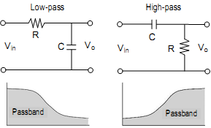
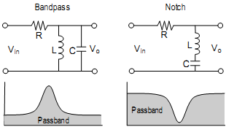
Background
The 4 different type of filters along with their schematics are shown below.
Figure 1
The grayed area is the passband, that is, the part of the signal that is passed to the output of the filter. The rejected portions are called the stopband. The frequency that separates the passband from the stopband is called the cutoff frequency. The cutoff frequency is equivalent to the half-power points discussed in Laboratory 6. The cutoff frequency is also sometimes called the corner frequency.

Slide 143

Cutoff Frequency for series RC and RL circuits
As mentioned, the cutoff frequency, sometimes called the corner frequency, is equivalent to the half-power points discussed in Laboratory 6. Since the power is half that at the peak, the voltage (or current) will be the peak voltage (or current) multiplied by 1/√2 = 0.707. For a simple 2-component RC or RL circuit, the half-power point will occur when half the power is dropped on the resistor and half on the capacitor or inductor. Thus, the cutoff frequency will occur when the
reactance of the capacitor or inductor equals the total series resistance in the circuit. That is,

Slide 144

decibels (dB)
As discussed in your textbook, the decibel (dB) is commonly used for the magnitude of voltages and currents in making Bode plots. Keep in mind that a decibel is a unit created to measure the transfer function for power gain (or loss) through a circuit module or stage:
Since power is proportional to the square of the voltage or the current, we have equivalently

Slide 145

Procedure
Low Pass Filter:
Obtain a 10 kΩ resistor and a 0.005 µF capacitor. Measure and record the actual values of the components.
Using the measured components, set up the circuit as shown in the figure below. Use the function generator FGEN for the supply voltage.
Figure 2

Slide 146
c. Calculate the cutoff frequency for the circuit, assuming the output is at Vo. At the
cutoff frequency, what, theoretically, will be the voltage Vo?
d. Connect CHANNEL 0 of the oscilloscope to measure the Vin (i.e., FGEN).
e. Connect CHANNEL 1 of the oscilloscope to measure the filter’s output voltage Vo. On the oscilloscope, turn on the measurement functions for CH0 and CH1 (Channel 0 and Channel 1, respectively). Vary the frequency from 500 Hz to 10 kHz in steps indicated in Table 1, and record the indicated values. Set the TRIGGER to EDGE and trigger on CHANNEL 0. You may press STOP to freeze the display when taking cursor measurements. For the Vin and Vo measurements, be sure the time scale is sufficient to show at least a few cycles, or the instrument may not properly calculate the PP and RMS values.
f. Use the oscilloscope’s cursors C1 and C2 to measure the phase shift Δt and then calculate the phase angle φ between Vin and Vo at 500 Hz, at 10000 Hz, and at the cutoff frequency.

Slide 147

Table 1

Slide 148
Design a low-pass inductive filter:
Design a low-pass filter using a 100 mH inductor and a single resistor R to obtain a cutoff frequency of 7500 Hz ± 2%. In your notebook, show your design procedure, including your design calculations.
Measure the actual value of the 100 mH inductor and record its value.
Using the value of R that you calculated, construct an RL circuit (similar to the RC circuit used in Part 1) designed to be a low-pass filter with the specified cutoff fre quency.
Connect the output of the filter to the Bode analyzer: Connect the high side of the fil-ter to AI0+ and connect the low side of the filter (GROUND) to AI0–.
Connect FGEN to AI1+. Connect GROUND to AI1–.
Be sure NI-ELVIS is turned on, then launch the NI-ELVIS’s Bode Analyzer.

Slide 149
g. Set the Bode Analyzer to scan from 1 kHz to 20 kHz. Set the “steps per decade” to at least 100, although you may need to increase this value to as much as 500 to get accurate readings of cutoff frequency and phase angle.
h. Verify that the Graph mapping is “Logarithmic” and that “Autoscale” is selected.
Turn on “Cursors”.
i. Turn on power to the NI-ELVIS prototyping board.
j. Start the Bode Analyzer by clicking on “Run”.
k. When the analyzer has finished, use the cursors to locate the cutoff frequency by finding the half-power point. (What identifies the half-power point?) You may need to interpolate, if you did not use enough “steps per decade”. Record the cutoff frequency and the phase angle.
l. Compare the experimentally determined cutoff frequency to the desired value.

Slide 150
m. If the cutoff frequency is off by more than 5%, change the size of R as necessary to obtain the specified cutoff frequency, and test again for the cutoff frequency. Record the final R, cutoff frequency, and phase angle φ.
n. Draw a circuit diagram of the final circuit that accomplishes the design objective. Explain any differences between the final value of R and your originally calculated value.
o. Sketch the Magnitude and Phase plots from the Bode Analyzer, marking key reference points

Slide 151

RLC Circuit #1
Set up the series RLC circuit shown in the figure below, using the function generator to provide the sinusoidal input voltage.
Calculate the resonant frequency f0 of the circuit. (See Laboratory 6.)
c. As in part 2, connect the Bode Analyzer to test the response of the filter by connecting leads from Vo to AI0+ and AI0–. The FGEN and GROUND should be connected to AI1+ and AI1–, as before
Figure 3

Slide 152
d. Set the Bode Analyzer to scan from 1 kHz to 20 kHz. Set the “steps per decade” to at least 100 (suggest 300 to 500). Set the “peak amplitude” to 1.0 V (that is, 2.0 VPP).
e. What type of filter is this if the output voltage is Vo?
f. What is the measured resonant frequency? What is the measured bandwidth? What is the phase angle at resonance? (To measure these values from the Bode Analyzer, you may need to increase the “steps per decade” or interpolate between points.)
g. In your notebook, sketch the Magnitude and Phase plots from the Bode Analyzer, marking key reference points.

Slide 153

RLC Circuit #2
Switch the positions of the resistor with inductor and capacitor to get the series RLC circuit shown in the figure below
Calculate the resonant frequency f0 of the circuit. (See Laboratory 6.)
As in part 3, connect the Bode Analyzer to test the response of the filter by connecting leads from Vo to AI0+ and AI0–. The FGEN and GROUND should be connected to AI1+ and AI1–.
Figure 4

Slide 154
d. Set the Bode Analyzer to scan from 1 kHz to 20 kHz. Set the “steps per decade” to at least 100 (suggest 300 to 500). Set the “peak amplitude” to 1.0 V (that is, 2.0 VPP).
e. What type of filter is this if the output voltage is Vo?
f. From the Bode plots, what is the measured resonant frequency fc? What are the lower and upper half-power points, f1 and f2? What is the measured bandwidth? What is the phase angle φ at resonance? (To measure these values from the Bode Analyzer, you may need to increase the “steps per decade” or interpolate between points.)
g. In your notebook, sketch the Magnitude and Phase plots from the Bode Analyzer, marking key reference points.

Slide 155
Probing Further
In Procedure parts 1 and 2 you measured the phase angle φ between Vin and Vo at the cut-off frequency. What values did you observe? What value would you expect? Why?
In Procedure parts 3 and 4 you measured the resonant frequencies and the bandwidths using the Bode Analyzer. Construct a table comparing the theoretical values (see Laboratory 6) and the values for f0, f1, f2, bandwidth measured in Procedure parts 3 and 4. Calculate the Q for these circuits.

Slide 156
ECE 212 - Electrical Engineering Lab VIII
Pre-labs for ECE 212
Douglas Dawson
Created: 02/16/2013 Updated: 02/23/2013

Slide 157
Transformers

Slide 158
Introduction
In this lab, we will investigate AC circuits with transformers
By the end of the lab you should be able to:
  Build circuits with transformers
  Predict voltages and currents through transformers
  Use transformers to isolate the ground in circuits
By studying transformers, you learn an important aspect of AC circuitry

Slide 159
Background
Transformers are a set of wire coils that are placed such that they share a magnetic field.
A voltage applied to one coil will induce a voltage on the other.
The voltage induced is proportional to the ratio of turns of wire that compose each coil.
We denote the ratio of turns as a
(where N₁ is the number of turns in the primary coil and N₂ is the number of turns in the secondary coil)

Slide 160
Background
Thus,
In an ideal transformer, the transformer absorbs no power. Thus, the power in is the power out:

Slide 161


Background: Impedance Matching
Consider the circuits below:
They are equivalent when
Therefore, using a transformer, we can make any load seem larger or smaller.
This can be done, for example, to match impedances and ensure maximal power transfer.

Slide 162
Objectives
Experimental Objectives:
  To characterize the behavior of power transformers including the following concepts:
    Turn-ratios
    Impedance matching
    Loading

Slide 163
Equipment
NI-ELVIS workstation
Resistor Substitution Box
Center-tapped Transformer Board from the lab.

Slide 164


Procedure
For these experiments, use a 120V / 12.6V center-tapped transformer mounted on Plexiglas.
Construct in your notebook tables like Table 8.1, Table 8.2, and Table 8.3 form the lab manual to record your results.
Throughout the experiment, set the TRIGGER to EDGE and use the AUTOSCALE button to ensure the waveforms are approximately the same height. You may press STOP to freeze the display when taking cursor measurements. You are encouraged to use the scope’s automatically calculated values for the peak-to-peak voltages displayed on the scope.
Note: Some of the resistances and voltages are small. The cables connecting the NI-ELVIS to the transformer must have a good connection at each end or the measurements will be unstable and significantly wrong.

Slide 165

Procedure
Resistance: Using the DMM’s ohmmeter function, measure the transformer’s primary and secondary resistances. Record the values in Table 8.1.
Nominal Turns Ratio: Based on the nominal rating of the transformer’s primary and secondary voltages, calculate the nominal turns ratio a_{nom} for this transformer. Record this result in Table 8.1.
Measured Turns Ratio: Connect the NI-ELVIS’s function generator to the primary winding of the transformer, as illustrated in Figure 8.3. Select a sine wave output and set the generator’s voltage to 3 VPP. Set the frequency at 60 Hz, since that is the operating frequency for which this transformer is designed.

Slide 166
Connect the NI-ELVIS oscilloscope across the transformer as indicated in Figure 8.3: CHANNEL 0 across the transformer’s primary (H1–H2) with H2 grounded; and CHANNEL 1 across the transformer’s secondary (X1–X3) with X3 grounded.
Use the oscilloscope to measure the transformer voltages indicated below and record the results in Table 8.2.
  VPP across the primary (H1 to H2) (on CH0)
  VPP across the secondary (X1 to X3) (on CH1, as illustrated in Figure 8.3)
  VPP from the center tap (CT) to one side of the secondary (X1 to X2). (Move the CH1 ground lead to X2 to make the measurement.)
  VPP from the center tap (CT) to the other side of the secondary (X2 to X3) (Move the CH1 leads to X2 and X3 to make the measurement.)
Do you see why the connection X2 is referred to as the center tap?
Stop the function generator.
Calculate the turns ratio a_{meas} between the primary winding and the secondary winding X1–X3. Record the result in Table 8.1.

Slide 167
Calculate the % Difference between a_{nom} and a_{meas} and record the result in Table 8.1:
Why are a_{nom} and a_{meas} different? Based on your measurements, estimate what the actual output voltage of the transformer (X1–X3) would be if the input voltage were 120V.
Calculate the turns ratio a_{meas} between the primary winding and the secondary winding X1–X2. Record the result in Table 8.1.
Calculate the turns ratio a_{meas} between the primary winding and the secondary winding X2–X3. Record the result in Table 8.1.

Slide 168
Phase relationship between the primary and secondary voltages:
  Connect the NI-ELVIS oscilloscope across the transformer, as indicated in Figure 8.3: CHANNEL 0 across the transformer’s primary (H1–H2) with H2 grounded; and CHANNEL 1 across the transformer’s secondary (X1–X3) with X3 grounded.
  Start the function generator (3 VPP at 60 Hz) and compare the phases of the two waveforms. Are the voltages in phase or out of phase? In your notebook, sketch the waveforms and record the phase shift, if any.
  Reverse the scope leads on the secondary: that is, connect CHANNEL 1’s signal lead to X3 and the ground lead to X1. Describe the result and sketch the waveforms in your notebook. Record the phase shift, if any.
  Connect CHANNEL 1 of the scope to observe the secondary-side voltage from X2 (signal) to X1 (ground). What is the difference from what you measured just previously in part c?
  Stop the function generator.

Slide 169

Secondary center-tap voltages
  Connect the NI-ELVIS oscilloscope across the transformer, as indicated in Figure 8.4: CHANNEL 0 across X1–X2; and CHANNEL 1 across X2–X3. In both cases, X2 must be connected to the scope’s ground lead.
  Start the function generator (3 VPP at 60 Hz).
  View the signals on each side of the center tap at the same time. Sketch the waveforms, showing the measured voltages. Describe your observations regarding voltages, phases, and anything else you observe about the signal.
  Stop the function generator.

Slide 170

Notice that in Steps 3, 4, and 5 we could ground any terminal on the secondary. That is a demonstration of the third major use of the transformer: to isolate two circuits (especially the grounds) from one another. Attempting the same thing on the primary side (e.g., connecting the oscilloscope’s ground to H1) could be disastrous because of the internal grounds on the function generator and the oscilloscope.
The effect of loading
  Construct the circuit shown in Figure 8.5. Use a resistor substitution box for the resistor R, and initially set the value to 1000 Ω.
  Connect the NI-ELVIS oscilloscope across the transformer, as indicated in Figure 8.5: CHANNEL 0 across H1–H2; and CHANNEL 1 across X1–X3.

Slide 171
Set the function generator to 6 V_{PP} at 60 Hz, and start the function generator and the oscilloscope.
For each of the resistor values in Table 8.3, record in turn the voltages V₁ and V₂, and record the values in Table 8.3.
Calculate the apparent turns ratio for each of the loads and record the results in table 8.3.
Graph V₁, V₂, and a versus R to visualize the relationships. You may create the graph by hand or in a spreadsheet.
Compare these turns ratios with the a_{nom} and a_{meas} calculated in steps 2 and 3. How might these new values explain the difference between those earlier values?

Slide 172
Preparations for Next Week
Reading:
  Read the chapter in your textbook on two-port networks. Pay particular attention to the way in which the various parameters in each set (i.e., the z parameters, the y parameters, the h parameters, etc.) are defined.
  Study the Background section of Lab 5.
Written:
  Review the steps in the procedure below and plan how you will make your measurements to determine the required parameter values.
  Sketch the test circuits you will use to make the measurements.
  Construct suitable tables to record the measured values.

Slide 173
ECE 212 - Electrical Engineering Lab IX
Pre-labs for ECE 212
Douglas Dawson
Created: 02/16/2013 Updated: 02/23/2013

Slide 174
Two-Port Network Characterization

Slide 175
Introduction
In this lab, we will investigate two-port networks
By the end of the lab you should be able to:
  Understand the z, y, and h parameters
  Make measurements to estimate these parameters
  Understand the importance of being able to characterize two-port networks
Two port networks can be seen everywhere (e.g. transformers, filters, transmission lines, transistor models) and are an important topic to learn

Slide 176
Background
A port is a pair of terminals subject to the condition that current entering one terminal will leave the other.
  Resistors, capacitors, inductors, voltage sources, and current sources are all examples of one-port networks.
Two-port networks have two ports (e.g. filters, transformers)

Slide 177
Background
We can characterize a two-port network in several ways.
Since we are assuming that all elements in the circuit are linear, each set of parameters are linear equations.
Impedance parameters (z-parameters):
Admittance parameters (y-parameters):
Hybrid parameters (h-parameters):

Slide 178
Background: Estimating the parameters
Suppose we have the following two port network:
We will see how to estimate the z parameters of this network for f=1kHz.

Slide 179
Background: Estimating the parameters
From , notice that and
So we setup the following circuit with Vtest = 1V at 0 degrees.
Measurements:
  VM1: 514.2mV
  at 64 degrees
  AM1: 8.22mA
  at -31 degrees
We can solve for the parameters now:

Slide 180
Background: Estimating the parameters
From , notice that and
So we setup the following circuit with Vtest = 1V at 0 degrees.
Measurements:
  VM1: 652.3mV
  at 180 degrees
  AM1: 10.44mA
  at 84 degrees
We can solve for the parameters now:

Slide 181
Background
Similarly, the y parameters can be estimated:
This time by shorting out either V1 and V2 and measuring both currents.
The h parameters can also be estimated:
This time either by shorting out V2 or by leaving I1 an open circuit.

Slide 182
Information
In your labs, you will not use an ammeter since the ammeter on the NI-Elvis does not allow phase angle measurement.
Instead, you will use 10 Ohm sense resistors and use the oscilloscopes to measure the voltage across the resistors (then convert to current).
This is the same as what we did in Lab 5.

Slide 183
Information
Important things to consider:
  Avoid grounding errors!
  Make sure you record the phase angles with the correct sign!
  Measure the exact value of any sense resistors you use.
  If you analyze the all required measurements, you will see there are only 4 test setups needed:
    Port 1 shorted out (voltage applied to Port 2)
    Port 1 open circuit (voltage applied to Port 2)
    Port 2 shorted out (voltage applied to Port 1)
    Port 2 open circuit (voltage applied to Port 1)
  Careful planning can reduce extra work and rewiring.

Slide 184
Objectives
Experimental Objectives:
  To characterize the given two-port network with the following sets of parameters:
    Impedance parameters
    Admittance parameters
    Hybrid parameters

Slide 185
Equipment
NI-ELVIS Workstation
Resistor Substitution Box (for sense resistor)
Two-port Network Box.

Slide 186
Procedure:
In this lab, most of the procedure will be developed by you.
Draw out circuit diagrams before building any circuit and make sure there will be no grounding errors.
Make sure you meticulously record all data in tables.

Slide 187
Procedure: Z parameters
Z parameters:
  Use the function generator to apply a 1 kHz sine wave of about 10 V_{PP} to the input terminals of the Two-port Network Box given to you by your instructor.
  Make the current and voltage measurements necessary to calculate the parameters z₁₁ and z₂₁ for the z-parameter set. Note that you must determine not only the magnitude but also the phase of the voltages and currents involved. How can you do that with the instruments at hand?
  Now apply the 10 V_{PP}, 1 kHz sine wave to the output terminals.
  Make the current and voltage measurements necessary to calculate the parameters z₁₂ and z₂₂.
  Describe your procedure in your laboratory notebook and record the data necessary to calculate the values for these parameters, including magnitude and phase.

Slide 188
Procedure
Repeat Part 1 to determine the two-port parameter values for the y-parameter set.
Repeat Part 1, as needed, to determine the two-port parameter values for the h-parameter set.

Slide 189
Preparations for Next Week
Review your lab manual. Think carefully of the procedures that you have followed and what you have learned from them.
How do you measure voltage, current, resistance, frequency, etc.?
How accurate are your measurements?
How are your measurements affected by the frequency response of your measuring instruments? Can you develop linear, semi-log, or log-log plots of your data to facilitate interpretation?

Slide 190
THE END

