Slide 1
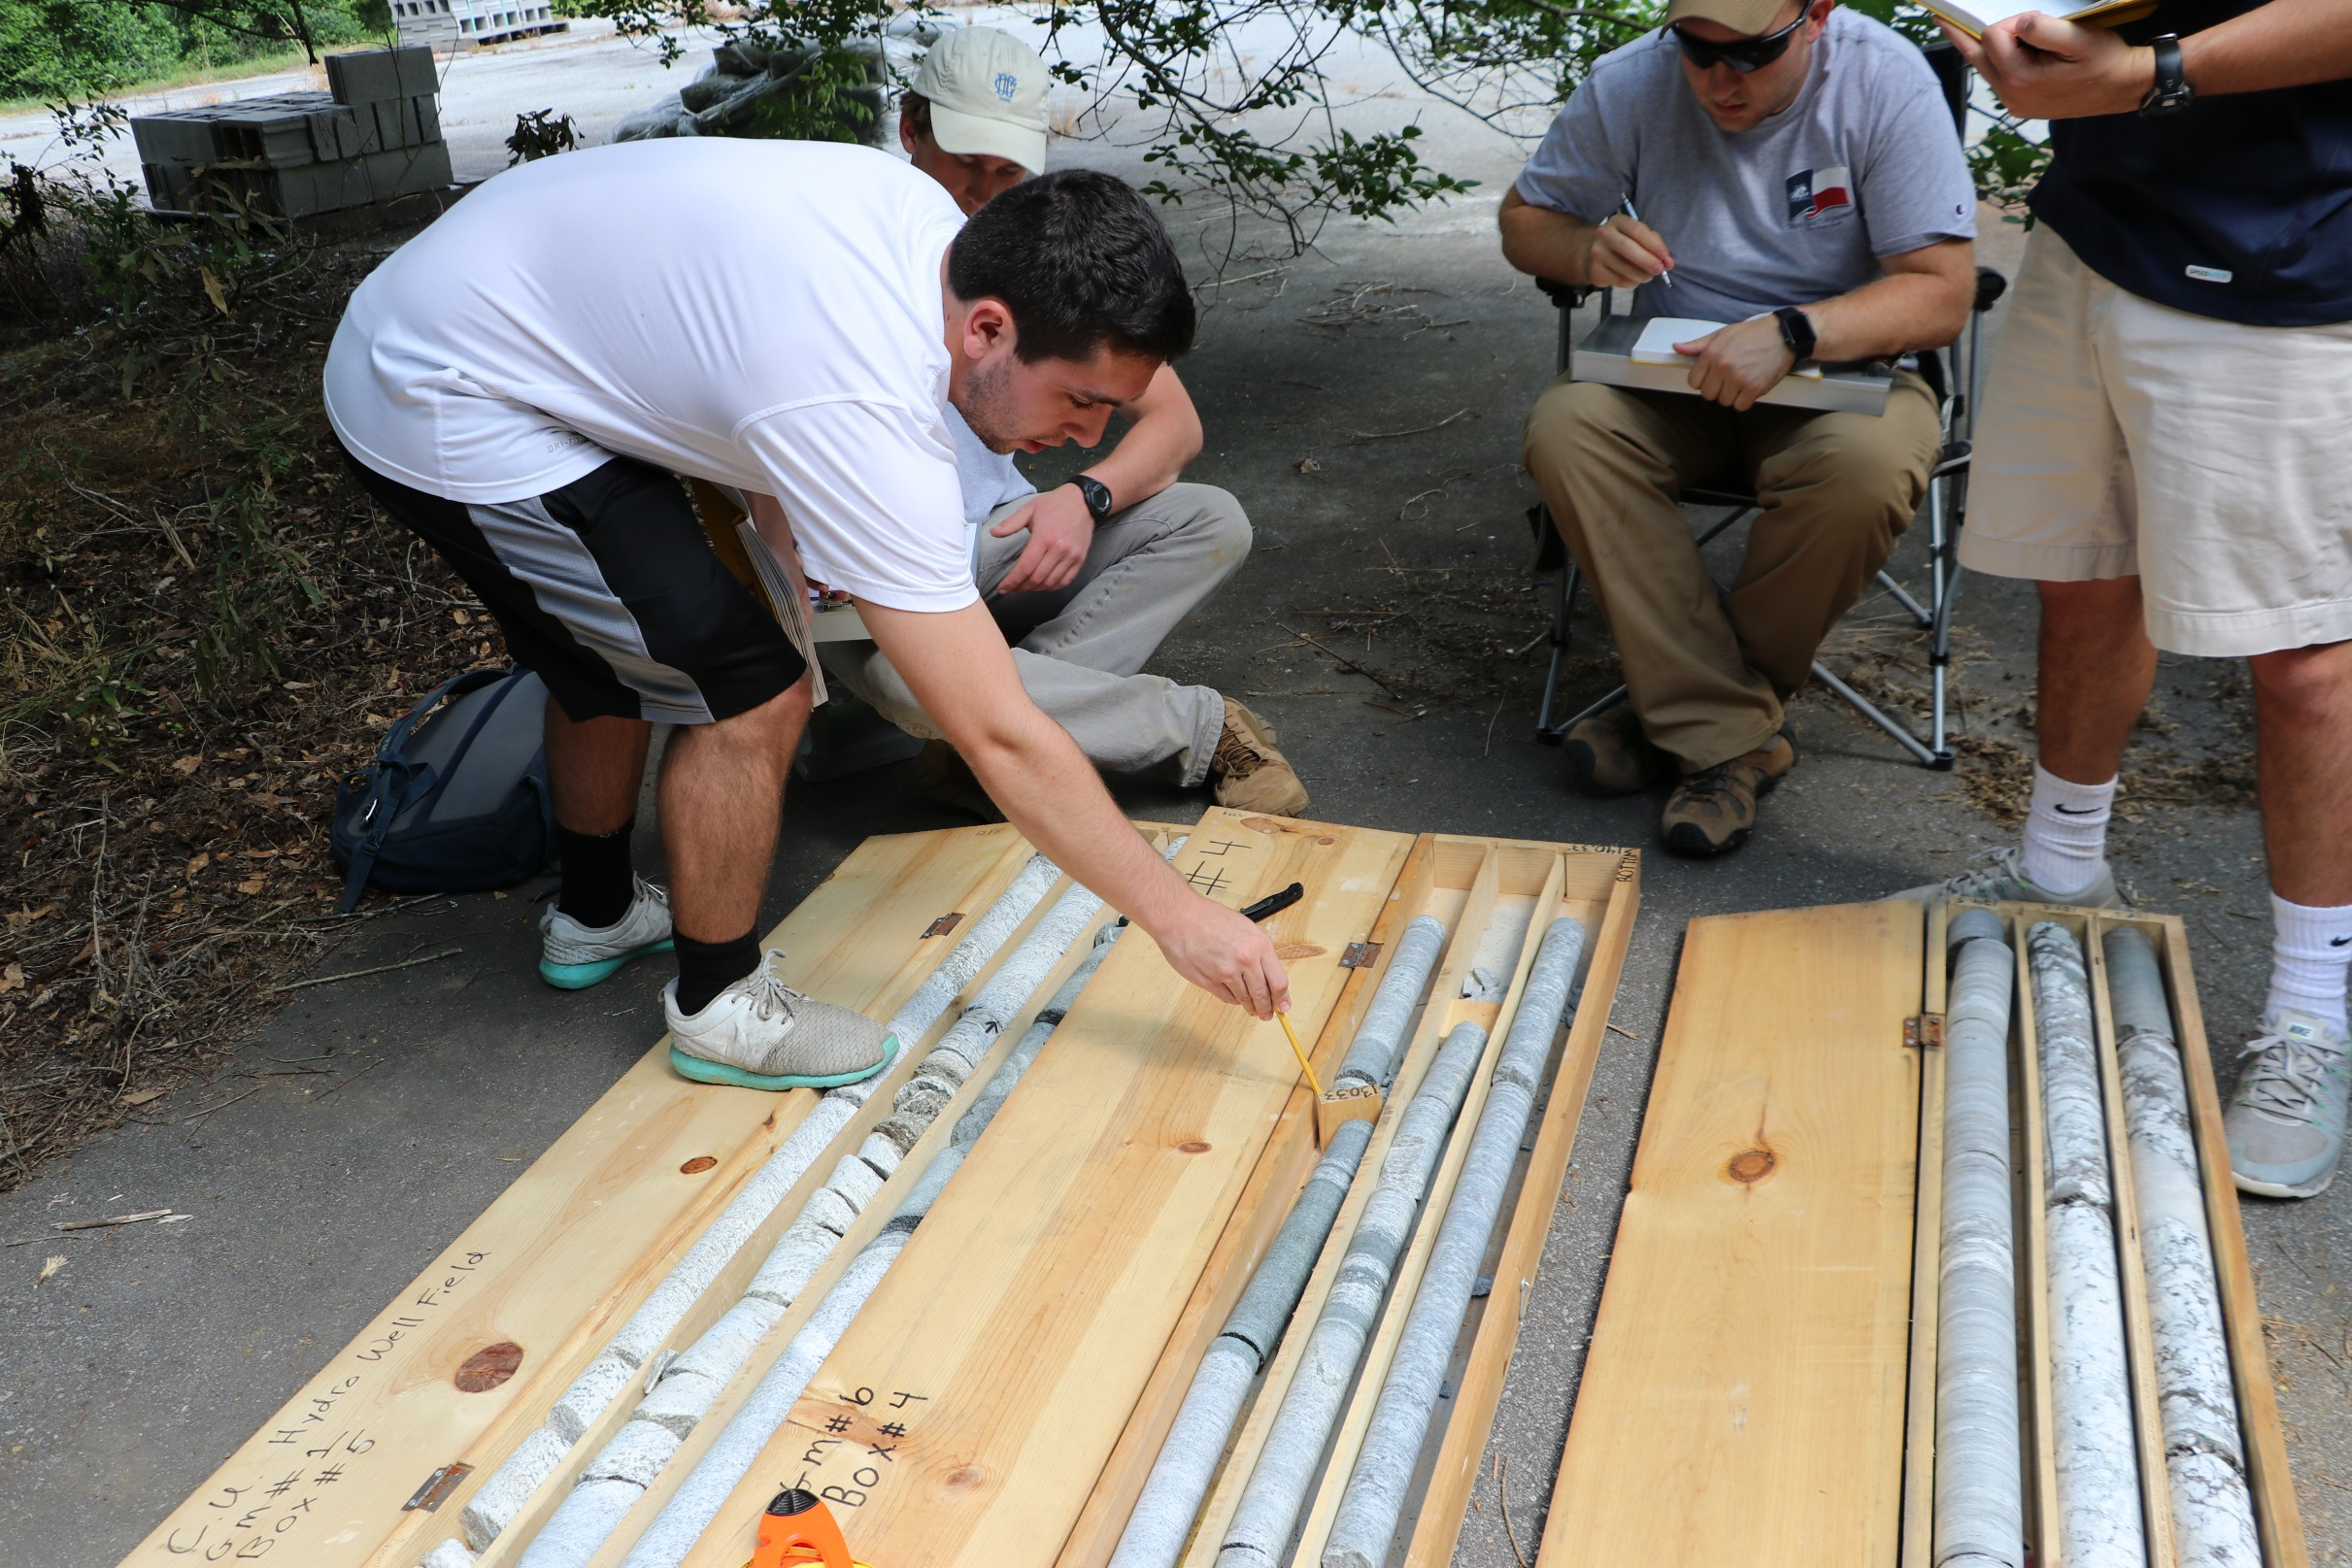
AN ON-LINE, HANDS-ON HYDROGEOLOGY FIELD CAMP
Scott Brame and Larry Murdoch Clemson University

Slide 2
The challenge
How do you offer an immersive hydrogeology field camp experience and create the optimal balance between:
delivering the background and content needed to build a firm theoretical foundation, and
(2) Providing a hands on experience where practical, marketable skills are developed?
AND, do this for up to 64 students at the same time!

Slide 3
Our Solution
Modularize the content into appropriate themes
Deliver the background and content using an online platform (we use Canvas)
Provide shortened lectures via youtube
Enable low stress, high quality field experiences

Slide 4
What we want to avoid

Slide 5
Divide and conquer
We have four content modules
The students are divided up into four groups.
Each group is broken into teams.
Each team has no more than four students.
in 2016, we had 64 students, thus we had sixteen teams ANd four teams/module

Slide 6
The modules
Wells
Drilling, Geoprobing, slug tests, pump tests, hand well installation
Aquifers
Core description, borehole camera, surveying, 3-pt problems
Streams
Stream gauging, manometers, water quality, seepage meters
Soils
Guelph permeameter, soil description , tensiometers, soil moisture

Slide 7
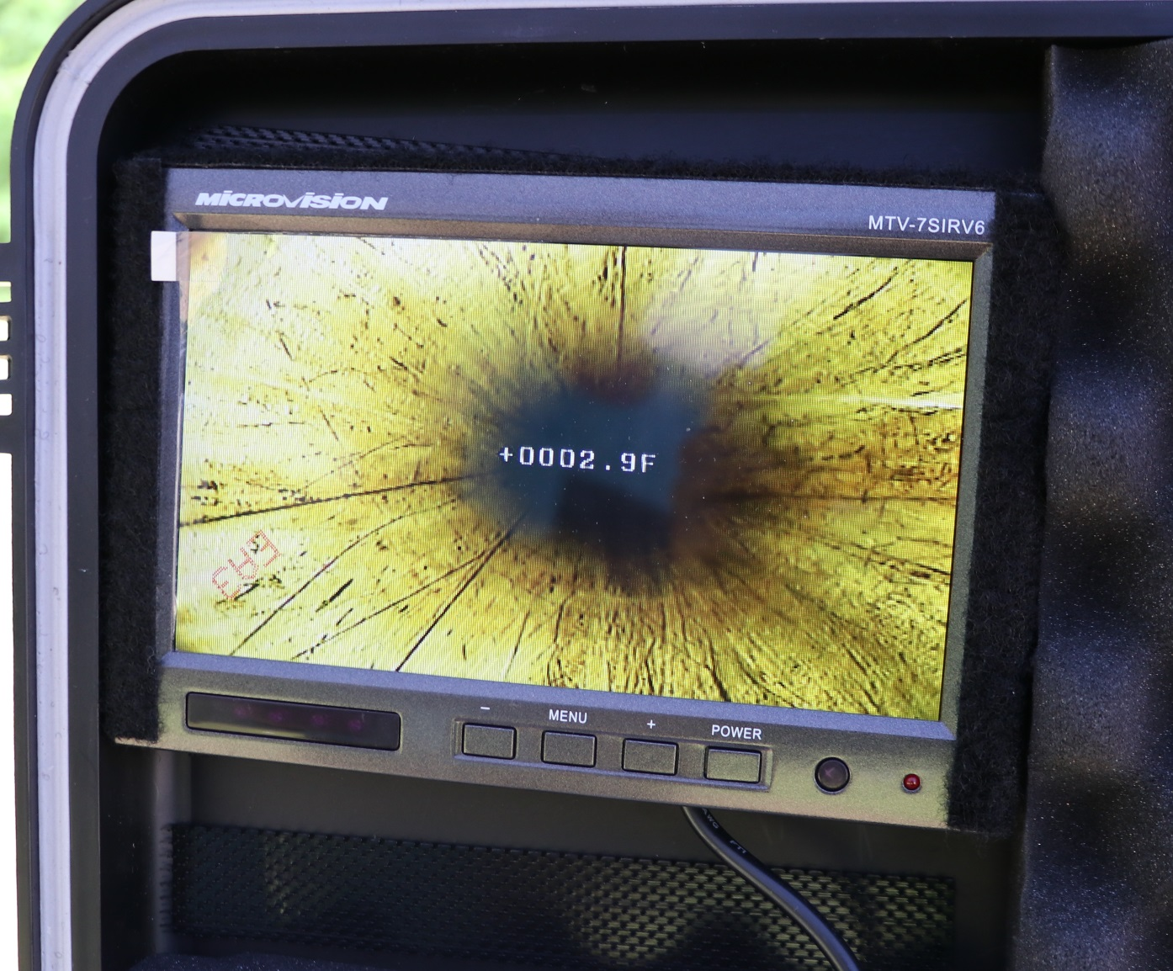
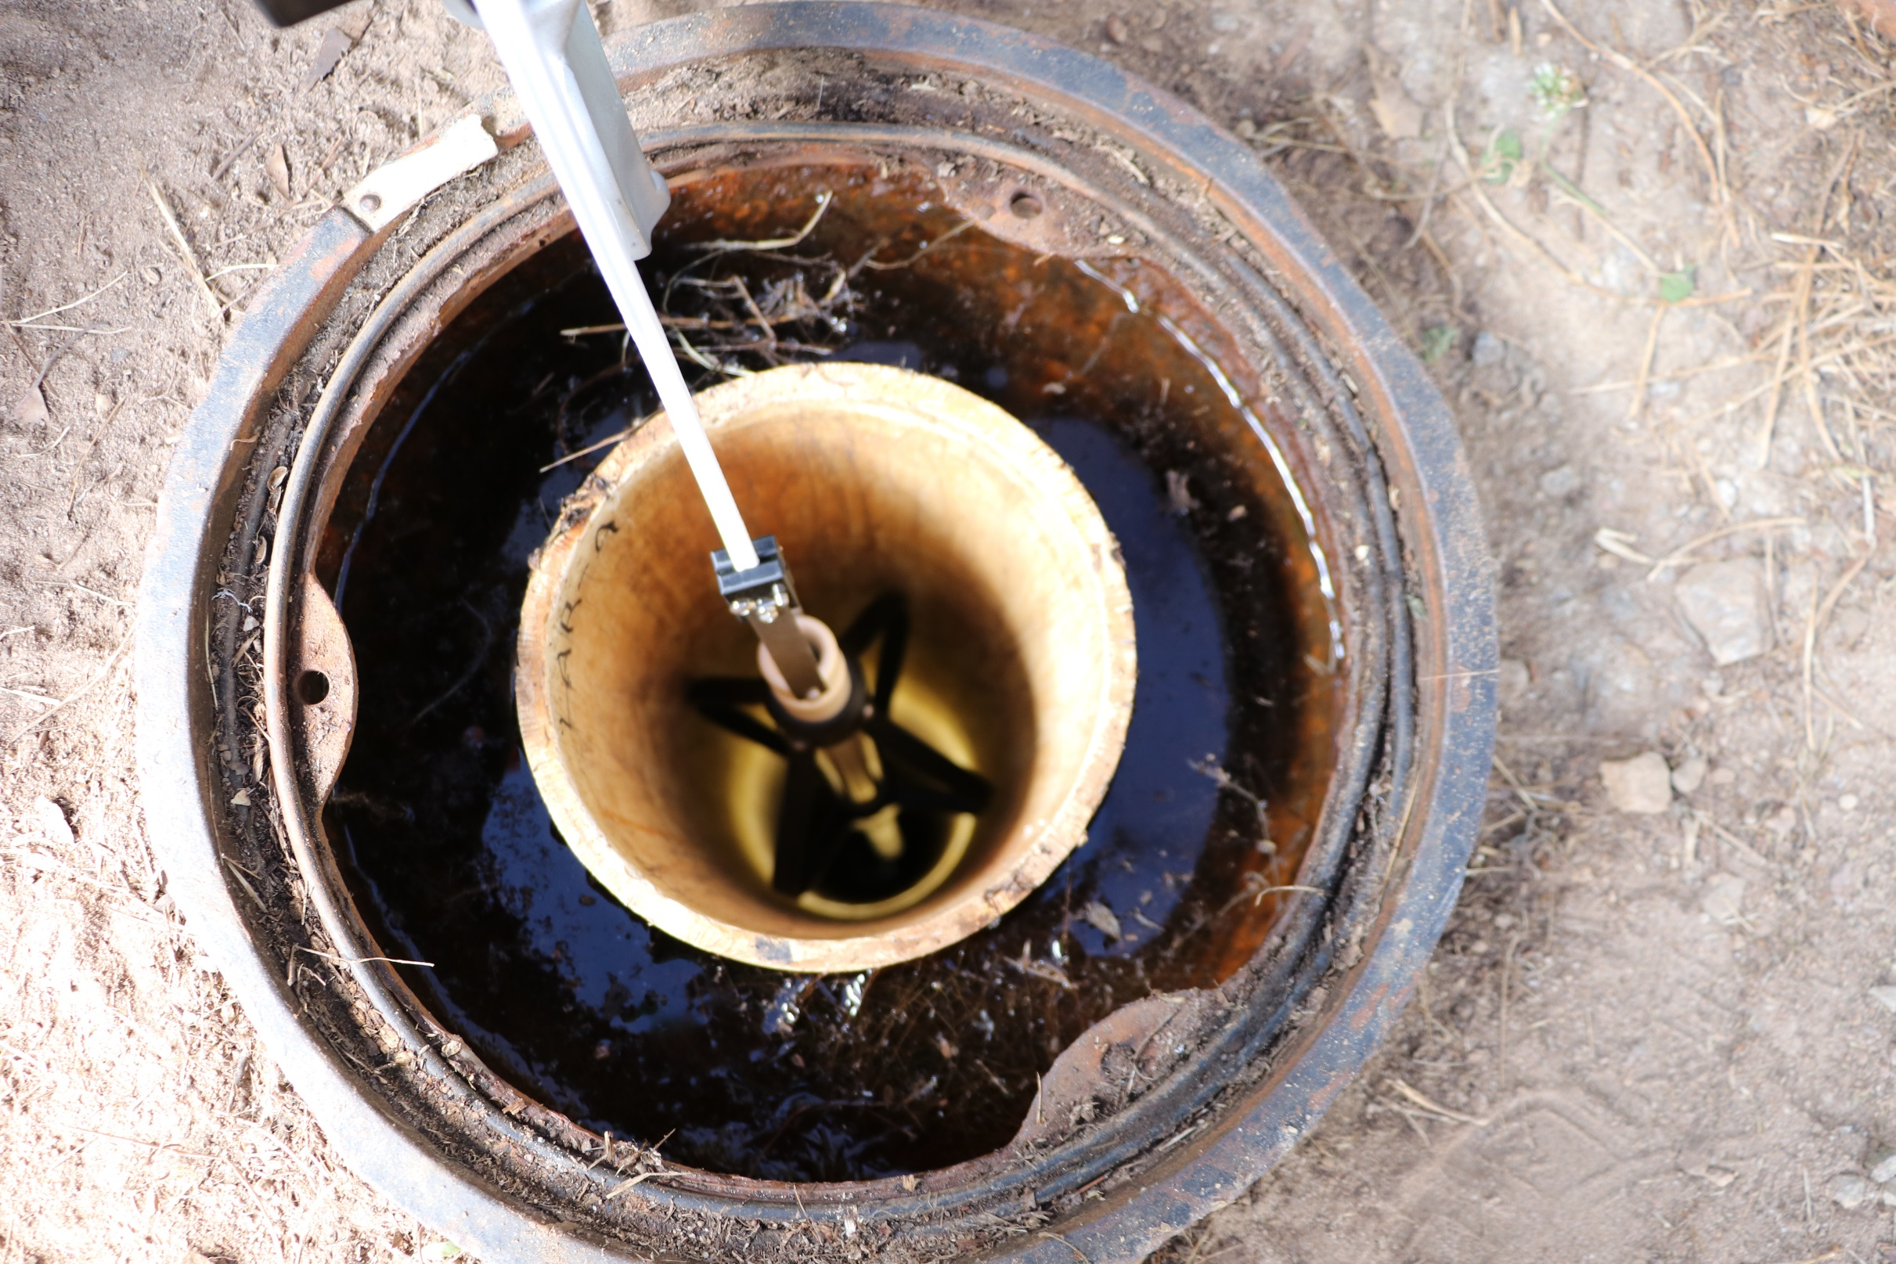
Borehole camera survey

Slide 8
Going modular
a module lasts a week and consists of (a) four activity days and
(b) one synthesis day = report preparation
The modules run concurrently and groups switch Rotate to a different module each week
Each module has a dedicated Teaching Assistant (TA) who has previously taken our field camp
This model requires planning and coordination

Slide 9
expectations
Before showing up in the field, Students are required to:
Review the written descriptions and background.
Watch the pre-recorded lecture(s)
Complete a quiz for which a passing grade is required.
In the field, the module TA briefs them on the activity and provides instruction as needed.
Reports for each activity are due on the last day of the module.

Slide 10
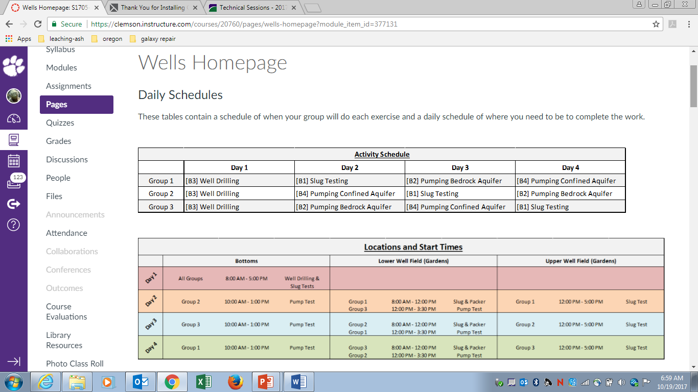
This is for the 2017 camp and there were only three teams in this group

Slide 12
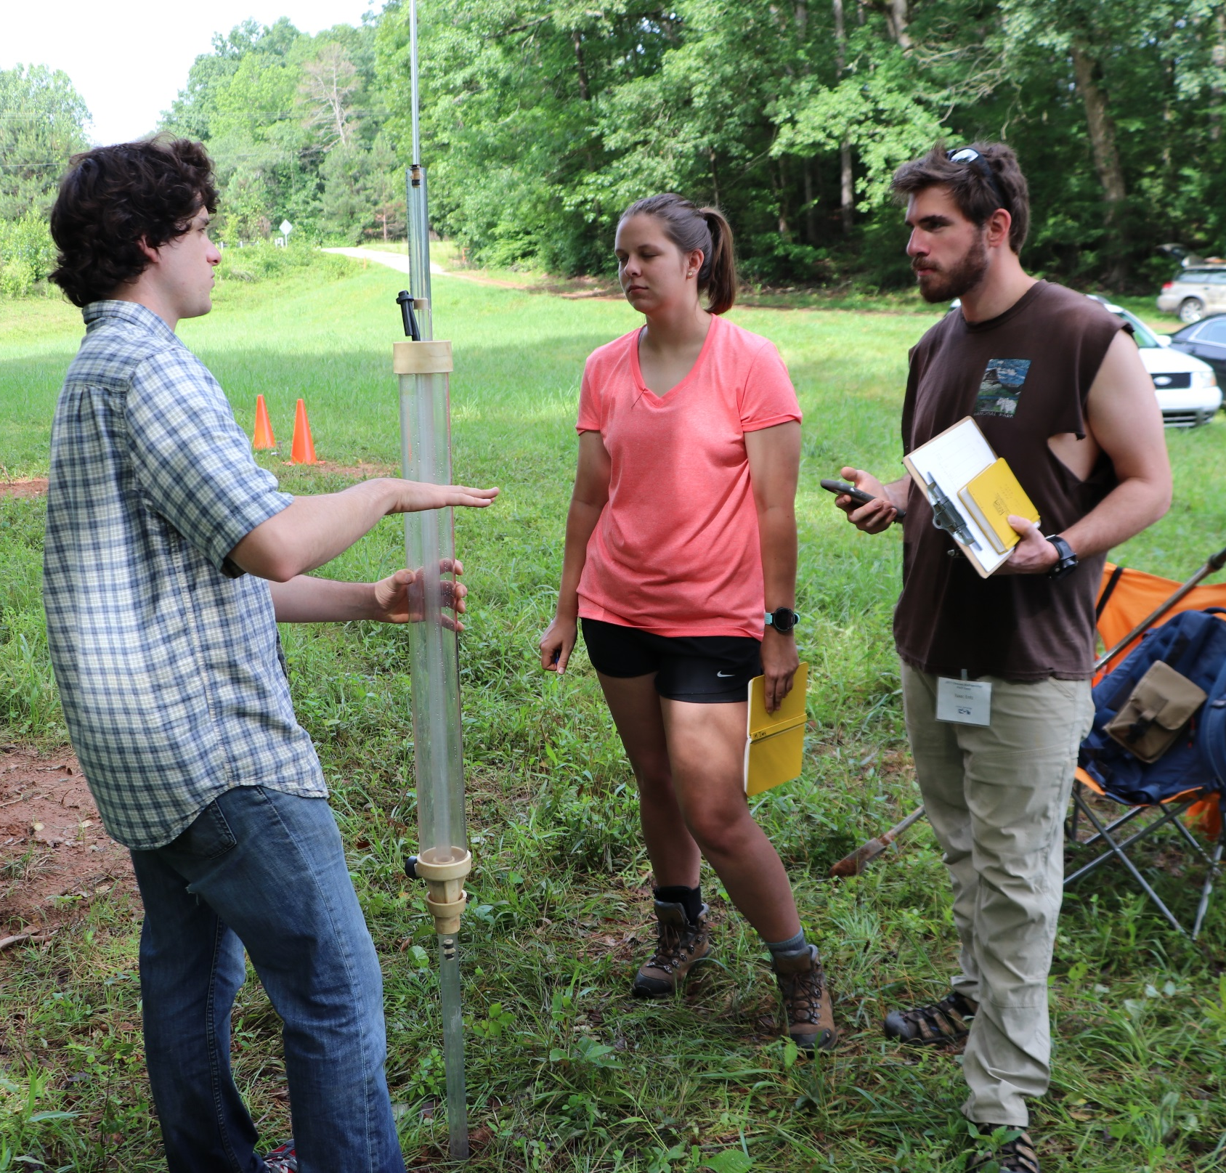
TA explaining the finer points of a Guelph permeameter

Slide 13
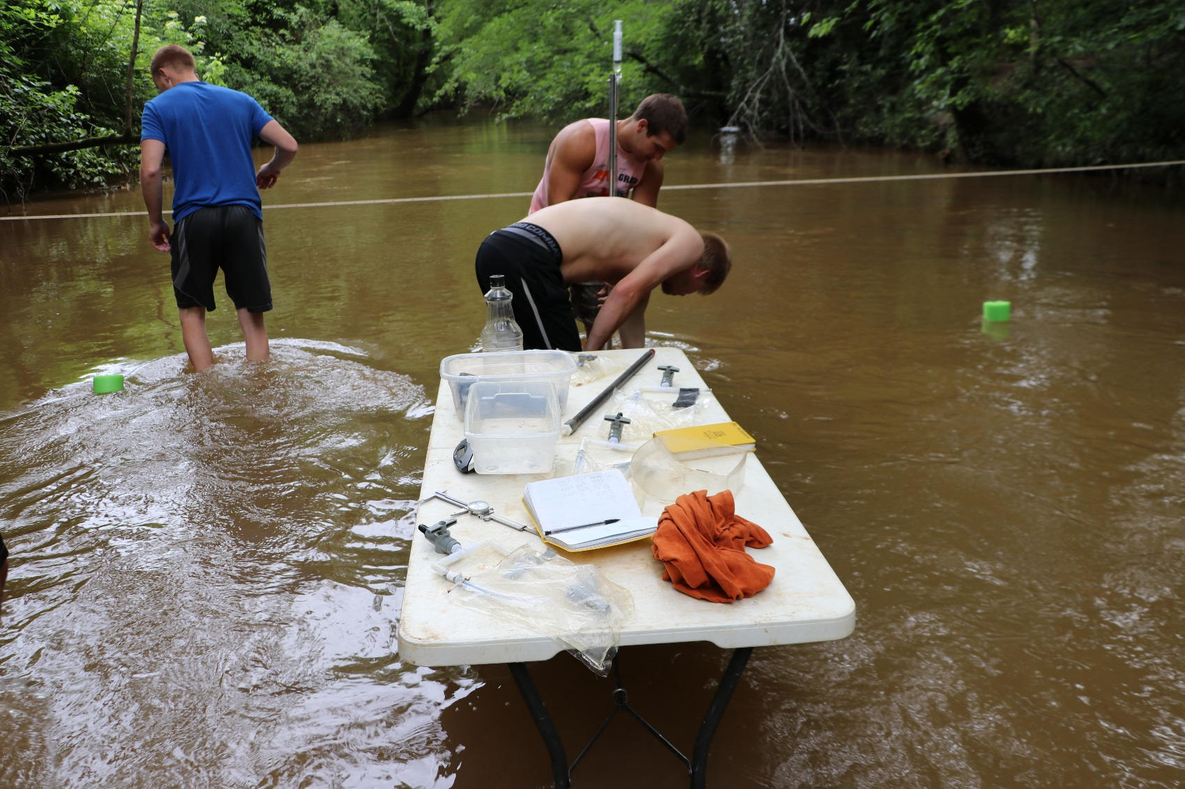
Deliverables
Each report has a standard format:
Goal
Methods
Results/data
Conclusions

Slide 14
DOES this work?
We have successfully implemented and tested this model (twice!)
In 2018, we will run our third field camp using this approach
Feedback from students has been overwhelmingly positive
The online aspect places a large burden on the students to prepare accordingly, but most appreciate the flexibility
This model allows considerable tweaking with regard to the level and type of content

Slide 15
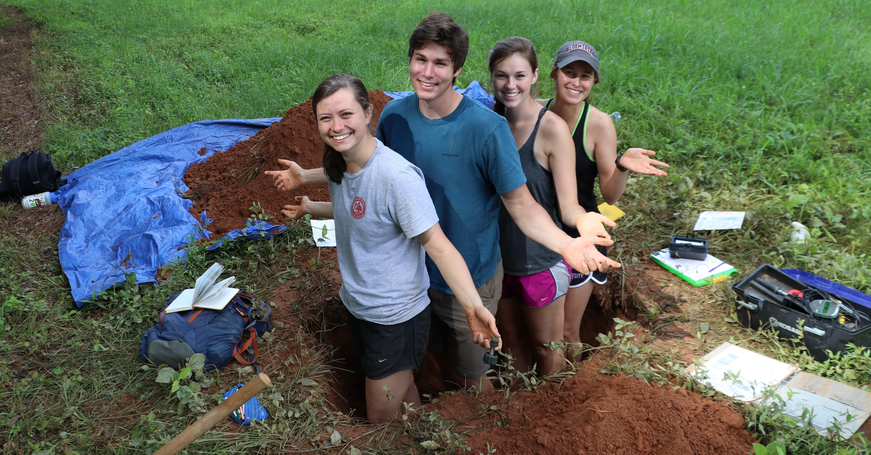
Questions?

