Slide 1


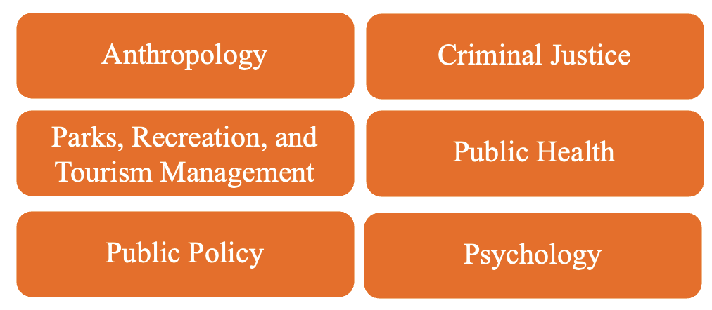

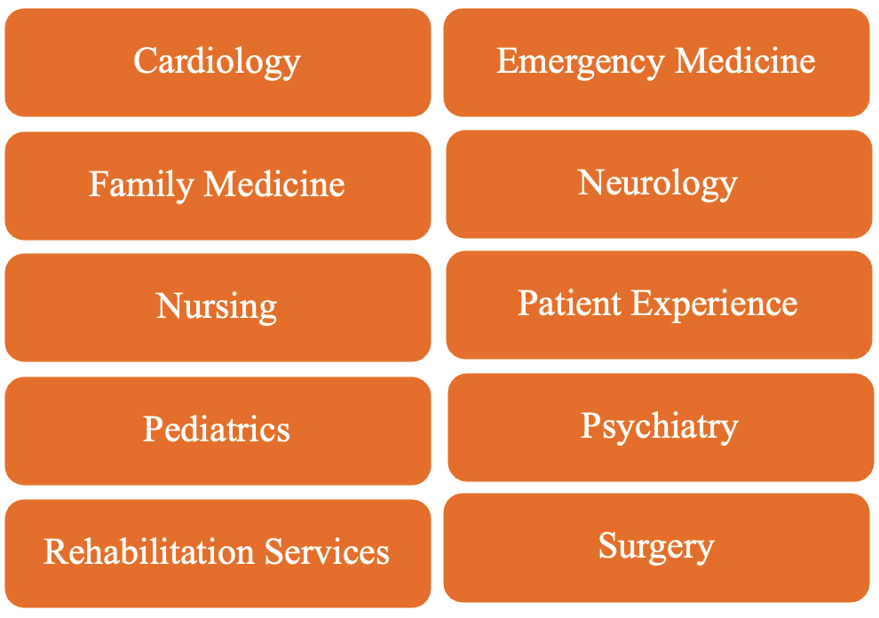
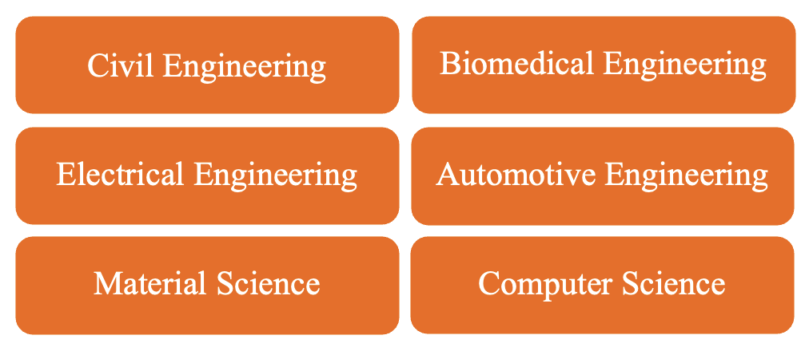
Mathematical and
Statistical Sciences
Physics
Education and
Organizational Leadership
Anthropology
Criminal Justice
College of Science
College of Education
Parks, Recreation, and
Tourism Management
Public Health
Public Policy
Psychology
Architecture
College of Behavioral, Social, and Health Sciences
Clemson
IE
College of Architecture, Art,
and Construction
Cardiology
Emergency Medicine
Family Medicine
Neurology
Civil Engineering
Biomedical Engineering
Nursing
Patient Experience
Electrical Engineering
Automotive Engineering
Pediatrics
Psychiatry
Material Science
Computer Science
Rehabilitation Services
Surgery
College of Engineering, Computing, and Applied Sciences
Prisma Health and Medical University of South Carolina
Notes:
Accessibility updates: department labels are editable text with larger type and high-contrast purple/white styling; institution labels were enlarged and centered. The relationship structure and content are unchanged.

