Slide 1
TOP 10
(-ish)
Things that can get you kicked out of the lab

Slide 2
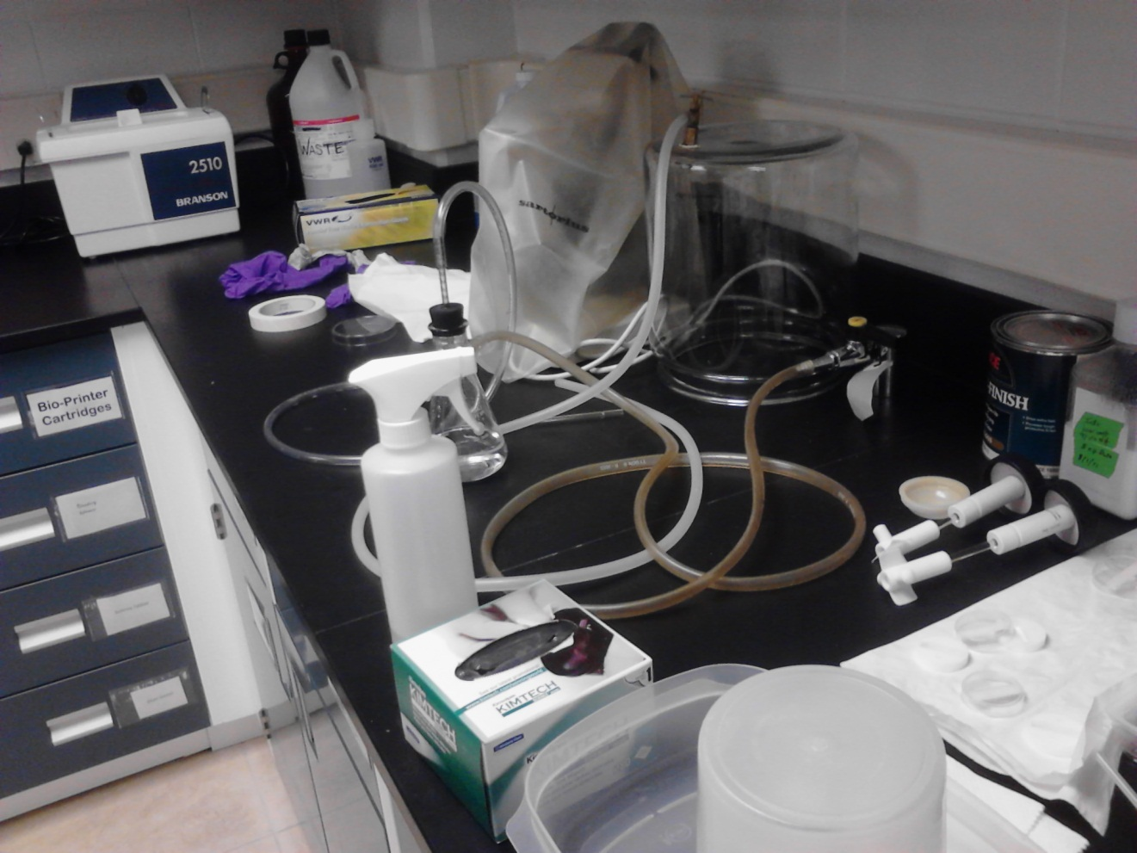
10:
Not Cleaning Up Your Messes

Slide 3
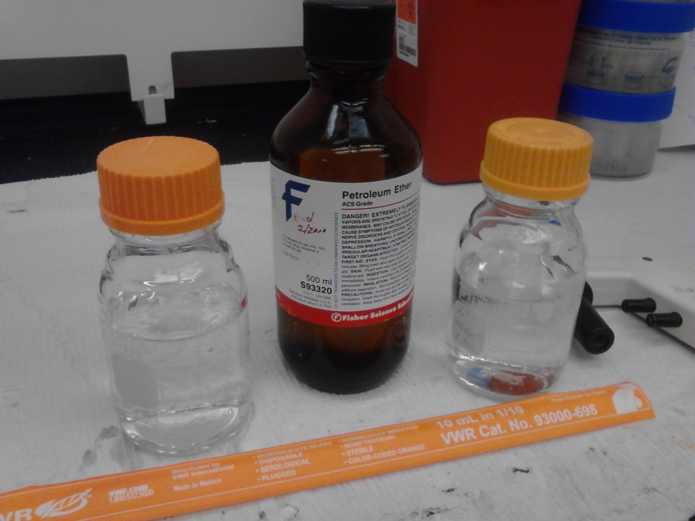
9:
Not Labeling your solutions

Slide 4
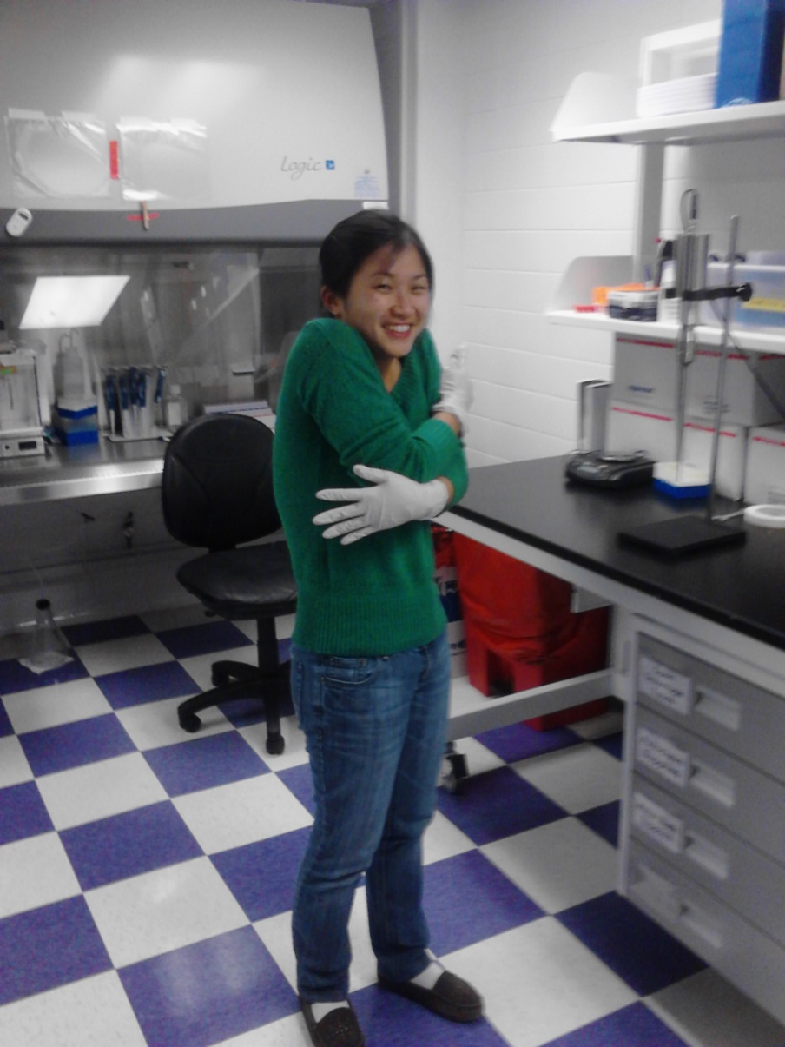
8:
Not wearing the correct PPE

Slide 5
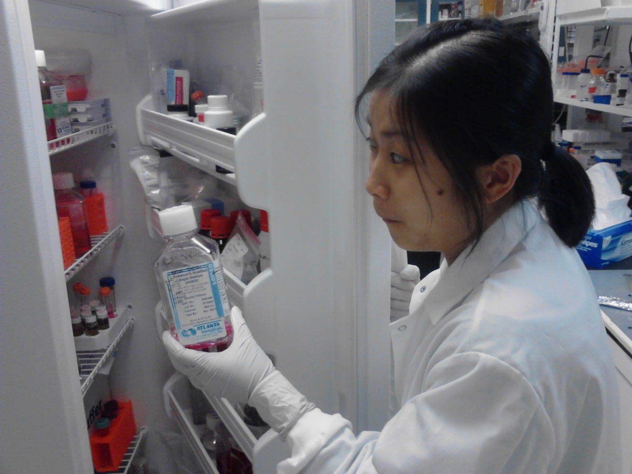
7:
Using up someone else’s stock solution without telling them

Slide 6
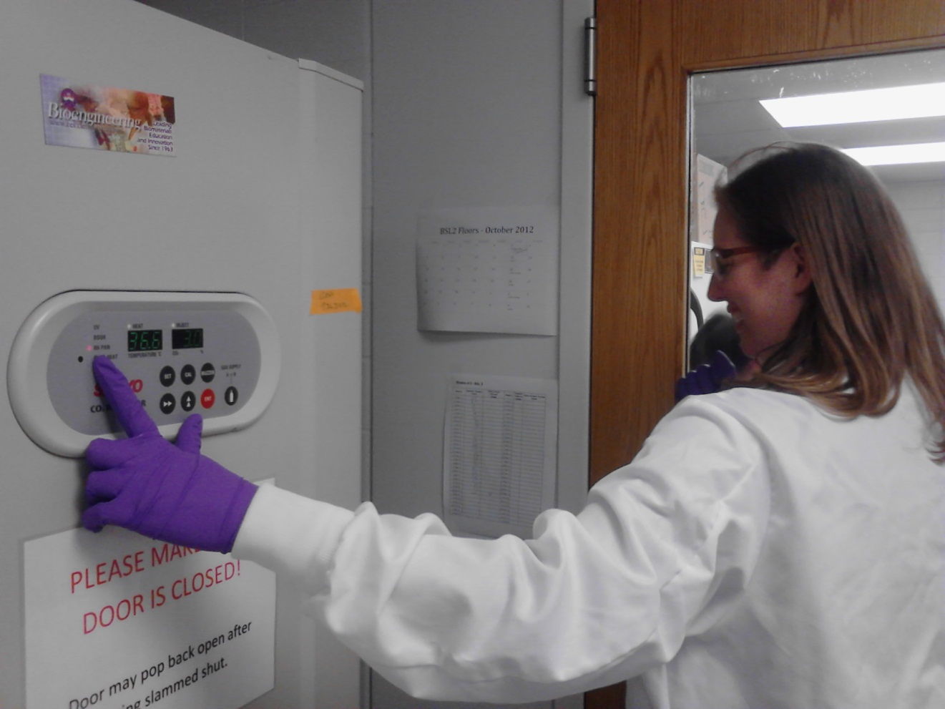
6:
Running away from incubator alarms

Slide 7
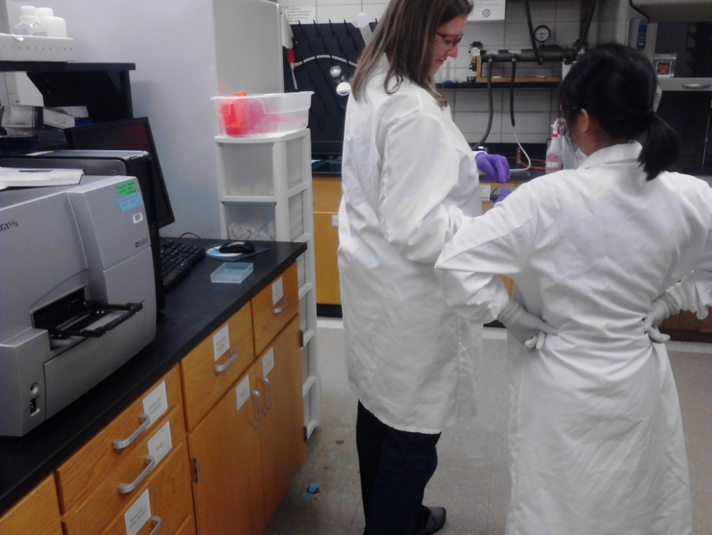
5:
Not Turning off the equipment after you’re done using it

Slide 8
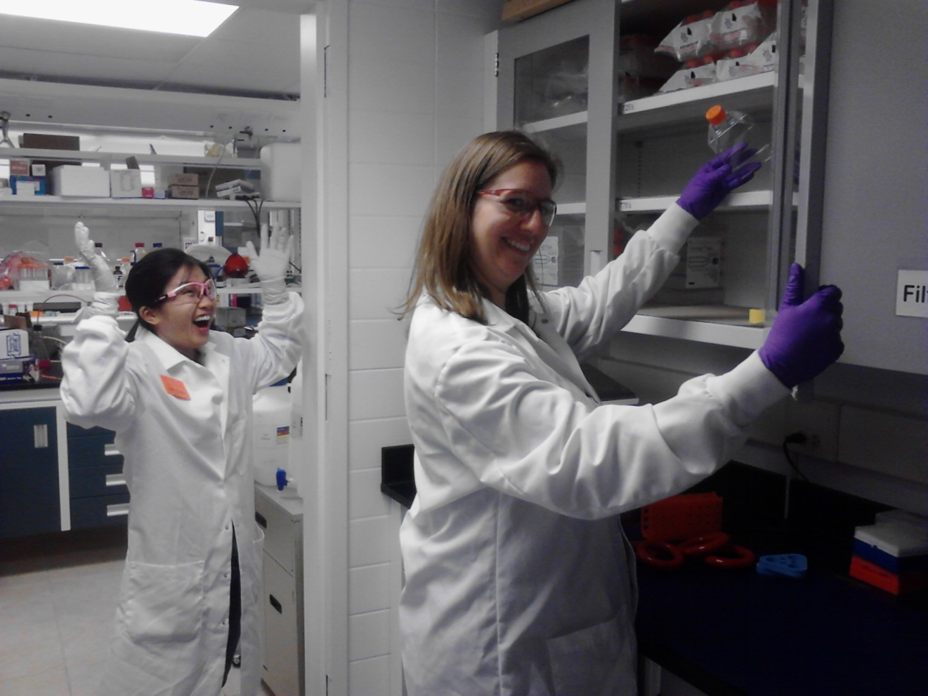
4:
Using the last of something without ordering more

Slide 9
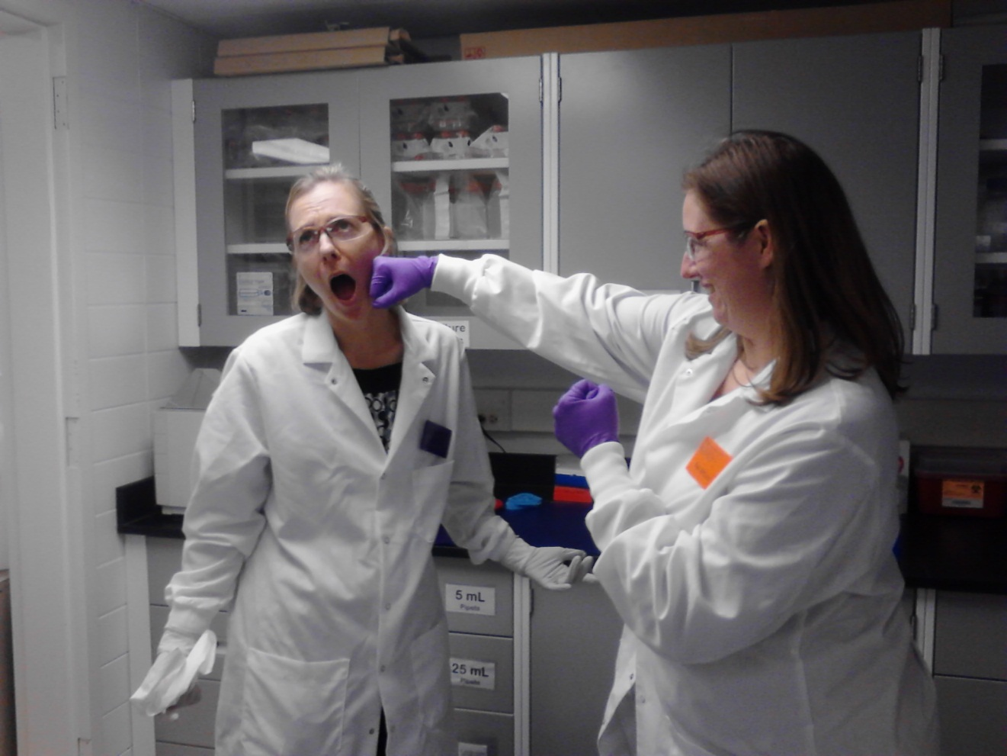
3:
Being mean to the lab staff, secretary, and/ or post docs

Slide 10
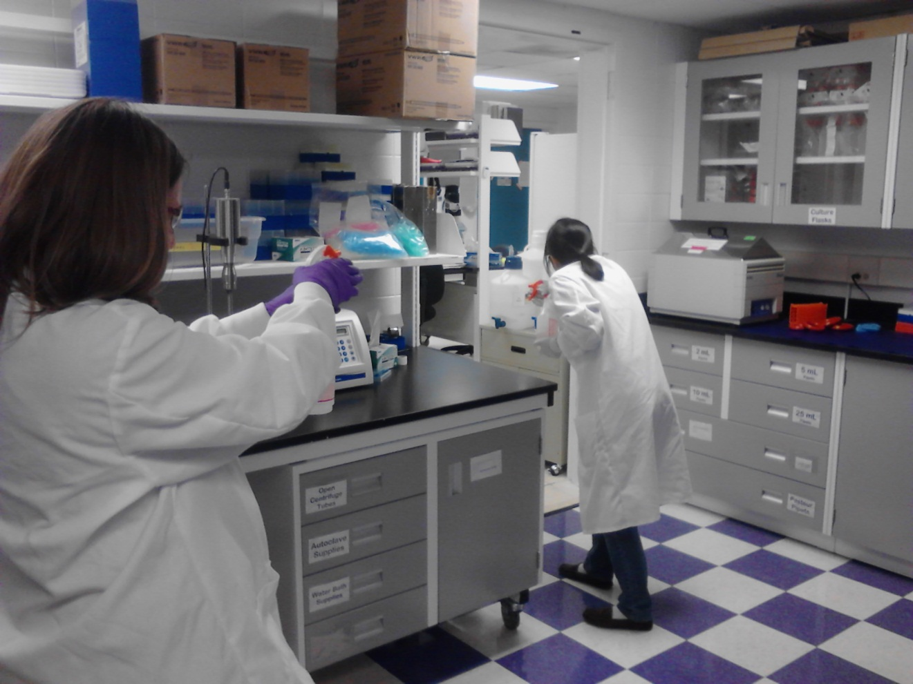
2:
Playing with the Lab Equipment

Slide 11
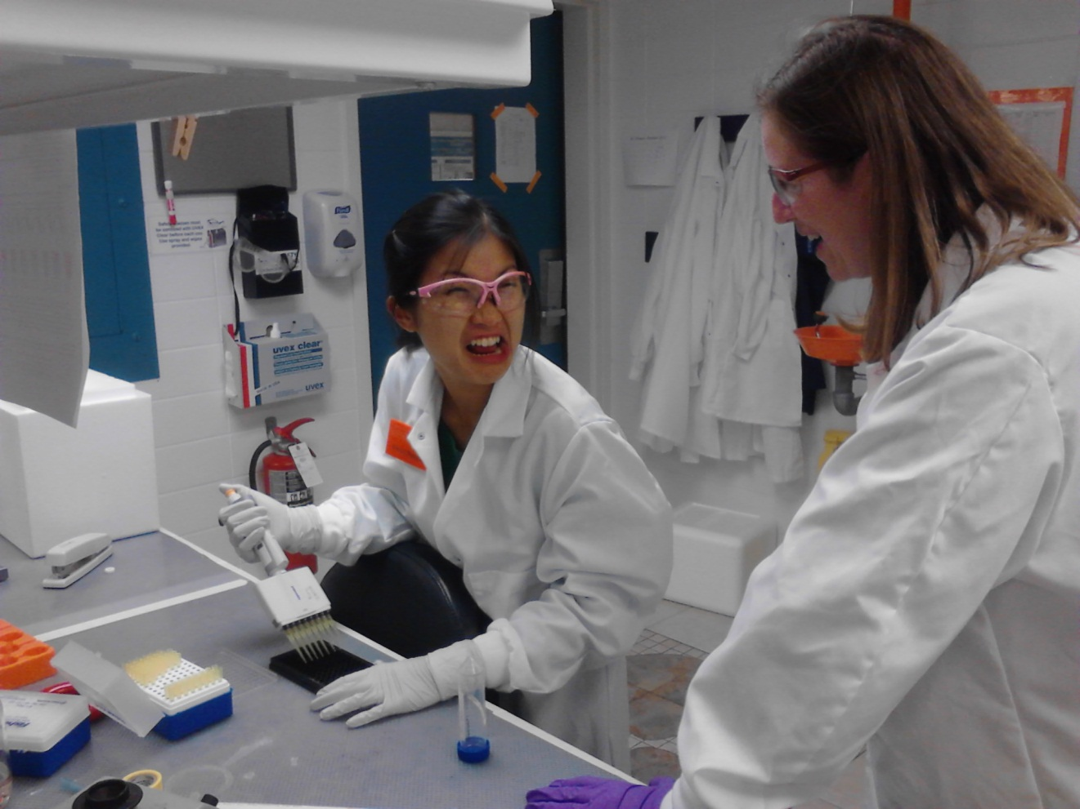
1:
Talking about religion, politics, or open access journals when someone is pipetting into a 96 well plate

Slide 12
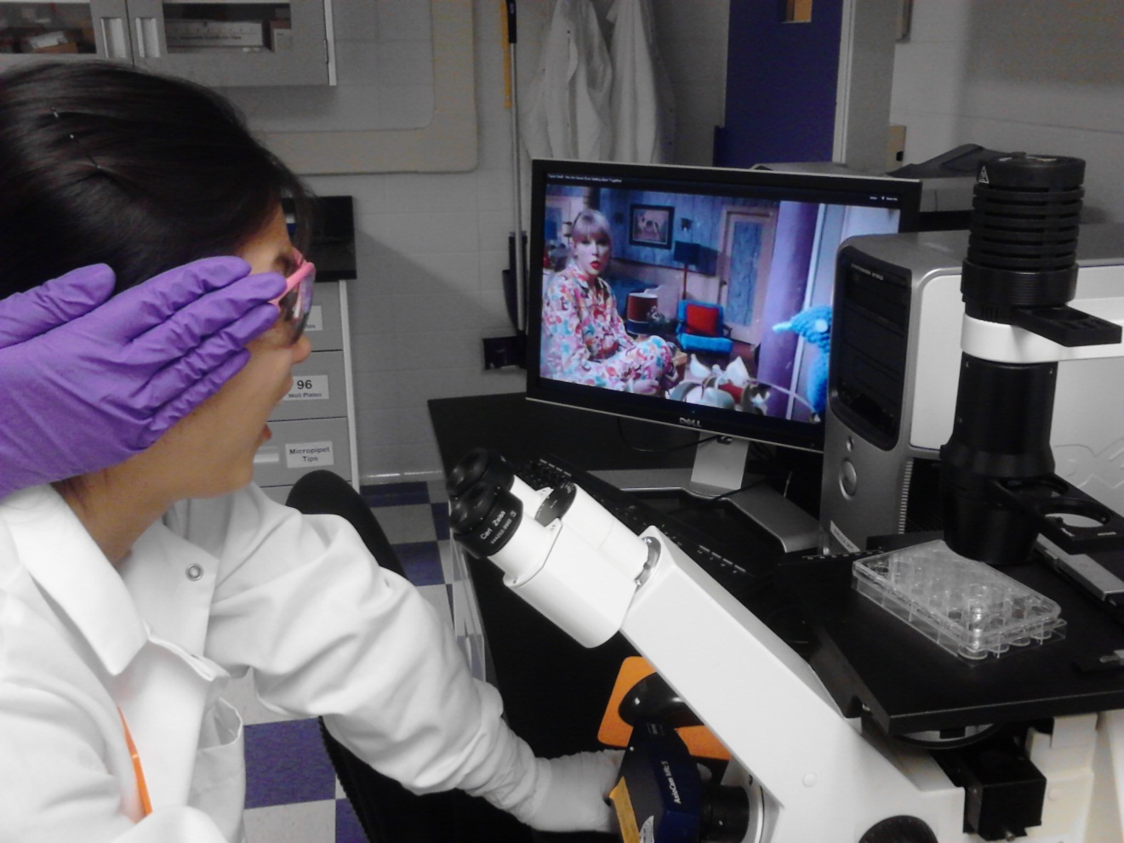
0:
Playing country music in the lab.
…the answer is always no
"you must ask before playing country music in the lab“

