Slide 1
Digital Measures
replaces FAS,
eTPR, eForm3
Townhall meetings
February 10 – 14, 2020
Amy Lawton-Rauh (APFA)
Melissa Welborn (Institutional Research)
Katie (Miller) Vogl (Provost’s Office)
Chelsea Waugaman (APFA/Provost’s Office)

Slide 2
Outline for Today: Background and Awareness
Purpose today: awareness and general information for roll-out
Decision and RFP to replace Clemson University’s home-grown systems: faculty activity system (FAS), eTPR, eForm3
implementation team
Transition timeline
Digital Measures has many additional features, but first focus is core essentials
Helpful terminology for navigating implementation
Status of field entry spaces and workflow point implementation(s) “where to explore, what you can access and enter now”
Implementation: next steps

Slide 3
Clemson Needs to Replace FAS
Steps leading to RFP (request for proposal) to replace FAS:
July 2017: user stories coordinated and compiled from 1-hour interviews (lead: APFA Ellen Granberg)
Interview participants
Executive assistant (1), CCIT rep (1), Provost’s admin (1), VPR admin (1)
Department chairs (9), faculty (4)
Represented 7 Colleges and ‘other’ university-level offices (CCIT, Provost, VPR)
Fall 2017-Spring 2018: formal interviews, additional feedback, and narratives prompted formation of RFP committee
Fall 2018: RFP committee charged with using transcripts from interviews and informal feedback to create RFP, with the goal of identifying the best replacement option by spring 2019
Spring 2019: Digital Measures selected through scoring system conducted by the RFP committee following state procurement guidelines and forwarded results to APFA Amy Lawton-Rauh March 2020
Summer 2019: Implementation team formed and transition strategy coordinated between Clemson University and Digital Measures, then implementation launched

Slide 4
Digital Measures selected by RFP committee
Mary Beth Kurz (RFP chair, Faculty Manual Consultant, Associate Chair Industrial Engineering, CECAS)
Sheila Lischwe (Office of Sponsored Programs)
Danny Weathers (Currently President of Faculty Senate; Associate Prof Marketing, Business)
Rob Baldwin (Chair of Grievance Board, Endowed Chair and Professor, Conservation Biology, CAFLS)
Melissa Welborn (Assistant Director of Institutional Research, ‘the one you contact’)
Calvin Williams (Associate Dean Undergraduate Excellence and Engagement, Prof Math Sci, Science)
Committee: formed fall 2018
wrote RFP, reviewed 3 viable proposals meeting basic criteria
selected Digital Measures spring 2019

Slide 5
Clemson Implementation Team
Executive Sponsor
Amy Lawton-Rauh (Associate Provost for Faculty Affairs)
APFA@Clemson.edu (amylr@Clemson.edu for other queries)
System Administrator
Melissa Welborn (Assistant Director of Institutional Research)
DMadmin@Clemson.edu
Project Liaisons
Katie (Miller) Vogl (Director of Academic Initiatives, Provost’s Office)
Chelsea Waugaman (Faculty Affairs Project Director, APFA/Provost’s Office)
Technical: Kim Thrower
University data: Jeremy King, Ben Wiles
Research data: Cris Boggs
CCIT: Nancy Griffis, HR: Greg Carlton
TPR and policies queries
Data and portal use queries
Lead trainer

Slide 6
Expert Users: Dean Appointees
Admin Faculty ‘Lead’: Appointed by Dean
CAAH: Associate Dean James Burns Business: Associate Dean Carl Hollingsworth
*CECAS: Department Chair David Bruce Libraries: Suzanne Schilf
CAFLS: Associate Dean Jean Bertrand CBSHS: Associate Dean Denise Anderson
Science: Steve Creager *CoEducation: Associate Dean Jeff Marshall
Department Chairs
TPR Chairs
Dean Admin Staff who facilitate TPR workflow and data entry
Faculty with experience
*Beta Testers: Expert Users from CoEducation and CECAS

Slide 7
Prior Digital Measures Users
If you used Digital Measures in recent years at a different university:
Send DMadmin@Clemson.edu:
name of your prior institution
your name and username at your prior institution
Digital Measures will move your transferrable data
If you’d like to volunteer as an Expert User for your department, please note this in your email

Slide 8
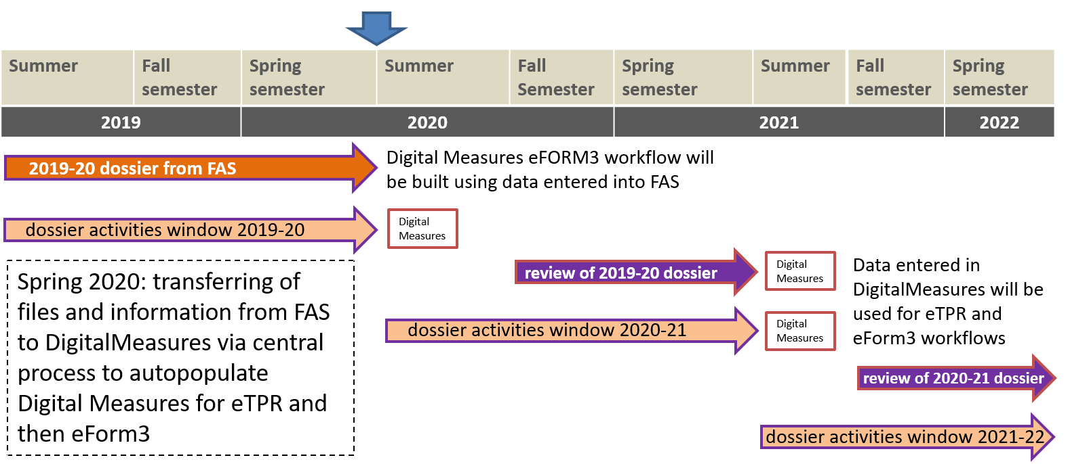
Transition to Digital Measures: Timeline
TPR: tenure, promotion, reappointment
Department Chair
TPR committee
@ promotion & tenure: 6 external evaluators + Provost, President
Form3: annual evaluation (separate from TPR)
Note: annual merit review is a separate evaluation and workflow

Slide 9
Digital Measures Applications:
Communications and Use of Other Features will roll out after eTPR, eFORM3 workflows
FAS = data
fields entered, CV uploaded
eFORM3, TPR = workflow
documents uploaded, access to documents and data, decisions entered

Slide 10
Helpful Terms to Facilitate Knowledge
We don’t use Academic Analytics benchmarking for TPR (see ‘Analytics at Clemson’ handout)
is the only system used for faculty evaluation data for individual faculty to curate
your awards and patents information can be pre- populated by pulling it from public databases but are ultimately curated and released by individual faculty
Benchmarking is restricted to opportunities available across all institutions benchmarked nationally, thus has many limitations (time window, nationally-available opportunities).
For Departments and Deans, comparisons are provided as aggregate (not individual faculty) level and can be useful for discovering potential opportunities to recognize our faculty and for seeking support from national calls for proposals and awards. This is different than ‘live-refresh’ or real-time draws from public repositories.

Slide 11
Digital Measures: Transition
10 – 14. February
Town halls by College (by College, 8 Town halls; live-streamed and recorded)
Q & A Training Sessions: online and in-person laptop lab, training of Expert Users
Training Sessions: online and in-person laptop lab for Expert Users to guide faculty
Face-to-face Drop-ins: in-person laptop lab open office hours
Under Development: ‘Faculty Academy’
Provost’s University Task Force on Faculty Mentoring, NSF Tigers ADVANCE
Annual, Spring 2021+
for all faculty (special, regular and admin)
Use of additional Digital Measures features
Annual goal-setting workshop and sessions
Other university-level professional development toolkit discussions
March
March/April/May
Spring 2021+

Slide 12
Training and Deeper Dives
Steps: 1) data entry 2) workflow
Knowledge Center:
Website up now, and will be updated regularly
FAQs
Login link in Overview tab: clemson.edu/provost/digital-measures
Online training 1: Data entry
Faculty training spring 2020 (March+)
Online training 2: Data entry and Workflow
Additional high-level Expert User training
Late spring 2020, summer 2020*, fall 2020
*admin faculty, staff, other Expert Users if available

Slide 13
Digital Measures Website
clemson.edu/provost/digital-measures
Login Link Here

Slide 14
Training and deeper dives
Sections to Explore/Modify - GENERAL
Timestamp: 17.Feb.2020
Personal and Contact Info
Biography and Expertise
Graduate/Post-Graduate Training
Licensure and Certifications
Awards and Honors
Media Appearances and Interviews

Slide 15
Training and deeper dives
Sections to Explore/Modify - CAREER
Timestamp: 17.Feb.2020
Professional Positions
Consulting
Professional Memberships

Slide 16
Training and deeper dives
Sections to Explore/Modify - TEACHING
Timestamp: 17.Feb.2020
Teaching Innovation/Curriculum Development
Mentoring
Non-Credit Instruction

Slide 17
Training and deeper dives
Sections to Explore/Modify - SCHOLARSHIP
Timestamp: 17.Feb.2020
Publications
Presentations
Exhibits/Performances
Intellectual Property
Research (Not associated with a formal award/grant)

Slide 18
Sections to Review for Accuracy
Timestamp: 17.Feb.2020
Degrees You’ve Received
Directed Student Learning
Grad Committees loaded from Aug. 2019 and Dec. 2019 Graduates, also enrolled students spring 2020
Scheduled Teaching (summer 2019, fall 2019, spring 2020)
Yearly Data –
Contact APFA@clemson.edu if you have a joint/dual appointment that involves an evaluation arrangement or if something is incorrect, especially if you are up for tenure and/or promotion

Slide 19
Sections to Ignore (for now)
Timestamp: 17.Feb.2020
Administrative Assignments
Yearly Advising Summary
Contracts and Grants
University Service
Professional Service
Public Service
Workload Information (Goals)
Permanent Data
Faculty Development
We will get to these during training phase
Feel free to explore, but we are trying to pre-populate these fields for you to self-curate from InfoEd, Banner, PeopleSoft, etc.

Slide 20
What can I do right now?
DO NOT add 2019-2020 activities or info in FAS after Feb. 15 2020-2021 NOTHING in FAS
Login and explore Digital Measures to get a ‘feel’ for the environment
How to locate and log in
clemson.edu/provost/digital-measures
‘log in to your account’ is located towards middle of page)
Send questions (provide screenshots and/or screen names when possible)
Systems administrator (data entry, technical): Melissa Welborn (DMadmin@Clemson.edu)
Policies, TPR, evaluation: Amy Lawton-Rauh and Chelsea Waugaman (APFA@Clemson.edu)
Your faculty admin lead will work with your College Expert Users to provide updates
Use publications guide to explore self-upload of published work with your colleagues (some databases/portals work better than others across disciplines and modes of scholarship)

Slide 21
Clemson Implementation Team
Executive sponsor
Amy Lawton-Rauh (Associate Provost for Faculty Affairs)
APFA@Clemson.edu (amylr@Clemson.edu for other queries)
System administrator
Melissa Welborn (Assistant Director of Institutional Research)
DMadmin@Clemson.edu
Project liaisons
Katie (Miller) Vogl (Director of Academic Initiatives, Provost’s Office)
Chelsea Waugaman (Faculty Affairs Project Director, APFA/Provost’s Office)
TPR and Policy queries: APFA@Clemson.edu
Data and portal use, training queries: DMadmin@Clemson.edu

